Slide 2
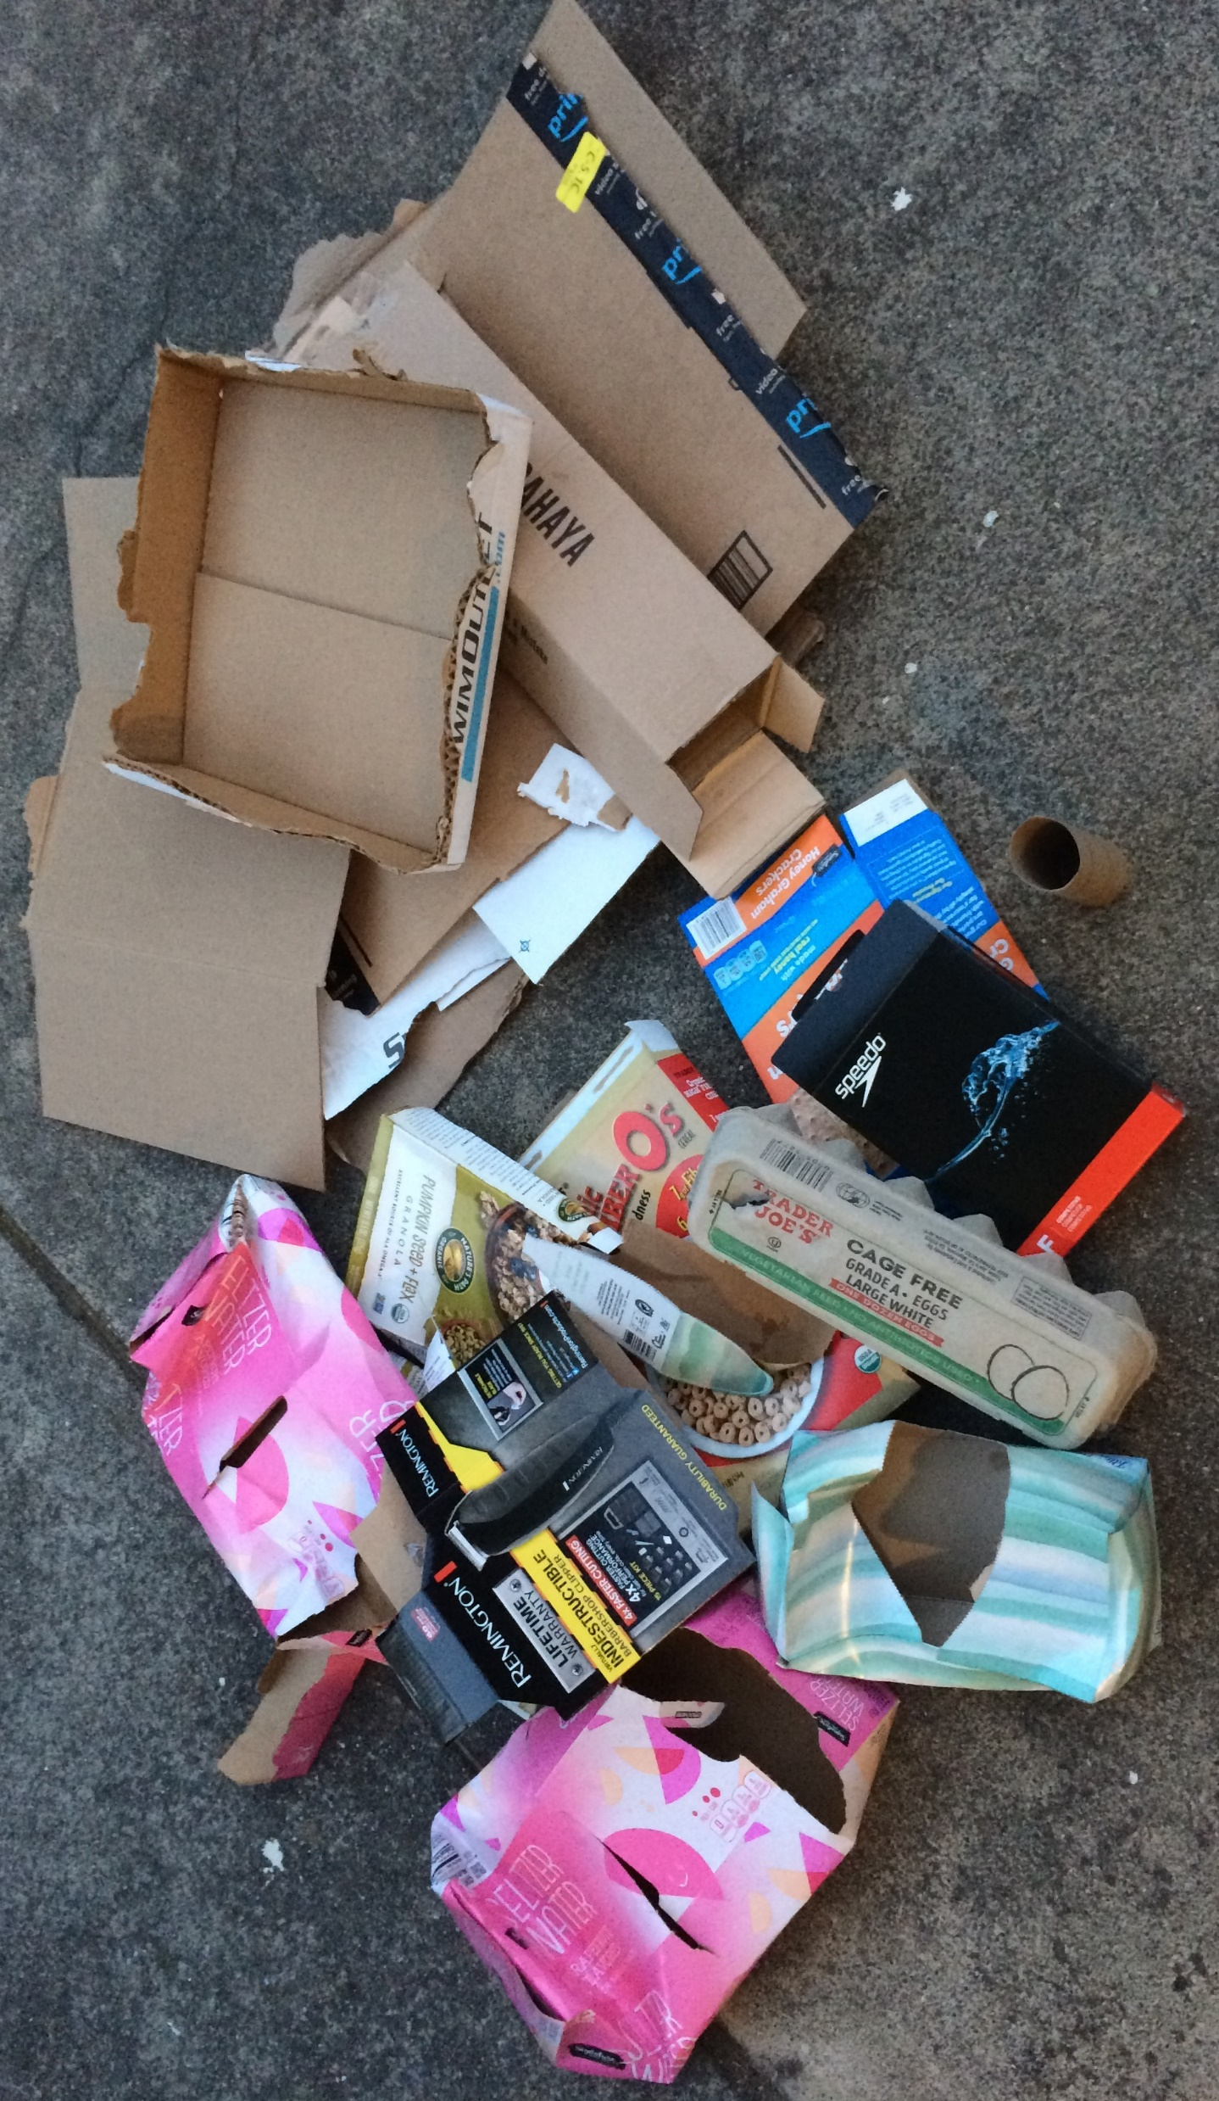
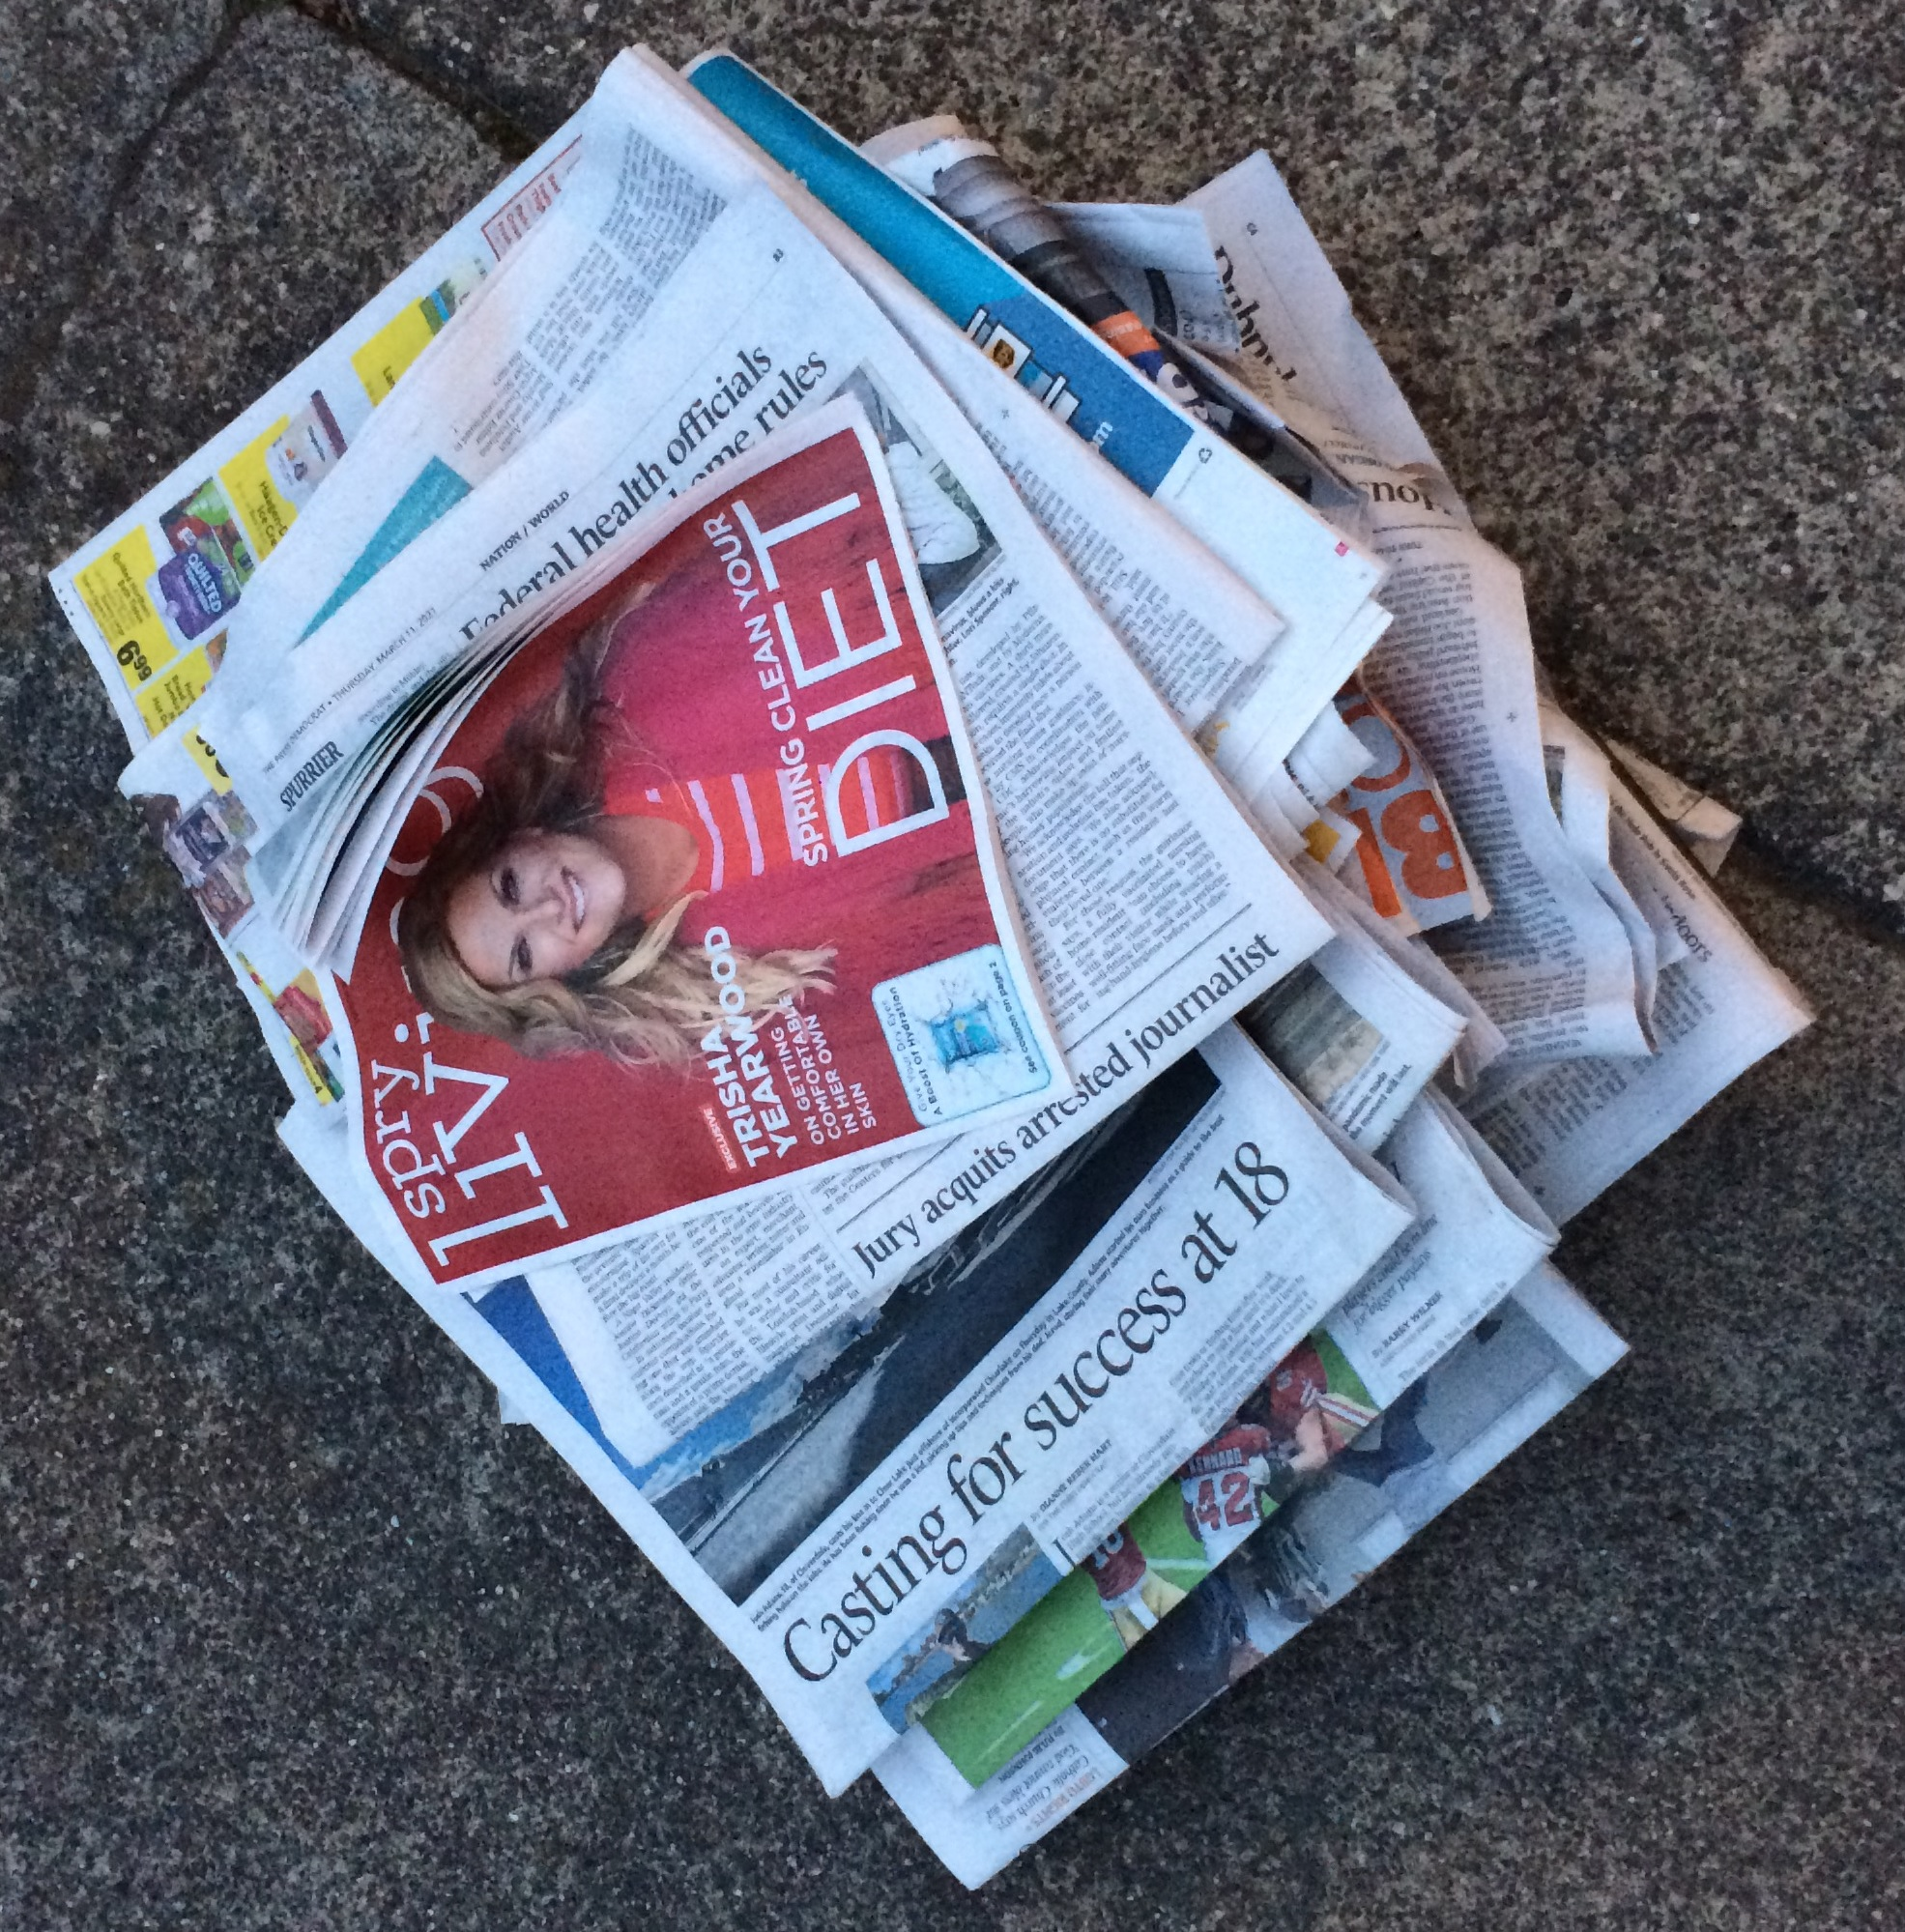
Newspaper: 2.27 lb, 5%; 4.) Switch to e-edition only and read on computer, phone or tablet.
Cardboard: 3.50 lb, 8%;
Shipping boxes, cereal boxes, seltzer water boxes, egg carton, tissue box, razor box, swimwear boxes, toilet paper roll.
1.) Minimize ordering stuff that is shipped.
2.) Switch to tap water only.
3.) Get bulk cereal in bins and bring home in Tupperware.

Slide 3
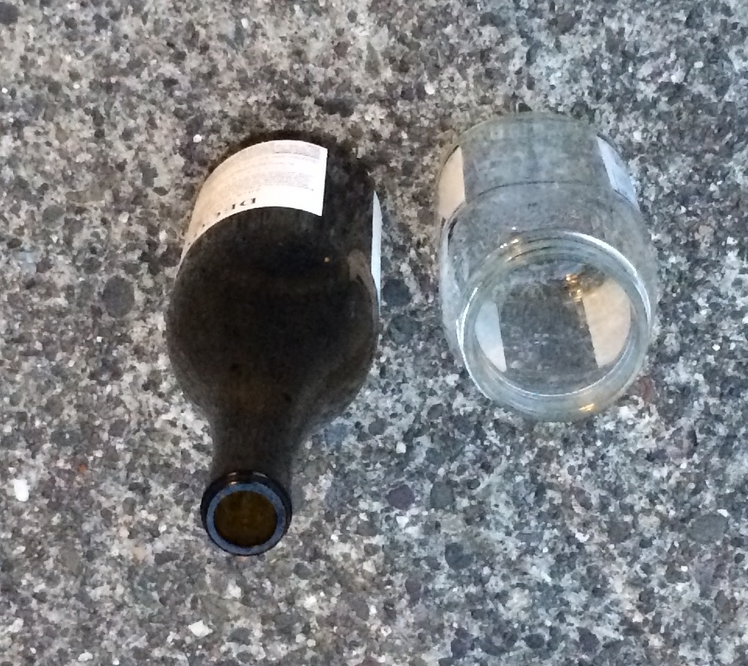
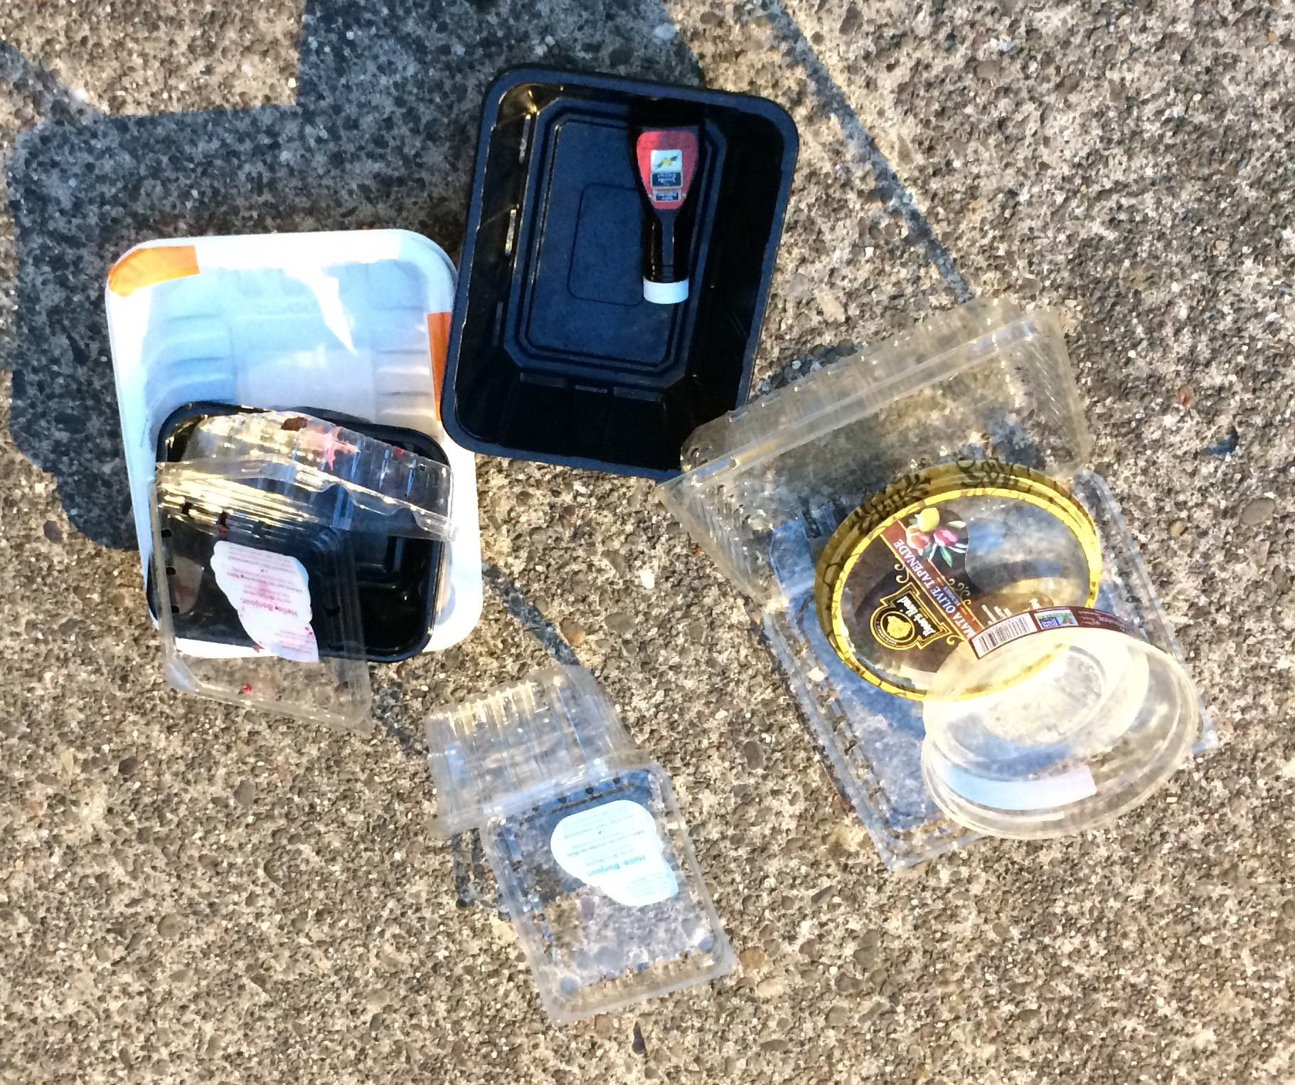
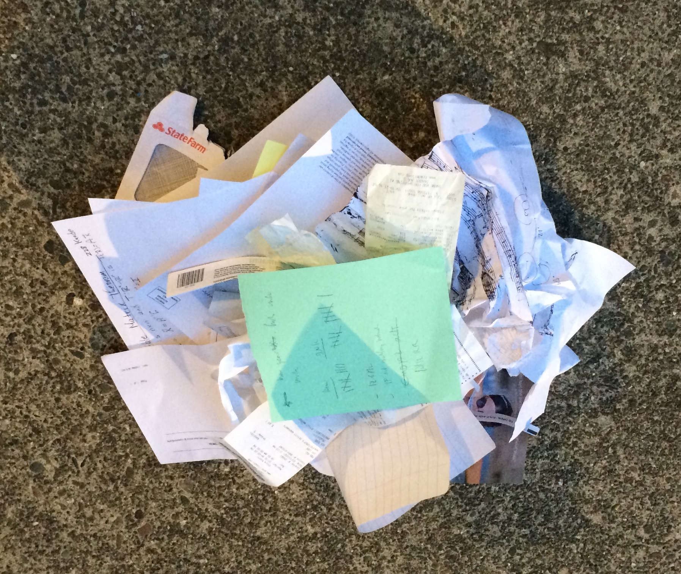
Plastic:
0.38 lb, 1%; all food packaging - ground turkey, mushrooms, blueberries, blackberries, raspberries, hummus, vanilla extract.
7.) See if markets exist that let you fill reusable containers for fruit and veggies like bulk foods.
Glass: 1.93 lb, 5%; wine bottle, pasta sauce jar.
5.) Switch to growler or aluminum can wine.
6.) Switch to canned tomatoes and make pasta sauce from scratch.
Other Paper:
.38 lb, 1%; receipts, printer paper jam, insurance bill, notes.
8.) Continue to reduce printing.
9.) Complete paperless billing.
10.) Ask for no receipts.

Slide 4
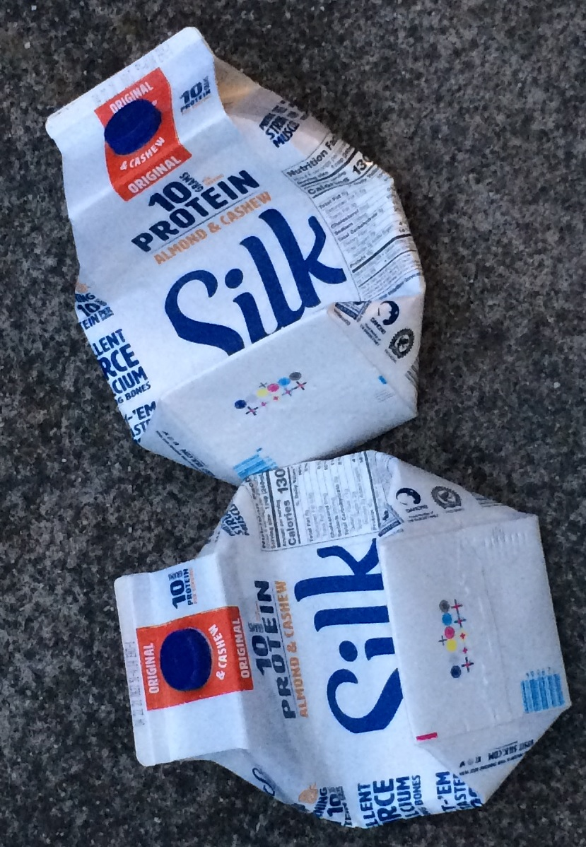
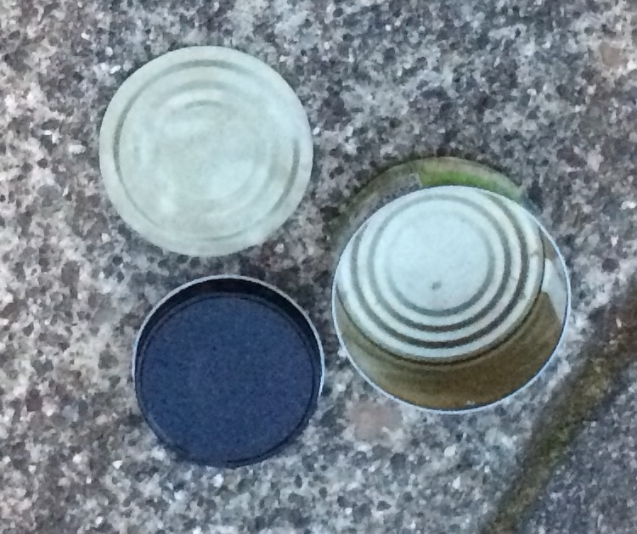
Milk Cartons:
.35 lb, 1%
Tin:
.13 lb, 0%

