Slide 1
Solar Performance Sept 21-27 2024

Slide 2
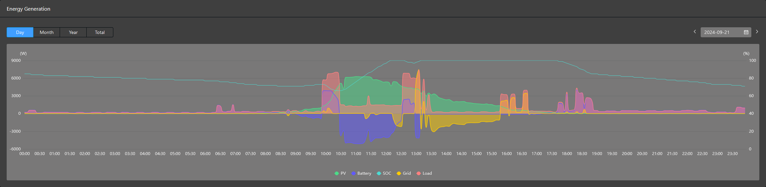
Sat Sept 21
dryer 1
dryer 2
baking brownies
cooking chicken satay dinner
brewing coffee, tea
Charging e-Stang 6 miles
start dishwasher

Slide 3
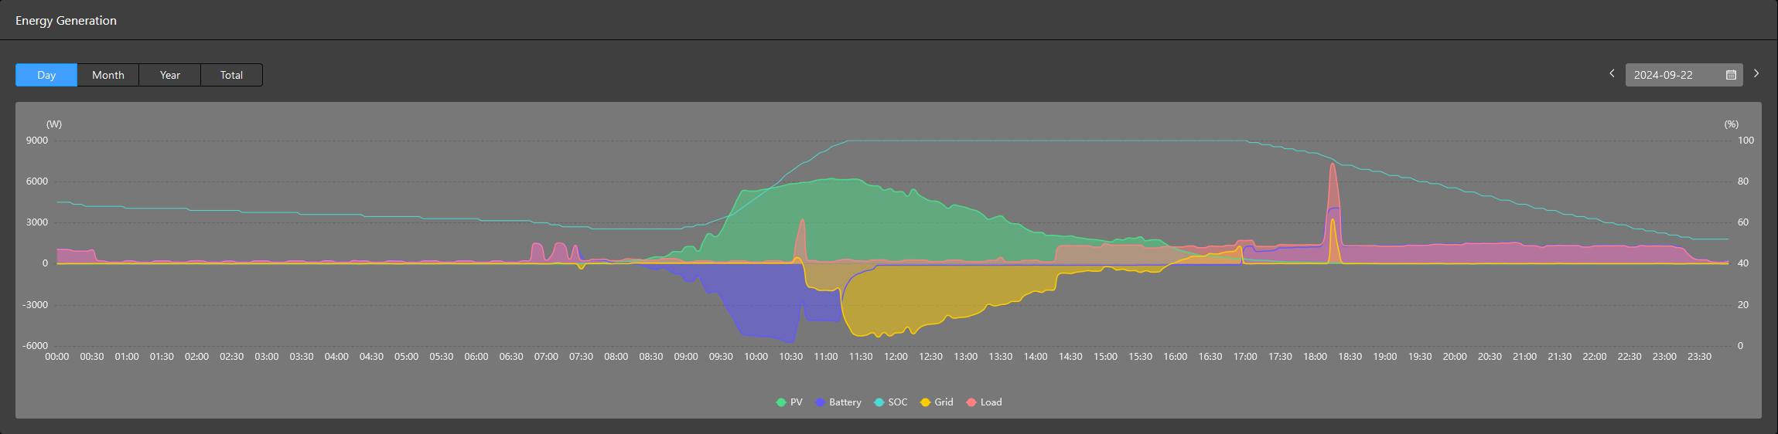
Sun Sept 22
reheating leftovers
end dishwasher
brewing 2 coffees, cooking egg
Charging e-Stang 20 mi

Slide 4
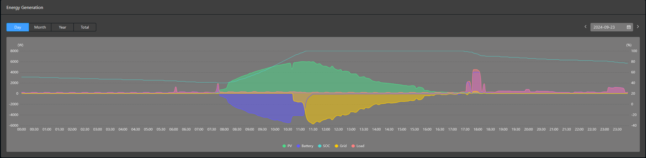
Mon Sept 23
cooking red sauce pasta dinner
brewing coffee
reheating coffee
start dishwasher

Slide 5
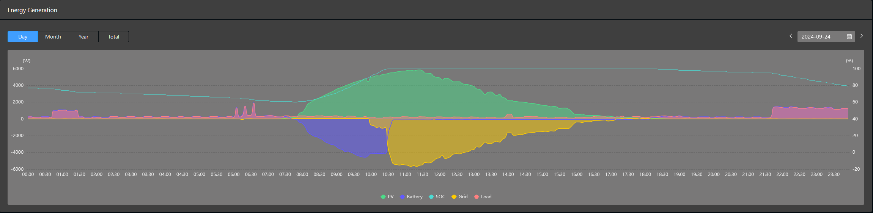
Tue Sept 24
brewing coffee, tea, reheating coffee
Shade, or southeast angle?
Charging e-Stang start 8 miles
end dishwasher
no reheating leftovers?

Slide 6
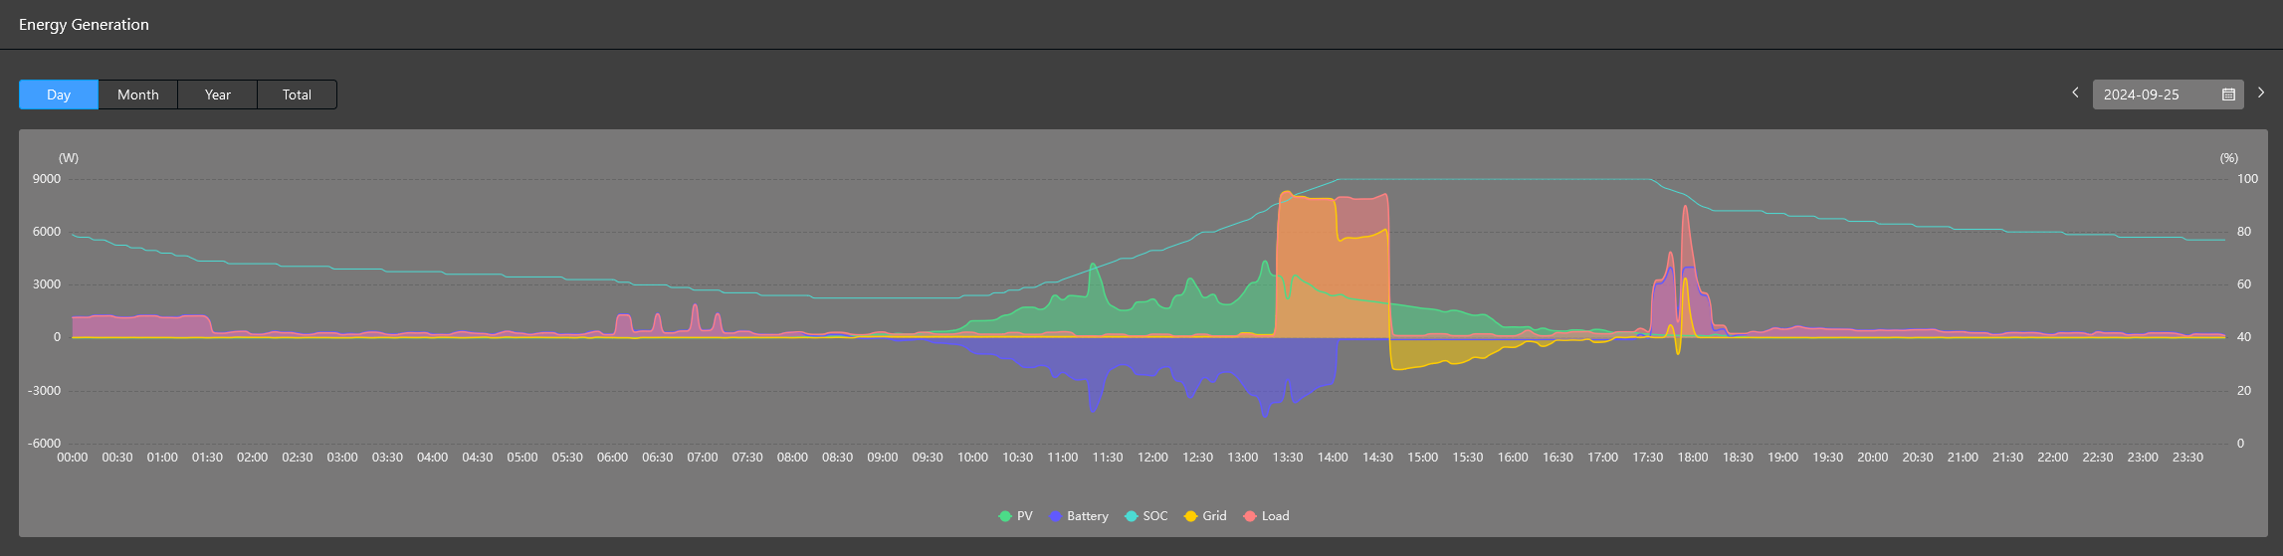
Wed Sept 25
charging Bolt
cooking turkey burgers
Charging e-Stang end 8 miles
brewing coffee, tea, other?

Slide 7
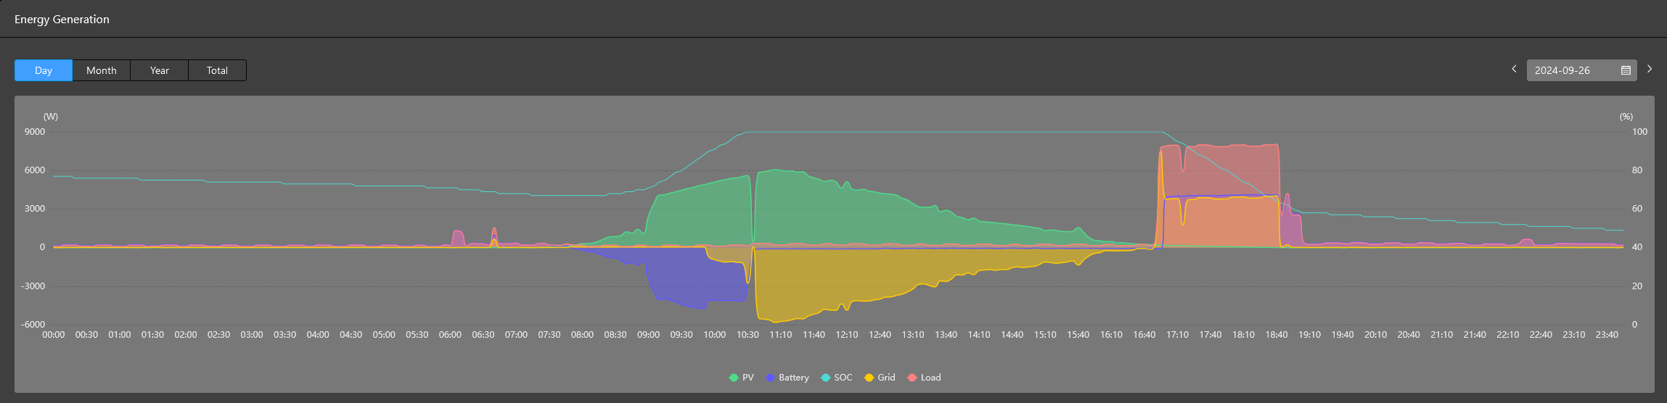
Thu Sept 26
charging Bolt
reheating leftovers
brewing coffee, tea

Slide 8
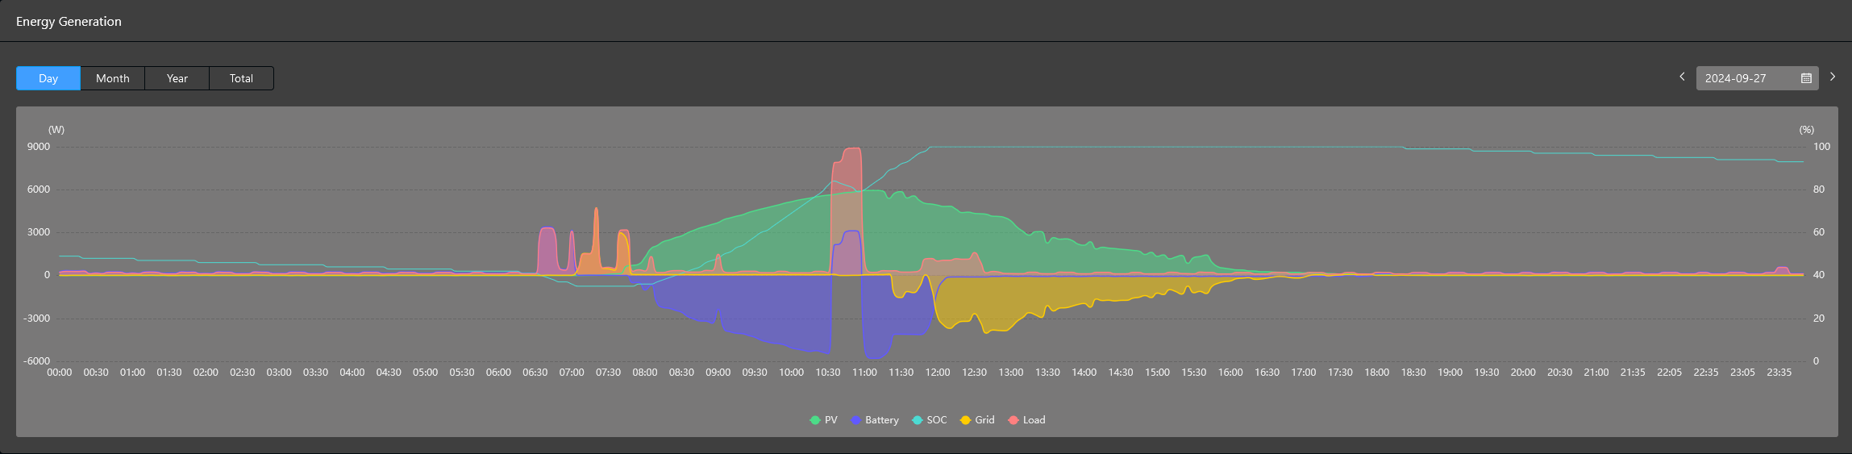
Fri Sept 27
charging Bolt
Baking zucchini bread, brownies
brewing coffee, tea
dishwasher

Slide 9
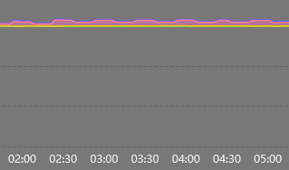
Low level loads
network, phantom
plus fridge

