Slide 1
Solar Battery Investment Payback Calculation
Chris Jones 3/11/2024
Page | Topic
2 | Goals
4 | Questions and Answers
5 | Equipment Selection
6 | Sizing the System
11 | Obtaining Bids
12 | Estimating Solar Production
15 | Estimating Loads
16 | PG&E Electric Rate History
18 | Estimating System Performance and Payback
28 | Equipment Size Optimization
35 | Power Backup Estimate

Slide 2
Goals
Minimize grid use, because the grid is not zero carbon and clean yet, and we must urgently make it so.
Buy American, to invest locally in jobs for products that are made to the high environmental standards and working conditions of the US.
Buy high quality long life equipment, so we invest our money wisely.
Buy equipment installed and maintained by local contractors with a good reputation that will take care of warranty repairs and ongoing maintenance cost and time effectively.
Purchase the right amount of equipment for the job.
Provide power backup during Public Safety Power Shutoffs during fire season and power outages during winter storms, although both are relatively rare for us in town.

Slide 3
Goals
Goals I gave up on:
I wanted to do it myself, like our original 2003 1.8 kW install with the help of my brother-in-law and a contractor that connected it to the circuit breaker. But I am very busy with work and life, and it would take me weeks including getting certified to obtain warranty support which is worth money, and I am fortunate to have some money to invest, so we decided to try to find a reputable local contractor to see if they could give a bid that competed with me DIYing it. The main components retail are inverter $7K, battery $11K and panels $4K so $22K + tax = $24K. The solar and battery portions of the bids were ~$37K so $13K for labor not counting additional parts. I think it would take me at least a few weeks to get certified with all the manufactures (if they would let me as an individual) and then do the install to get the warranty so 120 hours which is $108/hour which seems high but not out of the ball park, especially if there is a positive return on investment.
I also wanted to make our own batteries from used EVs with my son’s senior project Battery Management System from Cal Poly SLO computer engineering department, but we need to get it UL listed to get the permit so we have at least 10 years to get that certification before we need new batteries. We can prototype it in my EV conversion that does not have those requirements.
I also wanted to do NiFe batteries; they are lower power and energy density and have only 70% efficiency instead of 90% and need hydrogen ventilation and watering like lead acid, but unlike any other battery they can be overcharged and overdischarged and not be damaged, and there have been steel cased Edison batteries that still work after 100 years with common caustic but not toxic potash electrolyte changes every 20 years which would make the ROI calculations improve dramatically. But the new ones are uncommon and nichy and seem to be all made of plastic from China and are spiked with lithium and the vendors I talked to don’t deal with it so I dropped this dream this time around too. I will keep my eye out for vintage Edison batteries, some people are using them for solar.
I also wanted to add solar preheat to our future water heat pump, but the energy required to heat water isn’t much, the cost of the system is high due in part plumbing complexity but also lack of mass production, and at 4’ x 10’ it would take up a significant amount of prime solar photovoltaic panels, so we decided not to pursue that.

Slide 4
Questions and Answers
Question 1: what is the payback period for a 8.7 kW solar array with a 19.2 kWh backup battery in Santa Rosa, CA?
Answer: approximately 11 years if bills go up by 6% per year, 14 years if they remain flat.
Question 2: is the payback period less than the warranty period?
Answer: no; the warranty for solar panels is 25 years, but inverter and batteries is only 10 years. Selecting equipment with a reputation for high quality and cost effective repair support will reduce the risk of losing money, since all of these products are new.
Question 3: how much electricity will be able to self-generate?
Answer: approximately 73% with existing gas furnace and water heater, and approximately 57% with electric air and water heat. Since the grid is not yet clean and carbon neutral this is a significant impact that makes the risk of losing some money worth it due to the urgency of the need for change.
Question 4: are the size of the solar array and battery pack the right size for optimal utilization and payback?
Answer: yes, with heat pump they are on the “knee of the curve” for economy and performance. May add second battery with heat pump.

Slide 5
Equipment Selection
High quality American made equipment with long warranties and DC solar-to-battery coupling for maximum efficiency:
Sol-Ark all-in-one inverter and charge controller, Allen, TX
15K: https://www.sol-ark.com/sol-ark-15k-all-in-one/
Mission Solar solar panels, San Antonio, TX
22 x 395W: https://www.missionsolar.com/wp-content/uploads/2022/09/M6-9BB-Data-Sheets-SX9R-1.pdf
HomeGrid Stack’d LFP battery packs, San Jose, CA
19.2 kWh: https://www.homegridenergy.com/stackd-series
S-5! Standing seam metal roof attachment system, Colorado Springs, CO
S-5-U: https://www.s-5.com/products/s-5-u-clamps/

Slide 6
Sizing The System
We need a powerful enough inverter to run our home. According to PG&E data our maximum power over one hour last year was 7.01 kW, but the peaks could be twice that high easily, and that is before adding a 4 kW high efficiency heat pump.
Instead of getting a very high power system and not paying attention to peak loading, we want to schedule when we do high power activities such as clothes drying, charging our EVs quickly, running the stove and oven, and eventually running our heat pump. We already try to do this for time of use by doing laundry and charging cars before 4 PM and charging our cars after 9 PM for Time-of-Use bill minimization, but it also puts a lighter load on the grid and hence doesn’t drive upgrading the grid which will save cost even if everyone did it and could hasten renewable energy adoption. Adding the heat pump will be interesting, we might want to run it more during peak sun hours until 1 PM in winter, 2 PM spring/fall and 3 PM summer (if used for AC) and wear shorts and then bundle up at night. Eventually everything will be Internet-of-Things and this could be coordinated amongst the high power devices. I would like to mount large solar, battery, load and grid amp gages and a battery state-of-charge or voltage gage in the house so we can more easily manage this; I expect the Sol-Ark to have an app where I can check this on my phone.
The Sol-Ark 15K has 12 kW continuous and 15 kW peak which will probably work for most situations, and when the grid is up it can do the rest. I would also like to use my old panels to help with this.
22 395 Watt Mission Solar panels totaling 8.7 kW DC fit on our roof and will provide most of the energy.
One 19.2 kWh HomeGrid Stack’d battery can discharge and charge at 14.4 kW continuous which can keep up with the Sol-Ark with margin, although at 12 kW continuous limited by the Sol-Ark it would only run for about 1.3 hours to get down to 80% depth of discharge. They are warranted for 4,000 cycles (designed for 10,000) down to 80% of nominal capacity at 100% depth of discharge; at 1 cycle per day that is warranted for 11.0 years and designed for 27.3 years which is probably longer than the life of the battery due to thermal breakdown so keeping it above 20% SOC is probably good enough.

Slide 7
Sizing The System

Slide 8
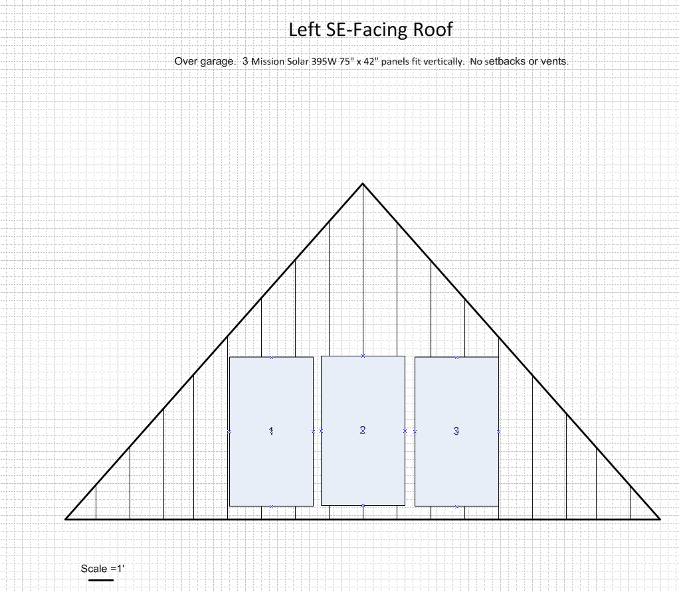
Sizing The System

Slide 9
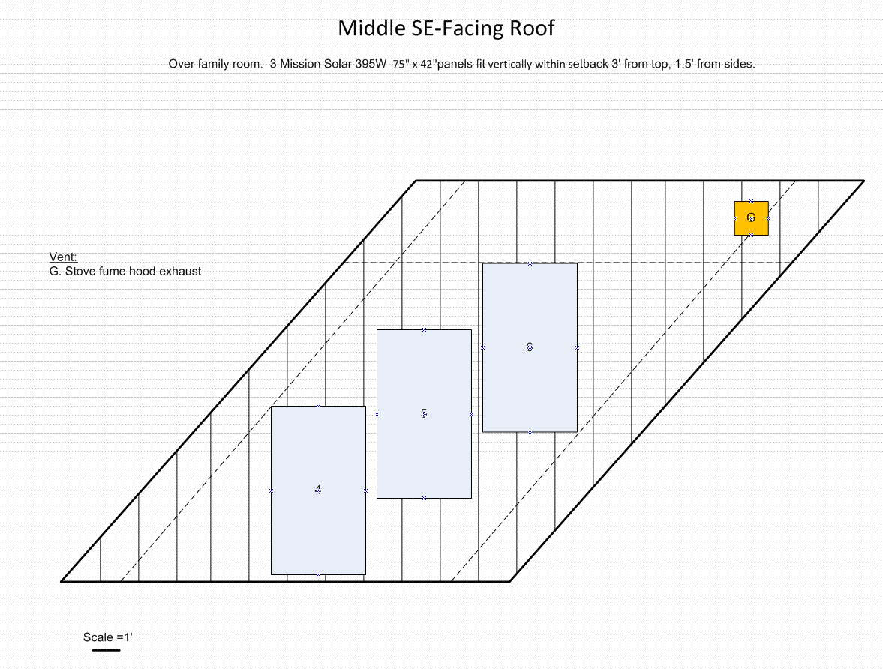
Sizing The System
Setbacks are to meet fire code.

Slide 10
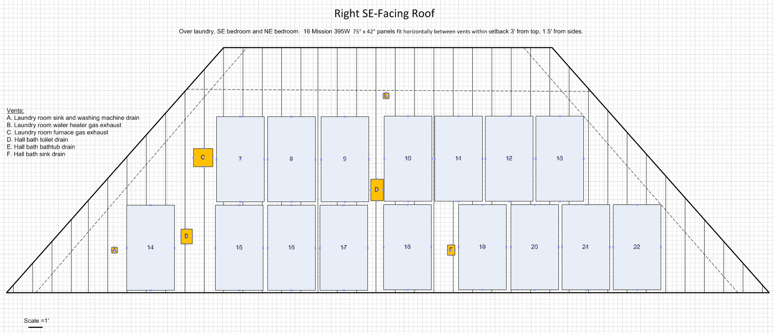
Sizing The System
Setbacks are to meet fire code.

Slide 11
Obtaining Bids
We narrowed it down to two contractors with high ratings in Sonoma County that are certified installers for the equipment that we want to use for our installation. Both proved to be mostly competitive.

Slide 12
Estimating Solar Production
I used NREL’s PVWatts calculator, https://pvwatts.nrel.gov/pvwatts.php, based on irradiance data taken in the region. This is the same tool I used 21 years ago to estimate the original system. I entered the system parameters and got hourly production estimate data for the old system as well as for the new system.
System parameters:
Santa Rosa, CA
8.69 kW DC
18.4 degree tilt – measured rise and run with level
126.5 degrees azimuth, roughly southeast – see map on next page
It predicts 12,290 kWh annual production, similar to the 12,701 kWh predicted by Enphase’s SolarGraf program that they used.
We have a 21 year old 1.8 kW Sharp/SMA Sunny Boy system that is only outputting about 40%, probably due to the original inverter wearing out. I want to include this in the new system, but that has not been agreed upon yet hence it is left out of the calculations.

Slide 13
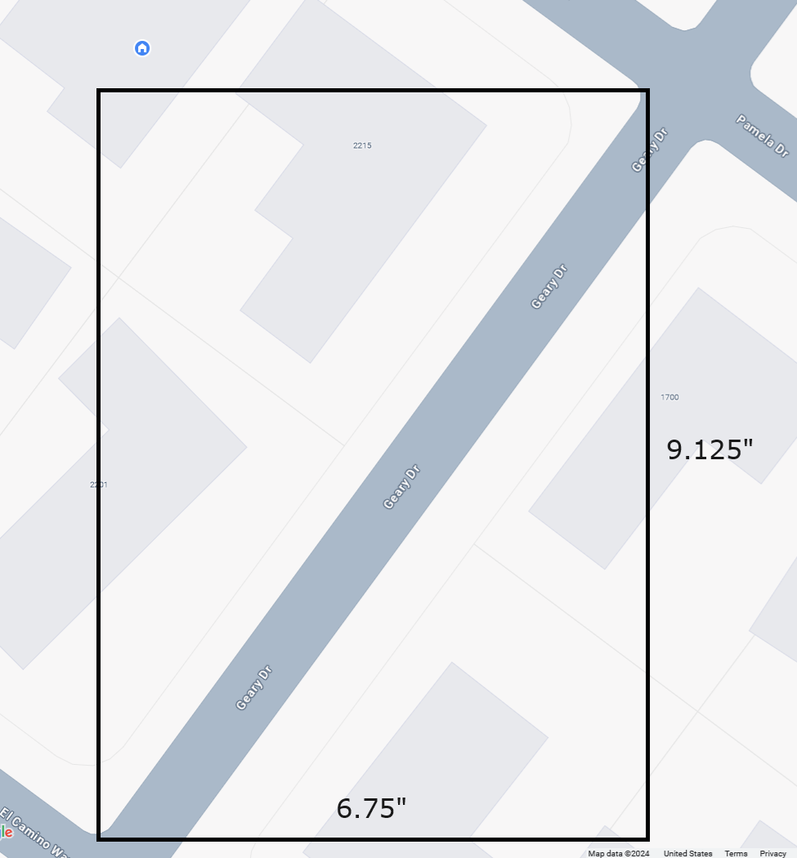
Estimating Solar Production
Southeast roof surface
East = 90 degrees clockwise from North
90-A = 36.5 degrees
A
90 degrees
A = tan-1(9.125/6.75)
= tan-1(1.35185)
= 53.5 degrees
90 + 36.5 = 126.5 degrees clockwise from North = azimuth
A

Slide 14
Estimating Solar Production

Slide 15
Estimating Loads
First I started with our 2023 PG&E net hourly electric data.
Then I added in 40% of the model data from PVWATTS of our old system, the performance level I think it’s at from spot checking over the last couple of years. There is also shade problems with a tall Valley oak tree, but I estimate the output now to be only about 10% of the new system, so even if I’m 50% off that’s only 5% of the new system.
For the heat pump scenario I took the daily PG&E gas usage data which has poor resolution, only rounded off to the nearest therm which may not tick up for a few days in the summer when we are only using hot water, and averaged it over each month, then applied it smoothly across the 24 hours. This is not accurate since our heater is not on at night, but it made calculations easy.
Then I converted the daily therms reported by PG&E to kWh by multiplying by 29.3; our furnace is 95% so this number is 5% high. I then divided by an estimated average Coefficient of Performance of 2.6, which I estimate is what the advanced Chilltrix heat pump will do in this climate that can run well below freezing without resistive heat due to an additional pump stage and variable frequency drive, 30% better than the competition they claim but I tried to get someone to install one in 2022 but I couldn’t find anyone certified to do it. It transfers via glycol so I could do it myself but decided I wanted someone to service it in situ so I will wait patiently for them to be available here. Like triple pane windows they are being deployed in colder climates, but they can enable us to go all electric with less infrastructure upgrades.

Slide 16
PG&E Electric Rate History
To estimate payback period we first need to estimate where energy bills are going.
This shows baseline rates have been going up exponentially over the past 10 years, and upper tiers have gone up at even faster rates, so this is conservative. Source: https://www.pge.com/tariffs/electric.shtml

Slide 17
PG&E Electric Rate History
This shows the annual rate change climbing up to 6% exponentially. Who knows what will happen, so I am using a conservative guess that they will be least 6% for the next 10 years during the warranty period.
If they go back down that will be a good thing for the masses and I can tell the story of how I lost my shorts on my install, but how much I value how much less greenhouse gases I have used. If everyone waits for a good deal it may be too late.

Slide 18
Estimating System Performance and Payback
I made a spreadsheet that I posted here: http://thjmedia.net/blog/posts/Solar/solar%20payback%20v1%20b2.xlsx . It has the following inputs and outputs:
Inputs | Value I settled on
Watts per panel | 395
Number of panels | 22
Battery capacity, kWh | 19.2
Max battery state of charge | 100%
Min battery state of charge | 20%
Battery round trip efficiency | 90%
Heat pump Coefficient of Performance | 2.6
Old annual electric bill if no old solar | $2,994
Bill increase year 1 | 6%
Rate rise subsequent years | 6%
Fixed electric cost year 1 | $191
Cost per kWh year 1 | $0.33
Payment per kWh year 1 | $0.08
System cost | $41,124
Min warranty, years | 10
Annual Outputs | Without Heat Pump | With Heat Pump
DC size, kW | 8.69 | Same
Solar production, kWh | 12,289 | Same
Load, kWh | 8,093 | 13,869 +71%
Solar direct to load, kWh | 2,572 32% of load | 4,212 30% of load
Battery to load, kWh | 3,406 42% of load | 3,682 27% of load
Grid to load, kWh | 2,163 27% of load 73% self gen 68% if SOC 40% min | 6,031 43% of load 57% self gen 53% if SOC 40% min
Solar to battery, kWh | 3,776 | 4,074
Solar to grid, kWh | 5,941 | 4,004
Payback period at 6% rate rise per year 0% | 11 years 14 years | 11 years 14 years

Slide 19
Estimating System Performance and Payback
Calculations in “hourly_calcs_no_hp” tab without heat pump and “hourly_calcs_with_hp” tab with heat pump :
Columns | Calculations | Notes
A-N | Consumption, without and with heat pump | Source: PG&E hourly consumption in 2023 CSV file
O-P | Solar generation | Source: PVWATTS model CSV file
Q-U | Starting battery capacity | From previous hour, calculated in kWh and SOC% and compared to min and max limits.
V-X | Priority 1.) Solar to load | If there is any solar and any load, transfer the lesser of the two from solar to load.
Y-AB | Priority 2.) Battery to load | If there is any load and available battery capacity left, transfer the lesser of the two from battery to load.
AC | Priority 3.) Grid to load | If there is any load left, transfer it from the grid.
AD-AG | Priority 4.) Solar to battery | If there is any solar and battery charging capacity left, transfer the lesser of the two from solar to battery.
AH | Priority 5.) Solar to grid | If there is any solar left, export it to the grid.

Slide 20
Estimating System Performance and Payback

Slide 21
Estimating System Performance and Payback

Slide 22
Estimating System Performance and Payback

Slide 23
Estimating System Performance and Payback

Slide 24
Estimating System Performance and Payback
Load spikes probably EV charging and/or clothes drying

Slide 25
Estimating System Performance and Payback
Load spikes probably EV charging and/or clothes drying

Slide 26
Estimating System Performance and Payback
Load spike probably EV charging and/or clothes drying

Slide 27
Estimating System Performance and Payback
Load spike probably EV charging and/or clothes drying

Slide 28
Equipment Size Optimization
Then I varied number of solar panels and battery pack size, estimating the cost would vary linearly with each change which is a crude assumption, to make sure I was close to the “knee of the curve” of cost and performance payback. I was past the knee without heat pump but still climbing with heat pump, so increasing capacity should pay, but it would be nice to see the actual solar, battery and heat pump performance first.
Thus we will have the 19.2 kWh battery installed such that it would not be a redo to add a second battery, and the panel upgrade needs to have enough capacity to run the heat pump.
We could even add more solar where the old system was on the SW roof; an overgrown tree shades that area much of the year, but it is growing in to the power lines and keeps getting cut back by PG&E so it may not be a problem in the future if we replace it with a shorter tree. Also adding or shifting solar to the SW roof may help skew production better to avoid relying on mornings that are often foggy here.
If peak power is a problem caused by charging EVs we can get a charging station with programmable power limits to smooth out the charging power.

Slide 29
Equipment Size Optimization

Slide 30
Equipment Size Optimization

Slide 31
Equipment Size Optimization

Slide 32
Equipment Size Optimization

Slide 33
Equipment Size Optimization

Slide 34
Equipment Size Optimization

Slide 35
Power Backup Estimate
Normally we will want to be on minimize grid mode, but in case of an upcoming fire or storm related power outage expected we will charge up our batteries and keep them full so we can use them for several days.
If we use 80% of the battery or 15.36 kWh, the fridge that runs at 60W average would run for 10.6 days. If the fiber to the house was working the network would probably take less than that plus charging laptops and occasional lighting so maybe we could run 5 days. If we get the second 19.2 kWh battery when we get the heat pump maybe we can run 10 days.
If we want to do some electric cooking that would be high power but very quick – for instance the 1447W microwave running for 5 minutes is 120 Wh so if we cooked 4 servings a day that would be 480 Wh or 20W average so only 1/3 of the fridge so might be considered although we could cook with our gas camping stove or charcoal BBQ.
But if it is sunny or even partially blocked by clouds or fire smoke, we should be able to power our fridge and network always by having the solar recharge the battery while off grid. The system will put out at least 26 kWh per day on a sunny winter day that is much more energy than 1.4 kWh to run the fridge.

