Slide 1
Jones Family Solar Expansion Project
Santa Rosa, CA January 14, 2022
Title | Page
Goals | 2
System Diagram | 3
Power requirements
Energy Requirements
Local Irradiation
Power Equipment
Load Equipment
Layout
Wiring Diagram
Power Generation Estimate

Slide 2
Goals
Minimize grid use in order to:
  Reduce greenhouse gas emissions
  Reduce toxic emissions
  Reduce strain on electrical grid
  Increase energy independence
Do not significantly disrupt our current lifestyle.
Do not significantly increase our ongoing home ownership cost.
Purchase equipment that is safe, reliable and repairable, with long lasting warranties and local support.
Purchase US made parts whenever available and competitive.

Slide 3
System Diagram
Split out critical loads?
Switch to heat pump clothes dryer?
Separate hot water heat pump, with outside air exchange?
Sun
Grid
meter
240V:
  Air and water heat pump w/ soft start
  Level 2 EV charger
  Resistive heat clothes dryer
  Double convection oven
  Stove (induction deferred)
120V:
  Level 1 EV charger
  Clothes washer
  Dishwasher
  Lighting
  Kitchen appliances
  Garage tools
  Electronics
  Everything else
Load circuit breakers
PV panels
Grid circuit breaker
Inverter/
charger
Transfer switch
Batteries w/ BMS
Service panel

Slide 4
Power Requirements

Slide 5
DC Coupled
Other Loads
Grid
98%
93%
Charge Controller
95%
Inverter/charger
Critical Loads
PVs
Batteries
If batteries used for all energy and are only charged from PV and not grid, overall efficiency is 98% x 95% x 93% = 86%.
AC Coupled
97%
Other Loads
PVs
Inverter
Grid
95%
93%
Inverter/charger
Critical Loads
Batteries
If batteries used for all energy and are only charged from PV and not grid, overall efficiency is 97% x 93% x 95% x 93% = 80% or 7% worse than DC coupled.
240 VAC
600 VDC
150 VDC
48 VDC

Slide 6
Power components
Item | Existing | Proposed | Notes
Grid service and circuit breaker box | 90A (21.6 kW) | 1.) size this | Needed to support 2 electric vehicles and added air source heat pump for space and water heating. Also need to separate out oven and stove on different circuit breakers to remove the junction under the house, or replace the wire and move the junction to a box under the stove.
PV interface | SMA Sunny Boy 2.5 kW inverter with no monitoring, currently not functional (or may be broken PV panels or wires) | Sol-Ark 12 kW inverter/ charger with monitoring | 2.) Need to know how to install a transfer switch to reconnect the house directly to the grid when the Sol-Ark fails. 3.) Need to confirm that we don’t need a separate critical loads panel. 4.) Need to know how the Sol-Ark battery charging and discharging current can be gracefully cut back by the BMS in the event of an unbalanced cell or over-temperature instead of opening the contactor.
PV panels | 12 180W Sharp NT-180U1, 1.8 kW net max output, ca. 2003 | 19 Solaria PowerXT-400R-PM, 6.6 kW peak, 11.2 MWh/year | Need to move from shaded small SW roof to unshaded large SE roof. 5.) Need to verify location is good since afternoon loss should mostly be made up by morning gain. 6.) Need to research Solaria’s prospective longevity vs. LG which is top tier but from Korea not the US.
Batteries | None | 8 Simpliphi PHI-3.8-M-48 48V LiFePO4 75 Ah 3.6 kWh 37.5 amp 1.8 kW, 28.8 kWh 14.4 kW total; also experiment with Nickel Iron new or refurbished cells (only 70% round trip efficiency but 25 year warranty) and used EV LiFePO4s; will make home-made mechanical mounting and BMS | 7.) Need to verify location: area, sun heating, can it be under the eaves in case of fire? 8.) Need to verify using homemade batteries and BMS can be done legally to code, and won’t void the Sol-Ark warranty.

Slide 7
Loads
Item | Existing | Proposed | Max power, kW | Average daily energy, kWh | Notes
Space heater, hot water heater | Natural gas furnace, natural gas water heater | Central air source heat pump | 5.0 | 12.5 | 9.) Need to verify location of heat pump; area, distance from duct system, can it be under eaves due to fire? 10.) Need to confirm that over half the house registers can be closed and doors to those rooms closed and with added temperature sensors the heat pump can continue to run efficiently given the small duct diameter. 11.) Only a 5 year warranty; need to understand expected ongoing compressor repair costs, or look for an alternative with a longer warranty. 12.) Can we sell the used 8 year old furnace? It would be a shame to scrap it, but the PV and heat pump contractors should work together real time so both should be done at the same time instead of waiting for the furnace to die. 13.) Soft start so we can avoid a critical loads panel, or will it peak at 15 kW? 14.) Need to verify that heat pump alone for hot water is cost effective, and that a solar thermal preheater is not also needed which at 4’x10’ takes the space of 2 PV panels. 15.) Can heat pump installation be DIY?
EV #2 | 2022 Bolt EUV with 250 mile range | No change | 7.7 | 7.9 | Need to turn down max current from 40 amps to 32 amps.
EV #1 | 1966 Mustang EV conversion with only 30 mile range | No change | 0.8 | 3.5
Everything else |  |  | Un-known | 5.2 | Need to estimate this
Total |  |  | 13.5 + un-known | 29.1 kWh/day 10.8 MWh/yr | At 12kW max Sol-Ark output we need to not run everything at once to avoid a critical loads panel, but we are OK with doing it manually.

Slide 8
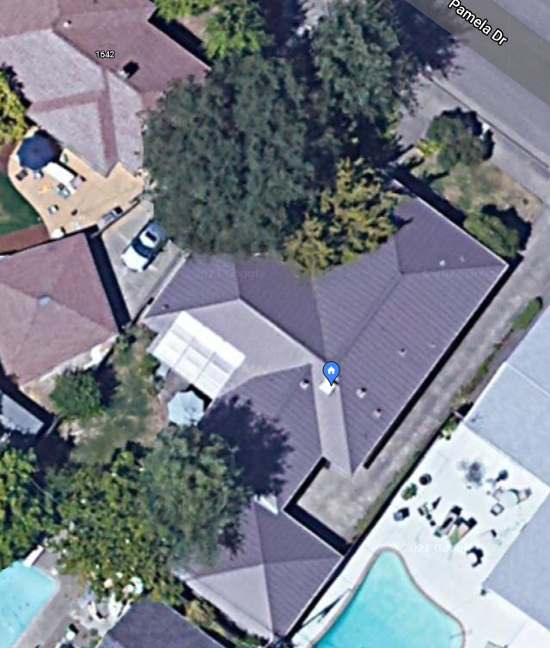
Layout
Alternate battery location #1
PV interface and batteries
Proposed new SE-facing PV array; less shade, larger
Circuit breakers
Central ducted space heater
Water heater
Alternate battery location #2
Old SW-facing PV array; too much shade
Heat pump
Legend
Tall Valley Oak that causes most of the shade
Power delivery
Additional SE-facing PV array locations to allow for expansion
Added electrical loads
Alternate heat pump location
Shade source
2 EVs

Slide 9
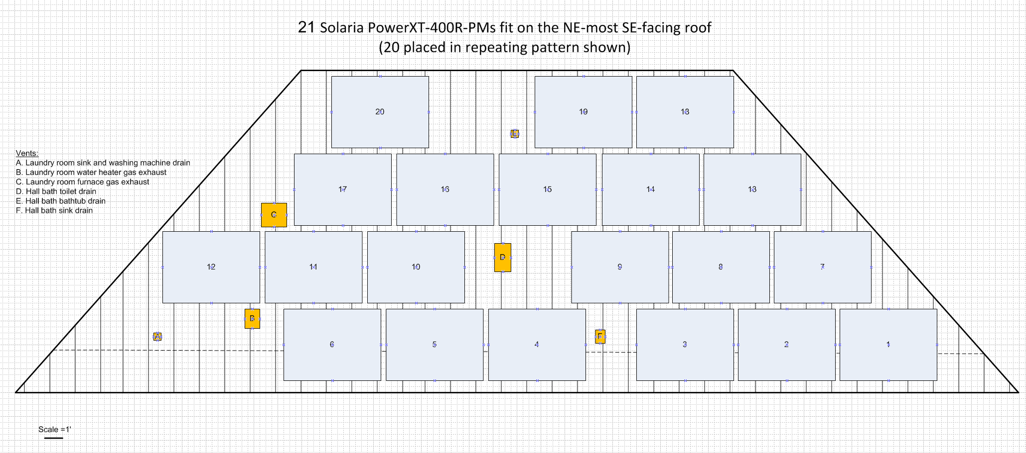

Slide 10
Equipment Links
PV interface:
  Sol-Ark 12k. Manufacturer’s site, Plano TX HQ and manufacturing: https://www.sol-ark.com/sol-ark-12k-all-in-one-homeowner/ EcoDirect distributor’s site, Carlsbad CA, $6,900, 10 year warranty: https://www.ecodirect.com/Sol-Ark-12K-12kW-48-Volt-Hybrid-Inverter-p/sol-ark-12k-p.htm . Supports both DIY and pro installers. Good ratings from DIYers.
PV panels:
  Solaria PowerXT-400R-PM. Manufacturer’s site, Fremont CA: https://www.solaria.com/powerxt-overview . EcoDirect distributor’s site, $10,950 for pallet of 25 panels or $438 each but not individually available, https://www.ecodirect.com/Solaria-PowerXT-400W-All-Black-Solar-Panel-p/solaria-powerxt-400r-pm.htm . Amongst highest efficiency with warranty of 86% capacity after 25 years. Equivalent life to 80% capacity is 35 years assuming linear decay and they don’t fail, with a per-year cost to replace at 80% of 3.1 cents per Watt. Korean LG 405W panel 405N3K-V6 for $445 has a 25 year warranty to 90% capacity or 2.2 cents per Watt if they last 50 years to 80% capacity, only a 1% increase in initial outlay but a 41% replacement rate premium for American made panels that would cost us an additional $69 per year for 19 panels, worth it to us to invest locally instead of giving to charity to help people without jobs.
Batteries:
  Simpliphi PHI-3.8-M-48 48V 75 Ah 3.6 kWh with BMS 10 year warranty 10K cycles to 100% DOD based in Oxnard CA, https://simpliphipower.com/wp-content/uploads/documentation/phi-3-8-m/simpliphi-power-phi-3-8-m-specification-sheet.pdf . EcoDirect sells something similar, $2,450, $776/kWh, https://www.ecodirect.com/SimpliPhi-PHI-3-8-48-60-48V-75-AH-LFP-Battery-p/simpliphi-phi-3.8-battery-48v.htm
Air exchange hot water output heat pump:
  Chiltrix CX-34. $4,450 per Sonoma Clean Power Advanced Energy Center https://scpadvancedenergycenter.org/products/chiltrix-air-to-water-heat-pump , Virginia Beach VA HQ and manufacturing, suggested by Sonoma Clean Power, most efficient with estimated COP for our highest use with furnace at 2.6 and designed for all-electric renewable homes. Manufacturer’s website https://www.chiltrix.com/chiller-technology.html
Other components:
  Heat pump hot water out to forced air duct system adapter: 16.) select
  Water heater tank or tankless with heat pump hot water out exchanger: 17.) select
  PV wire routing, length and gage to cost effectively minimize loss: 18.) route and select wire gage
  PV panel attachment to standing seam metal roof scheme: S5! S-5-S system, https://s-5.com/products/s-5-s-clamps/
  PV installation (maybe) and heat pump installation (required) bids: 19.) get PV bid. 20.) get heat pump bid.

Slide 12
Current electrical load breakdown estimations
EV #1 Long Range:
A 125 mile range VW e-Golf was added Dec 2017-Sept 2020, then we had no long range EV for 9 months, then we got a 2022 Bolt EUV in July 2021. The Bolt currently being driven at a rate of ~20,000 miles per year to care for an ailing parent 90 miles away, and for taking longer road trips during a sabbatical. It will probably settle out closer to ~12,000 miles a year like our gas cars we used up until Nov 2017 and Oct 2020-Jun 2021. At least 9,000 miles will be charged overnight at either a.) 4 MPH rate on 120V 8A, b.) 6 MPH rate on 120V 12A, or c.) 25 MPH rate on 240V 32A.
EV #2 Short Range:
Added July 2006. Driven only ~4,000 miles per year or 11 miles per day on average. Charge at 2 MPH rate overnight on 120V 6.5A, 2.5 mi/ kWh AC. Can be charged at 7.7 kW, but rarely done due to limited range.
Everything Else:
Includes fixed electrical appliances including stove, double convection oven, furnace fan, whole house fan and lighting, as well as plug-in appliances clothes dryer, clothes washer, electronics, kitchen tools, vacuum cleaner and garage tools. Estimated by subtracting the EV estimates above from our energy usage history when we’ve had two EVs. More study can be done if needed to reduce energy consumption, but the added heat pump is swamping out the peak energy needs so more insulation and ability to close off and unheat unused rooms is the obvious action.

Slide 14
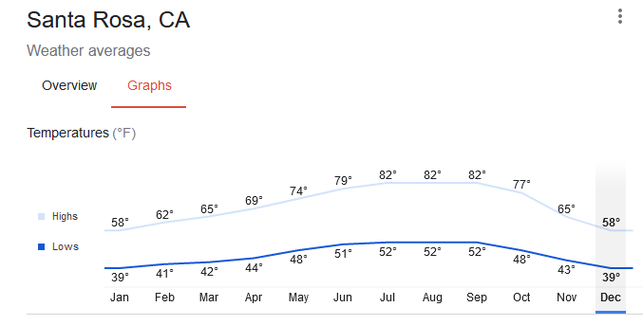
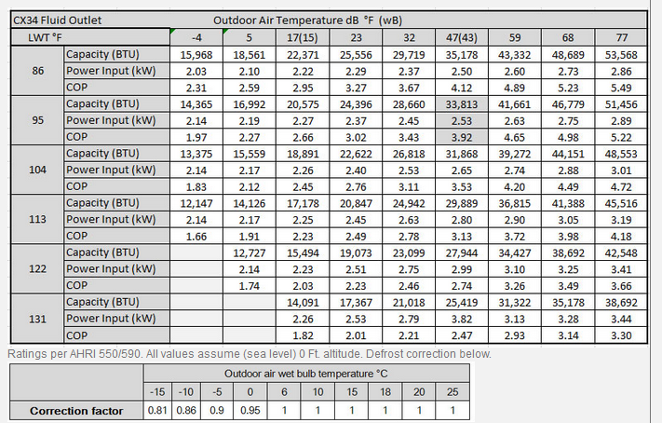
Added heat pump load estimate
We consume an average of 420 therms or 12,306 kWh/year of natural gas for space and water heat. We generally run our heater Nov-Apr where the lows are 39 to 44 F on average, vs. 48 to 52F for the rest of the year. Based on Chiltrix data it looks like COP will be around 2.6 for 122 degree domestic hot water which is assumed to be what will be used for the furnace, so we will need about 4,733 kWh per year, and our energy bills without solar would be about $346 more per year or about $1 per day, not a high price to pay to enable renewably powered heating, only ~1/4 of a Venti latte at Starbucks.
Average temps according to Google:
Heat pump COP according to manufacturer:

Slide 16
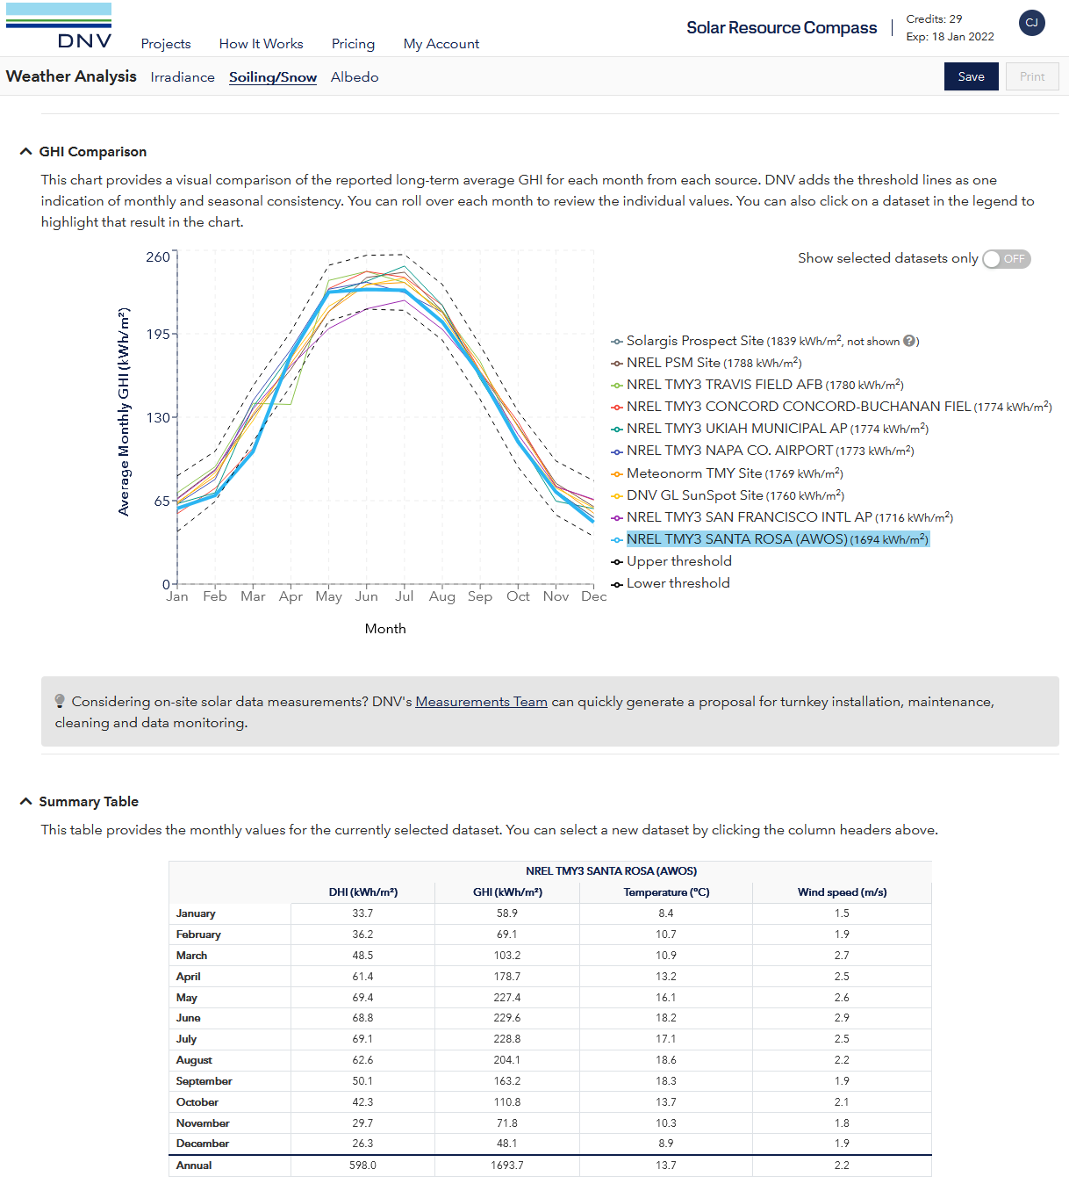
Local irradiation
According to NREL, our GHI (Global Horizontal Irradiation) = full sun hours equivalent per year = 1694, in Jan it is 65/31=2.1 hours per day and in May-July it is 225/31=7.3 hours per day. Annual average is 1694/365=4.6 hours per day. Multiply by net PV output to calculate energy produced in kWh per day.
Furnace needed Nov-Apr;
April good for solar, Nov bad

Slide 17
System sizing

Slide 18
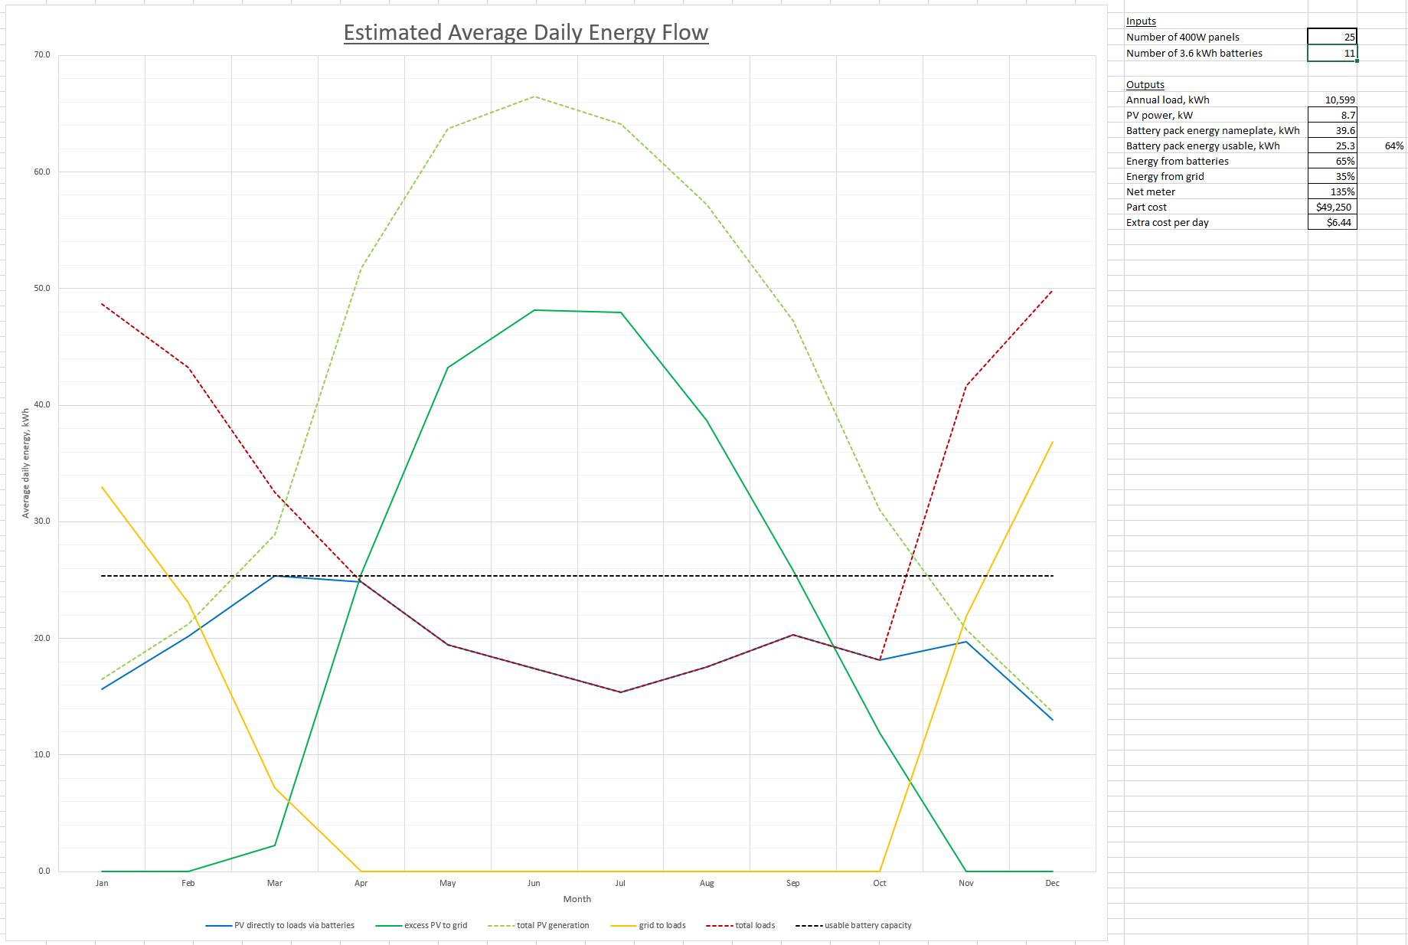
System performance estimate

Slide 19
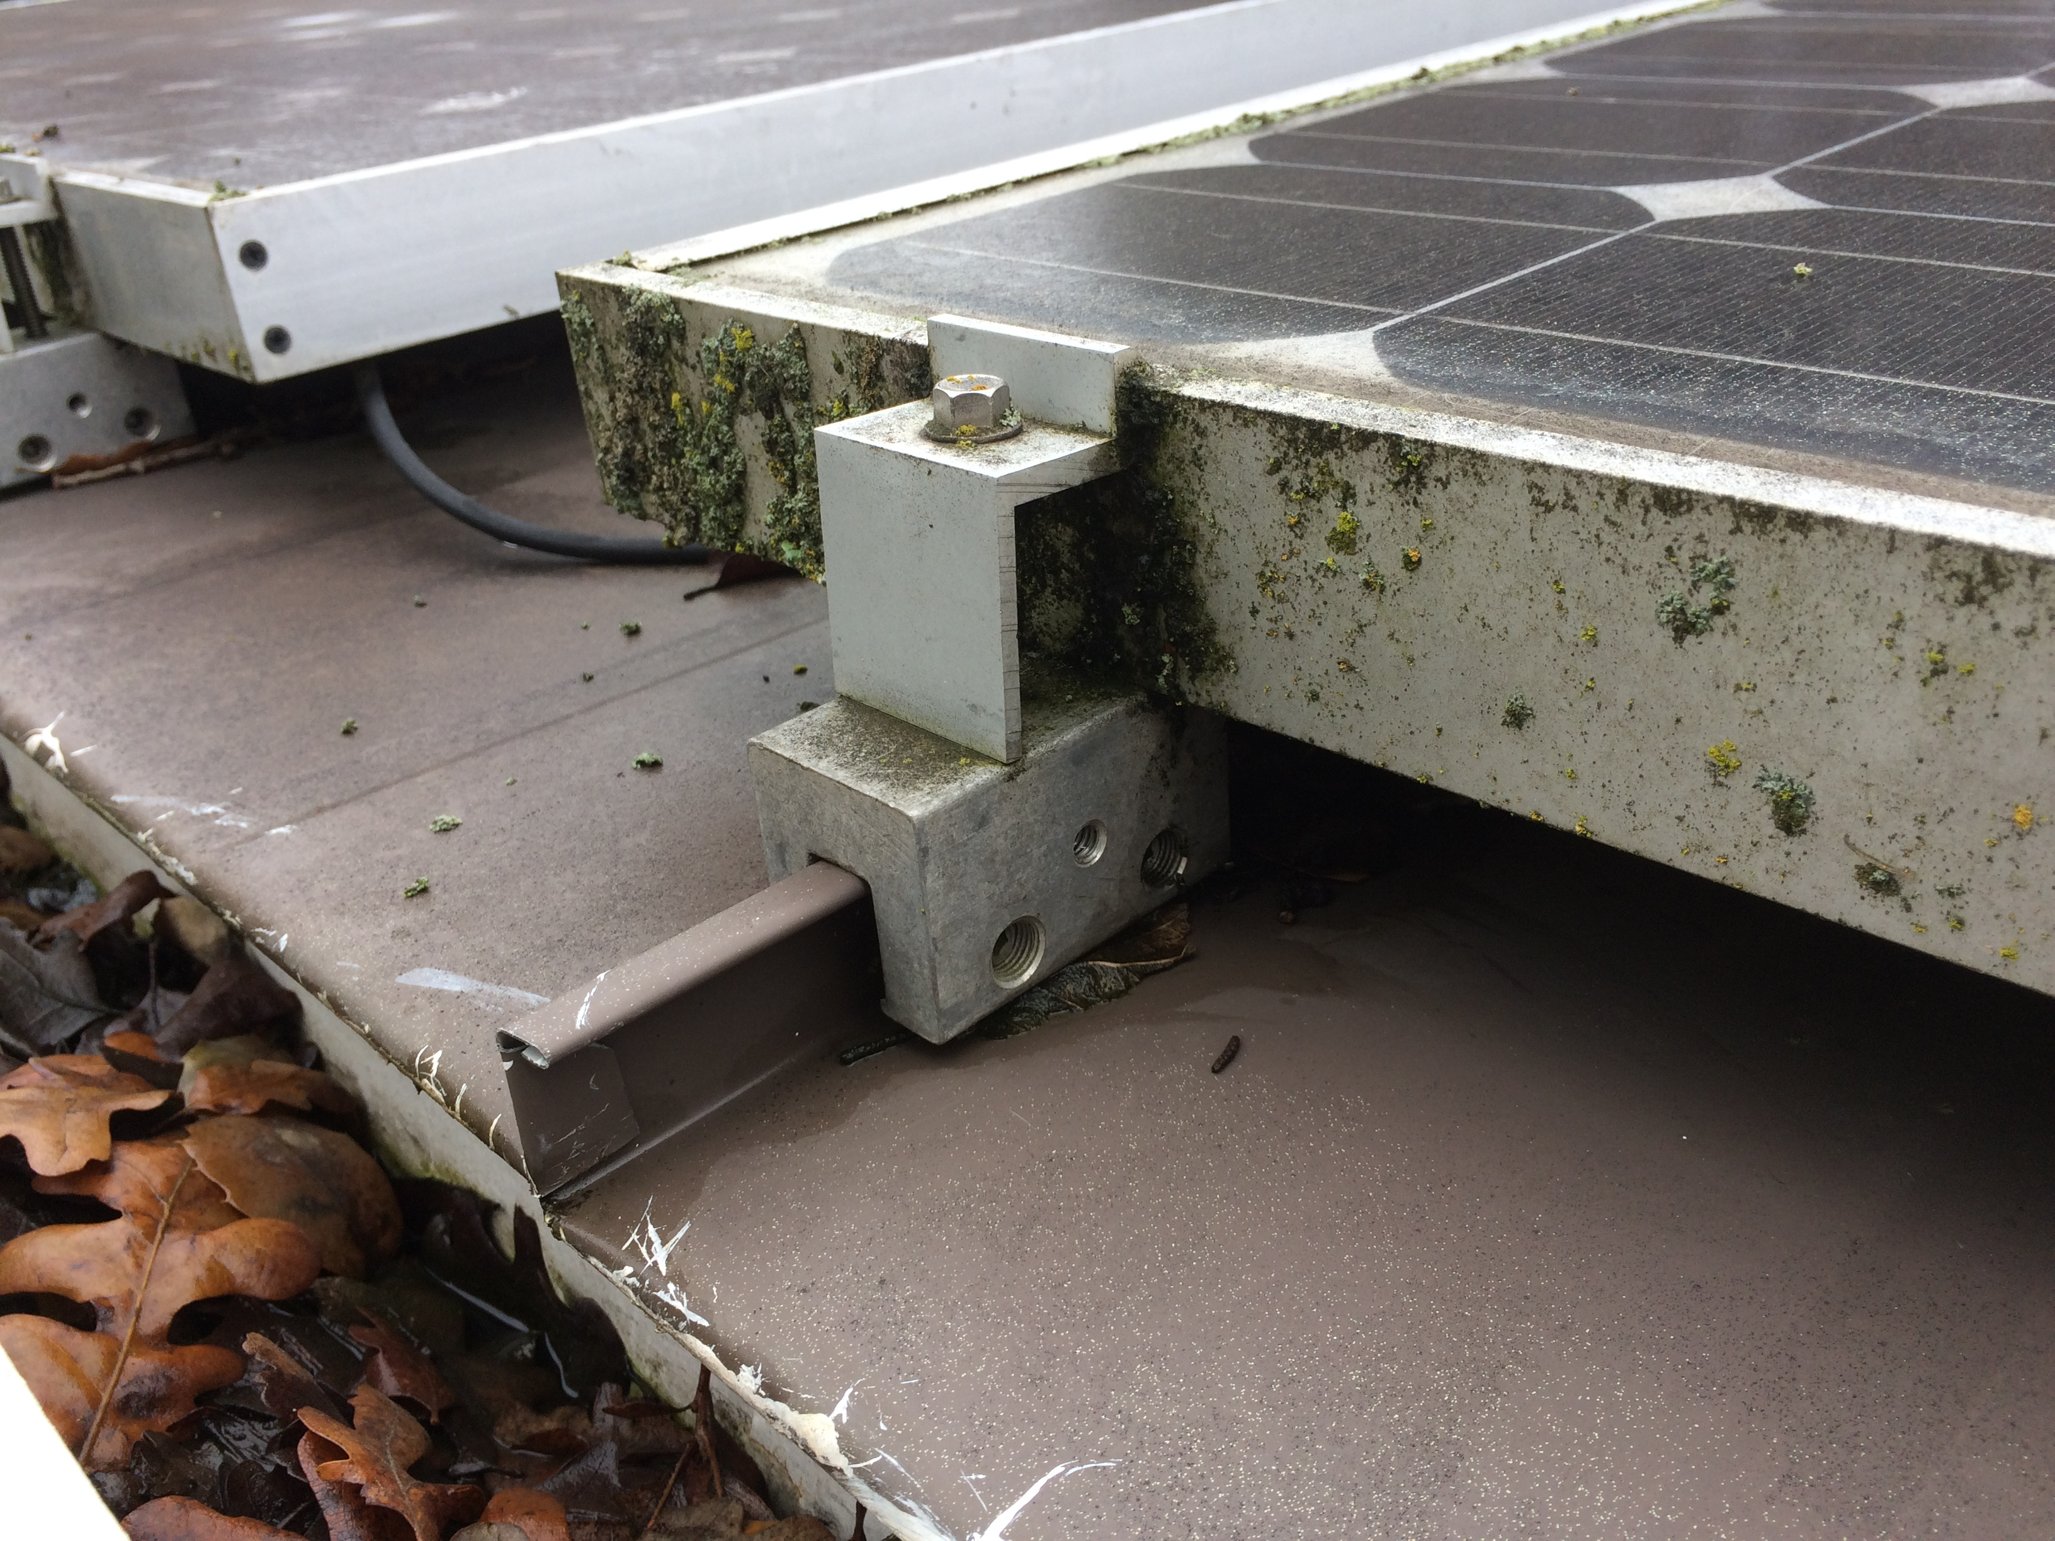
PV roof mount system
Standing seam metal roof installed ~2007, 1” high x ½” wide seam, 17.25” center-to-center
Current array on SW overhang with 2.5/12 pitch; SE side is 5/12
S5! S-5-S mounting system, 1” spacing on ends and between panels

Slide 20
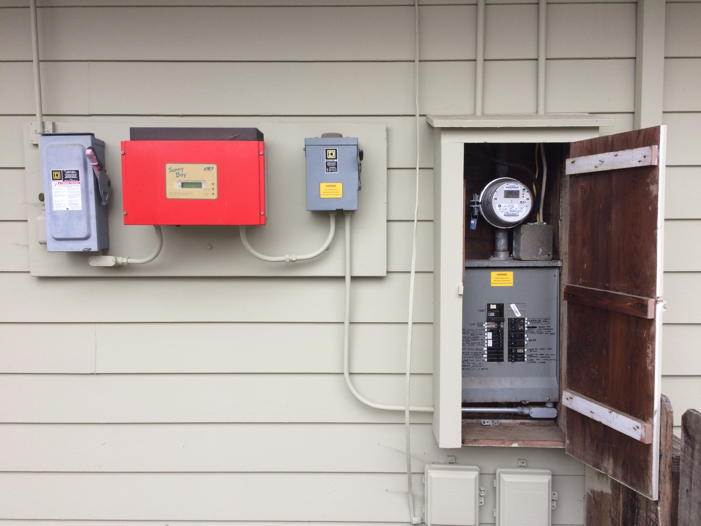
Pictures
Power feed

Slide 21
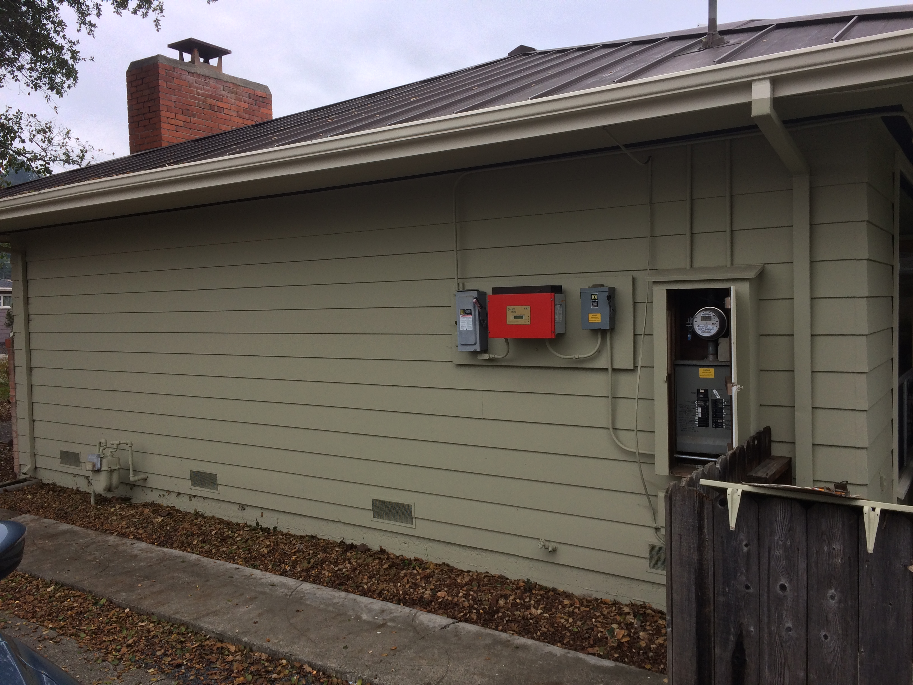
Close battery location
Best place for shortest cables, but only 2’ between house and walkway, and in full summer SW sun that could heat the batteries up more and shorten their lifespan. Perhaps a canopy over the batteries, similar to what we put over the inverter, would work if this is enough space.

Slide 22
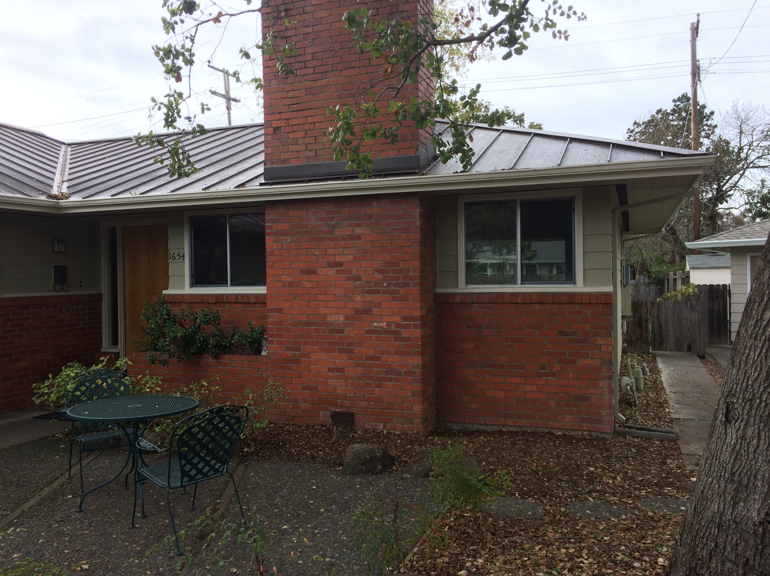
Alternate battery location #1
25’ NE of circuit breaker box, a long way away, but larger and very shady.

Slide 23
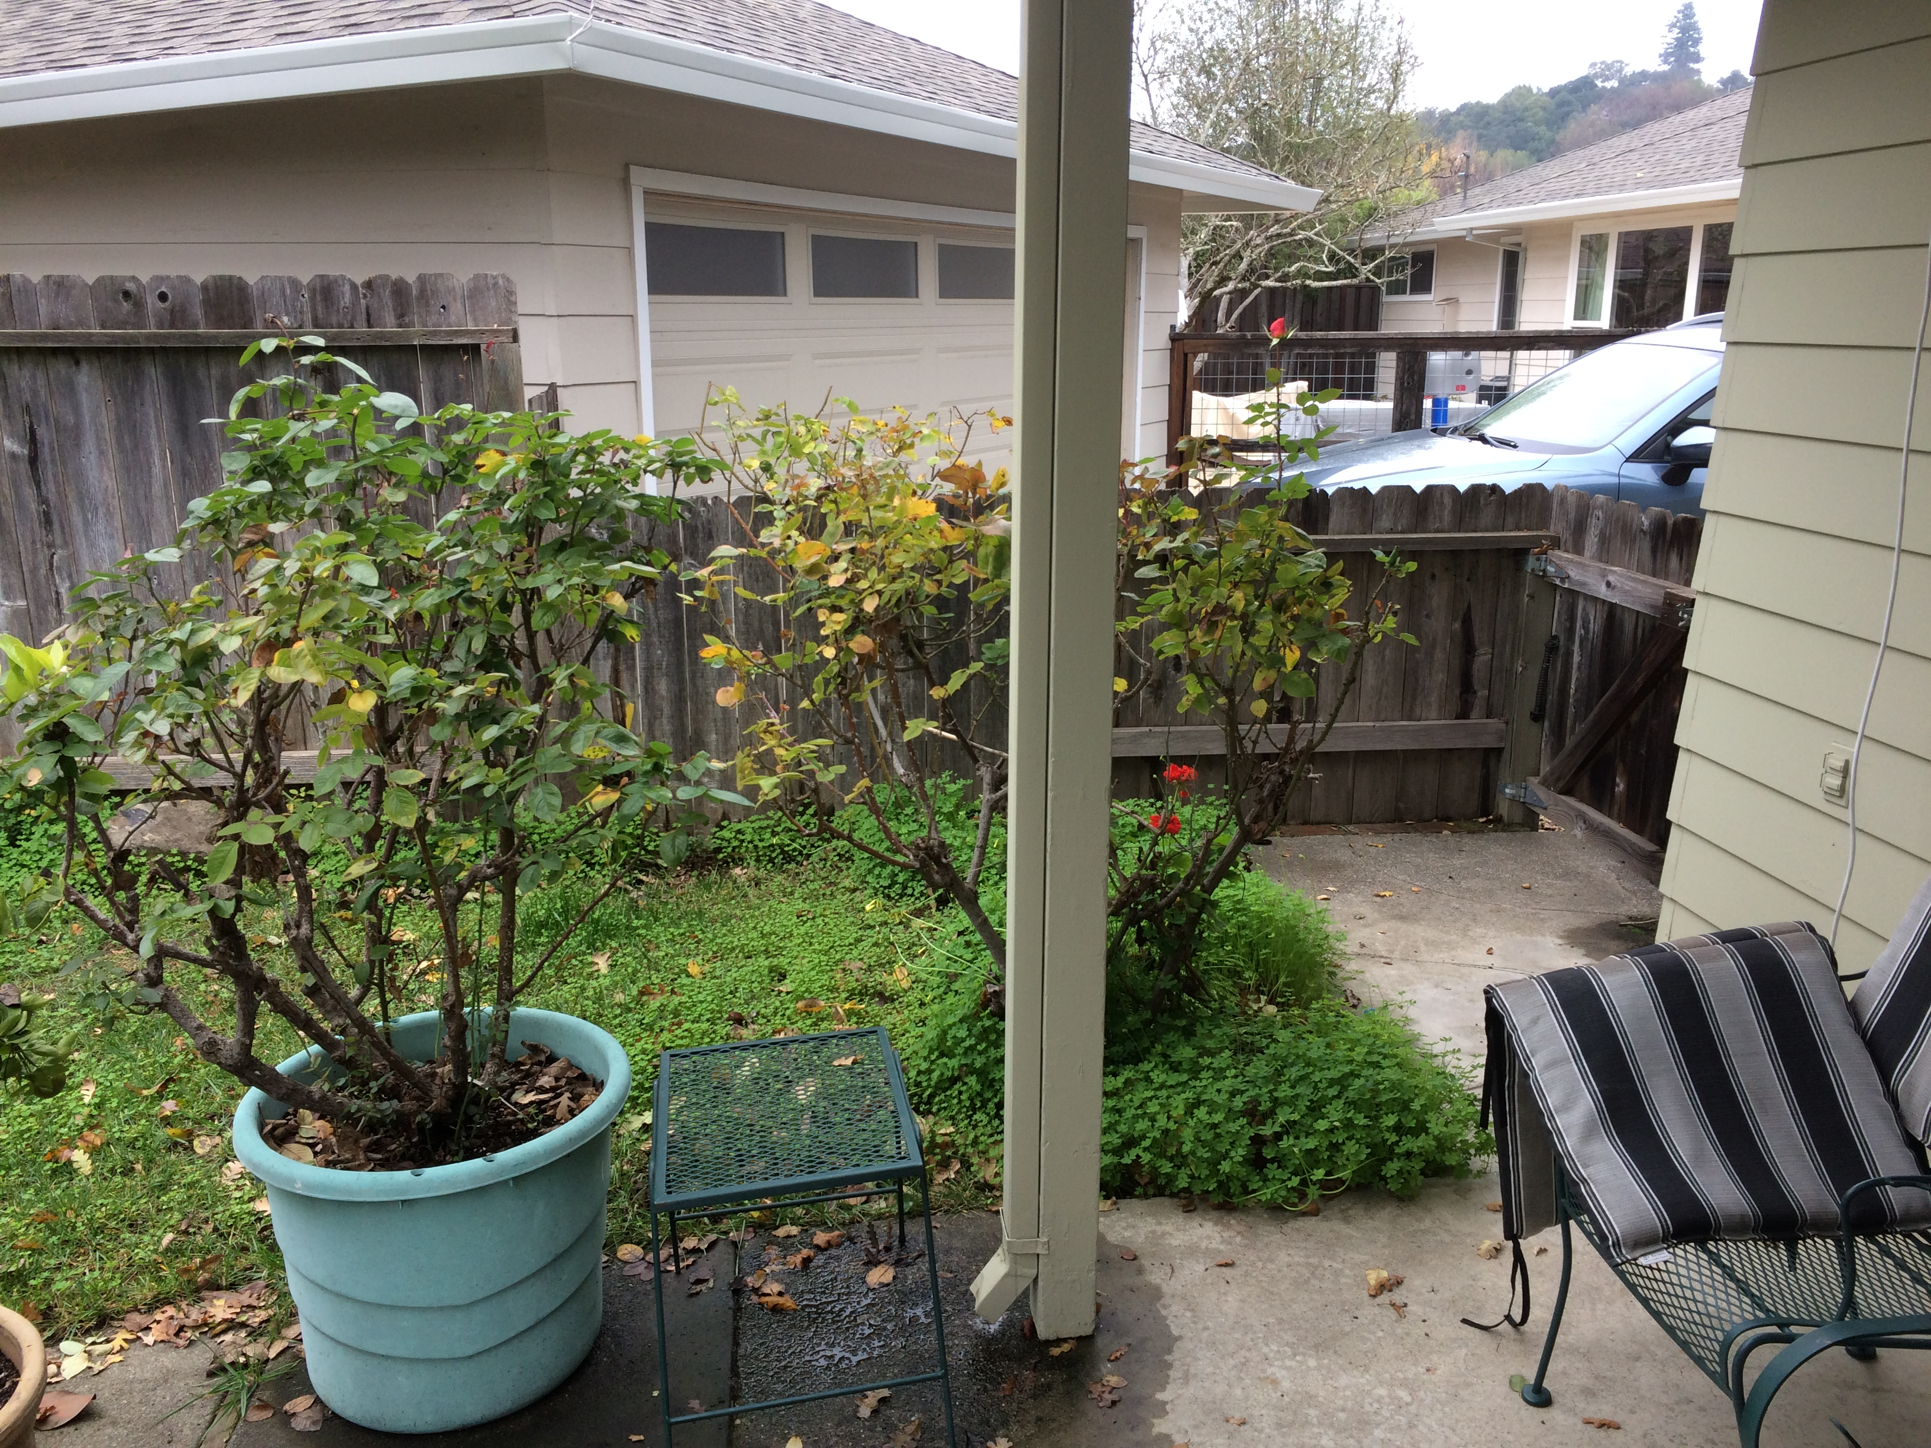
Alternate battery location #2
15’ SW of circuit breaker box, larger and more shady later on summer afternoons.

Slide 24
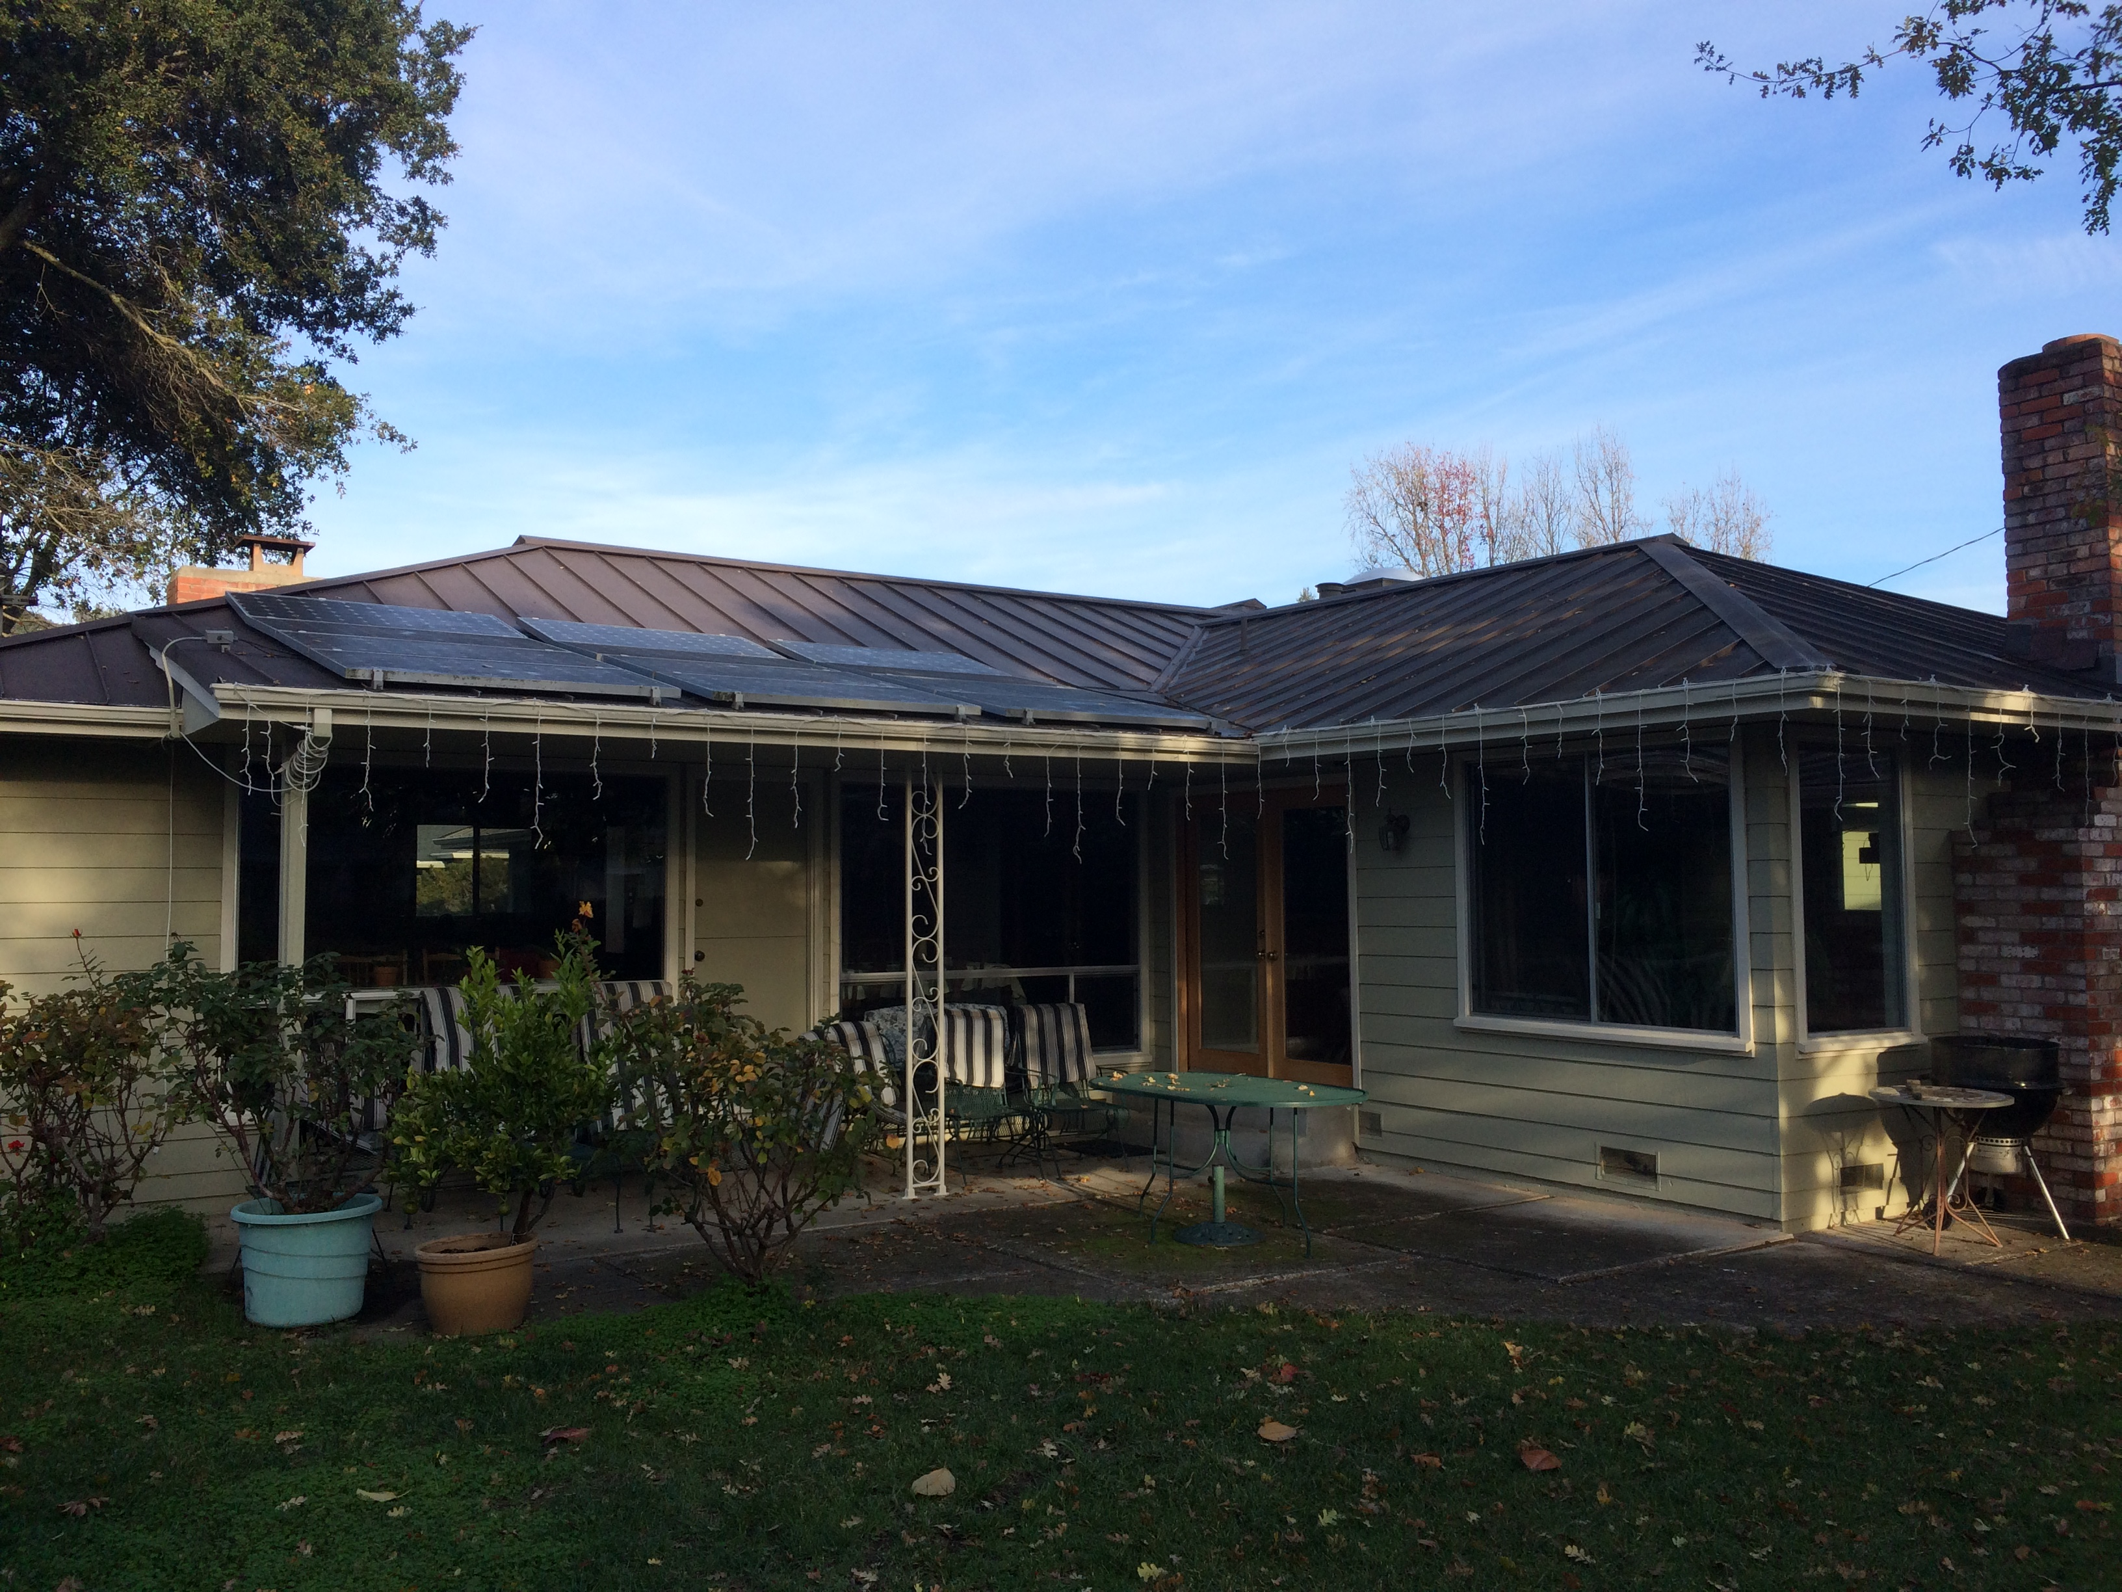
Old SW panel location
In shade at 3 PM on Dec 18 2021 due to tall Valley Oak that may be removed because it is growing in to the power lines, but area is small. Currently not functional; either inverter malfunction or roof rats chewing cables is expected. Want to continue to use panels since they are only 18 years old.

Slide 25
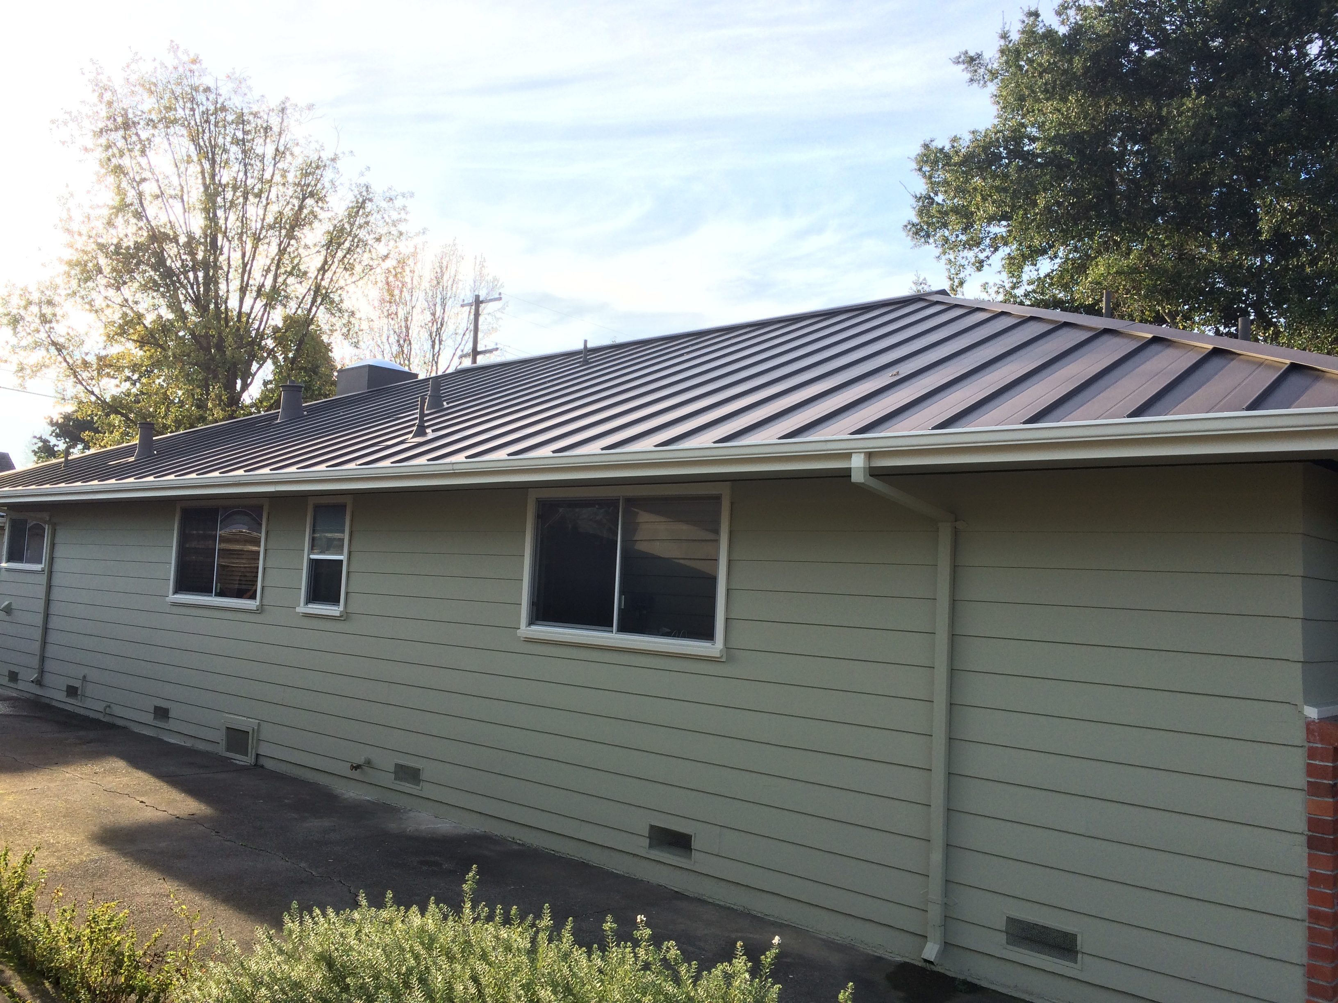
New SE panel location
In sun at 3 PM on Dec 18 2021, but facing ~90 degrees east of where the sun is setting on 5/12 pitch; have to place panels to avoid 6 vents, although 2 natural gas vents could be removed after conversion to heat pump.

Slide 26
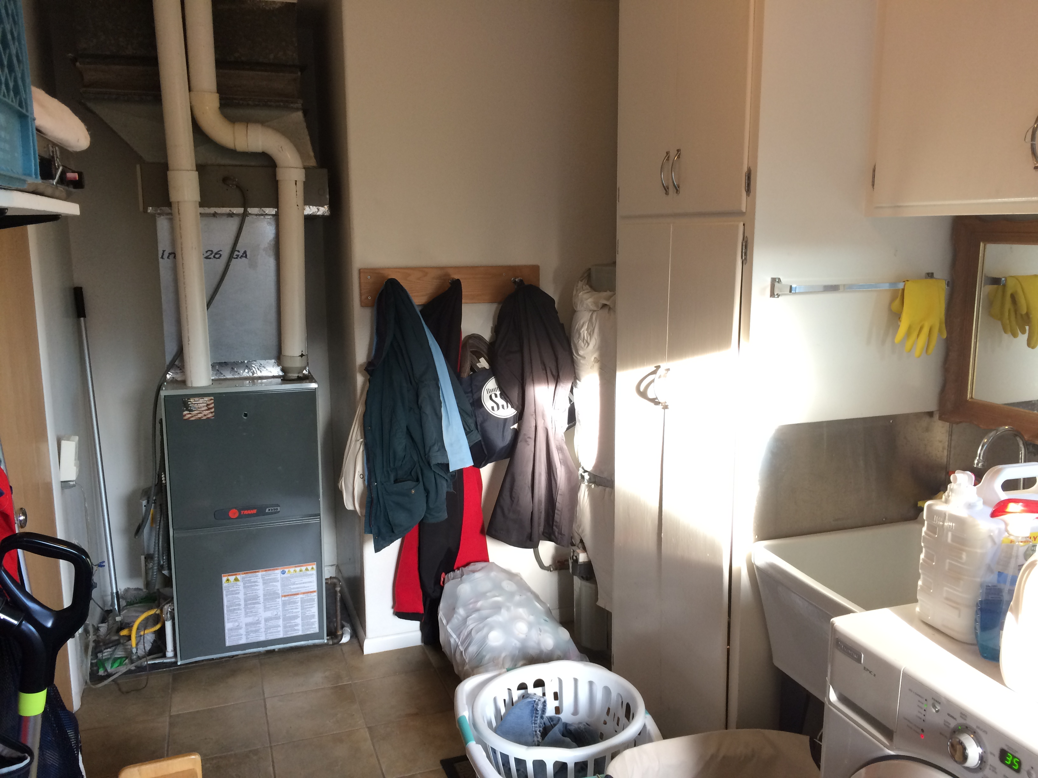
Laundry room
Has ~8 year old Trane XV95 5 ton furnace with Honeywell electric air filter system, and a hot water heater that is older than 20 years ago when we moved in.

Slide 27
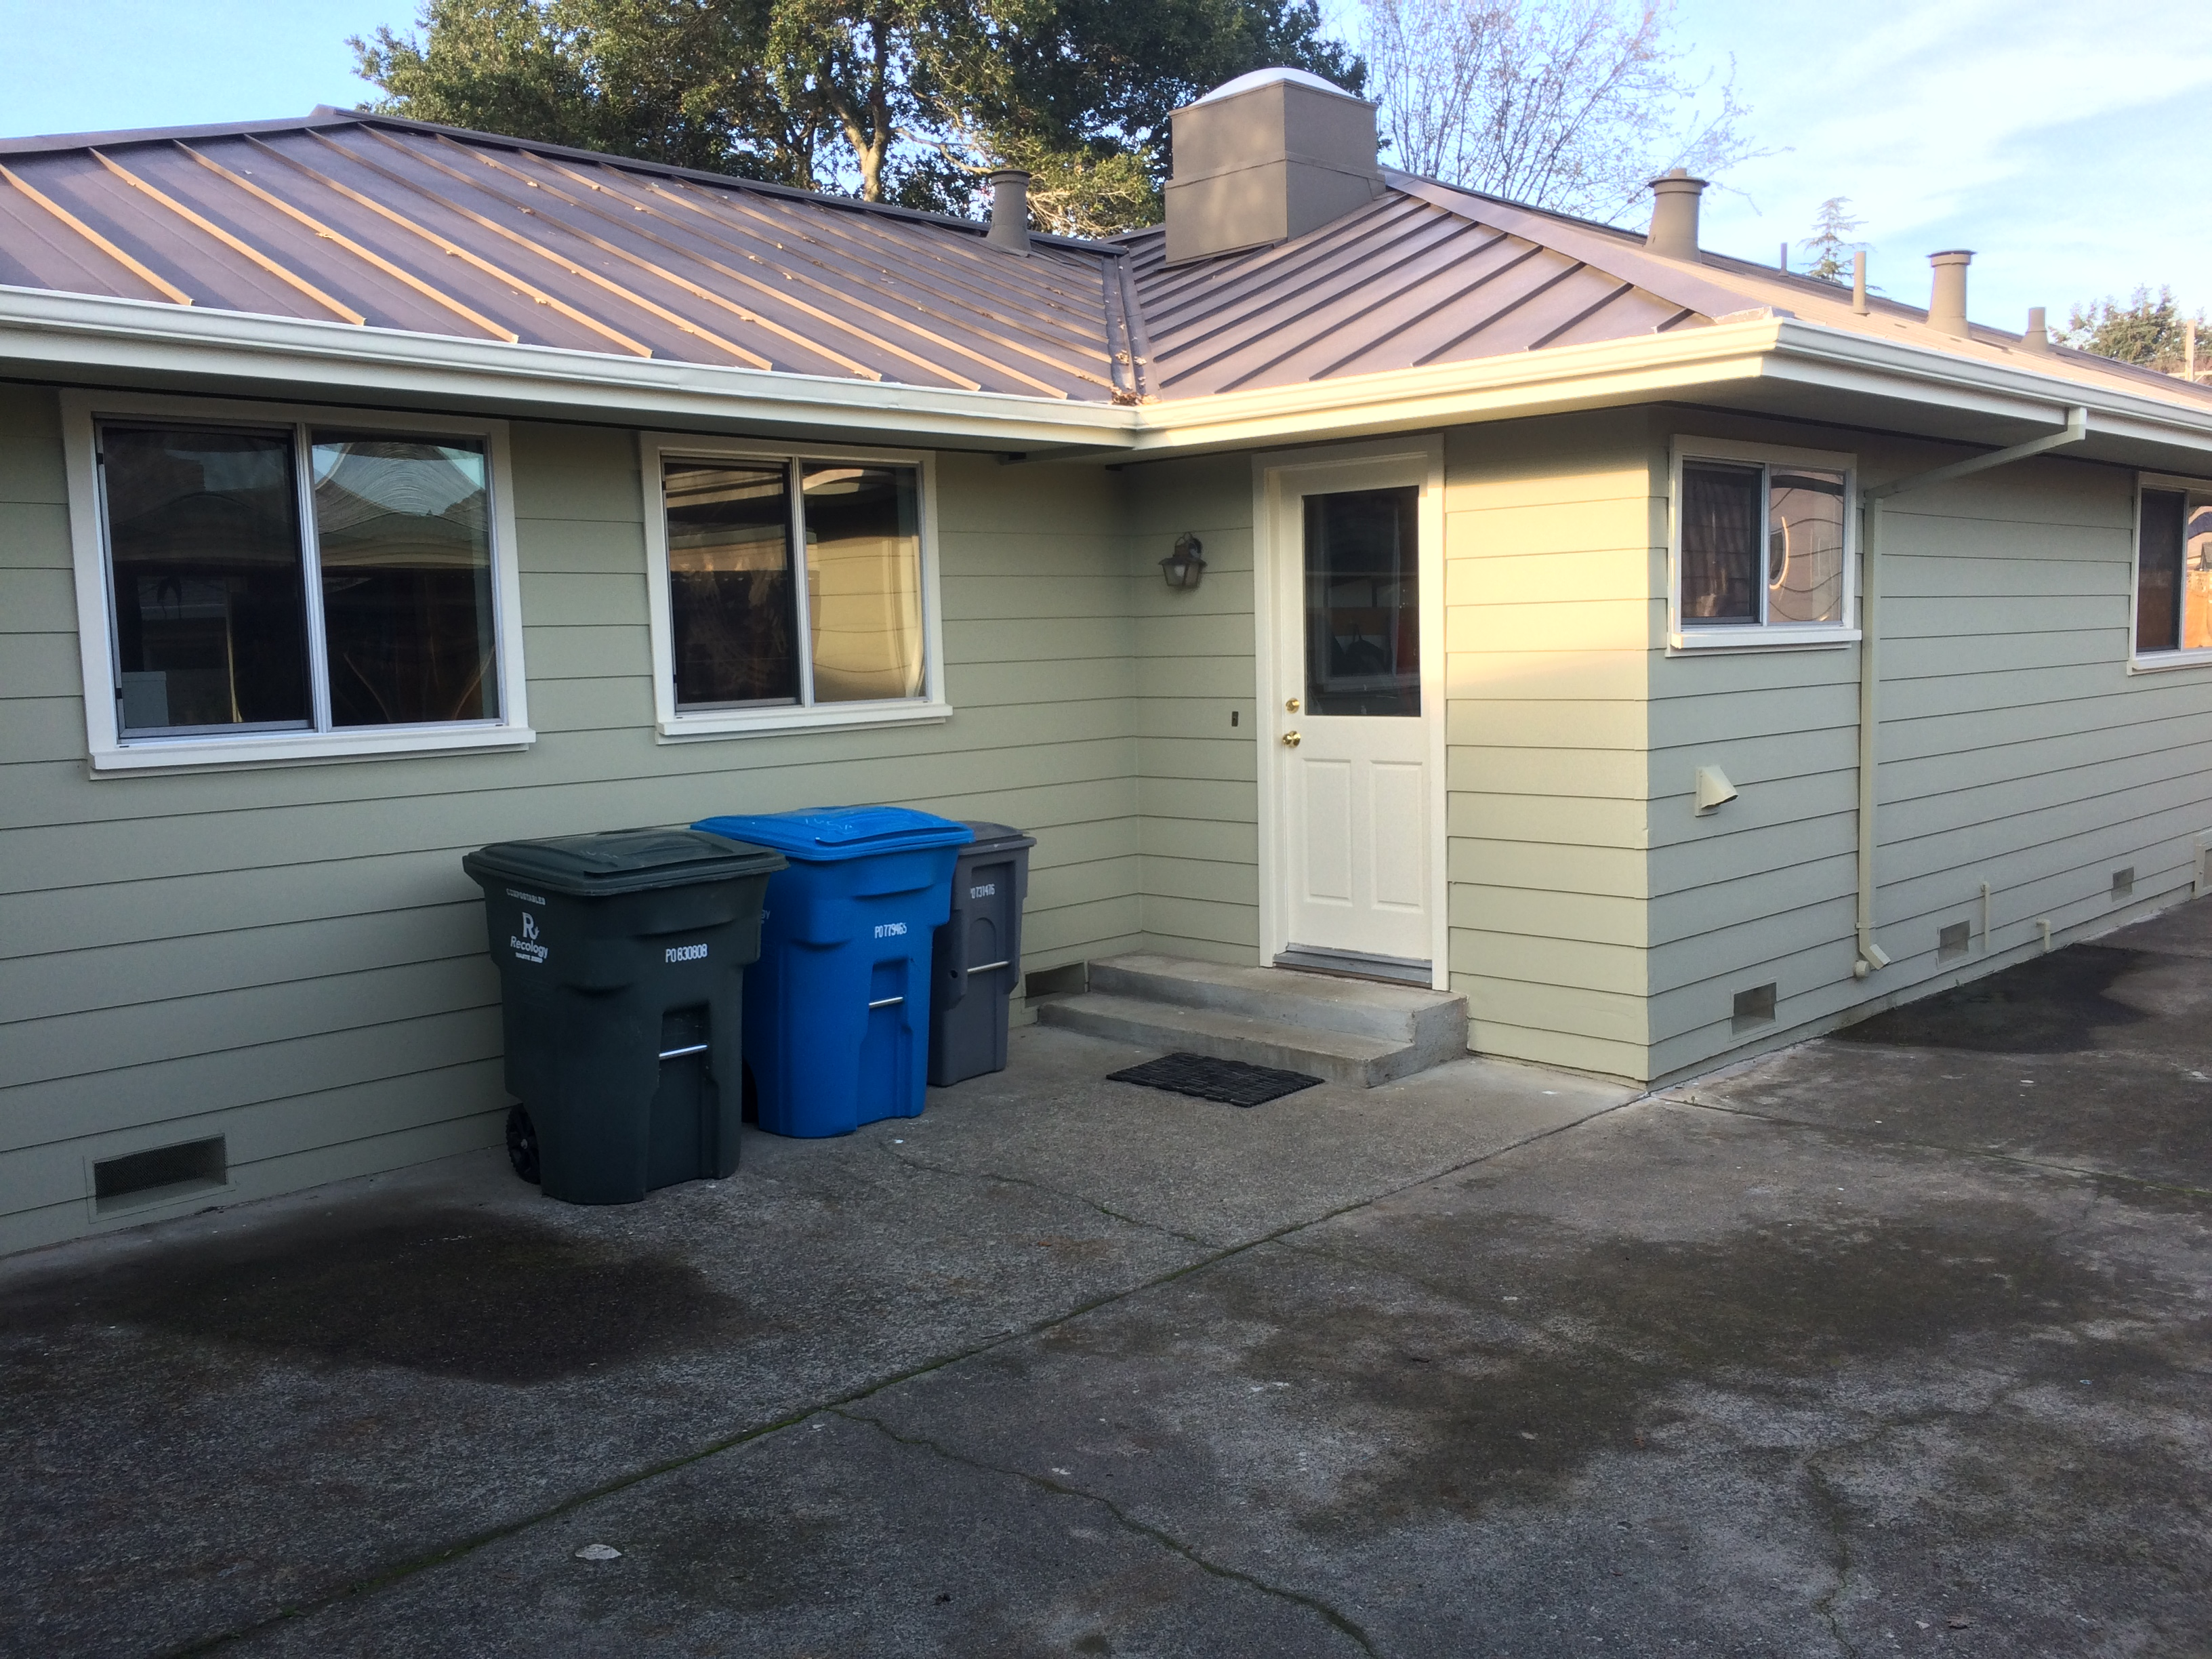
Close heat pump location
It won’t fit on the driveway to the right of the back door, but it could be put with the garbage cans if it’s not too big, starting about 15 feet from the ducts. But it could get in the way here, and it could be noisy.

Slide 28
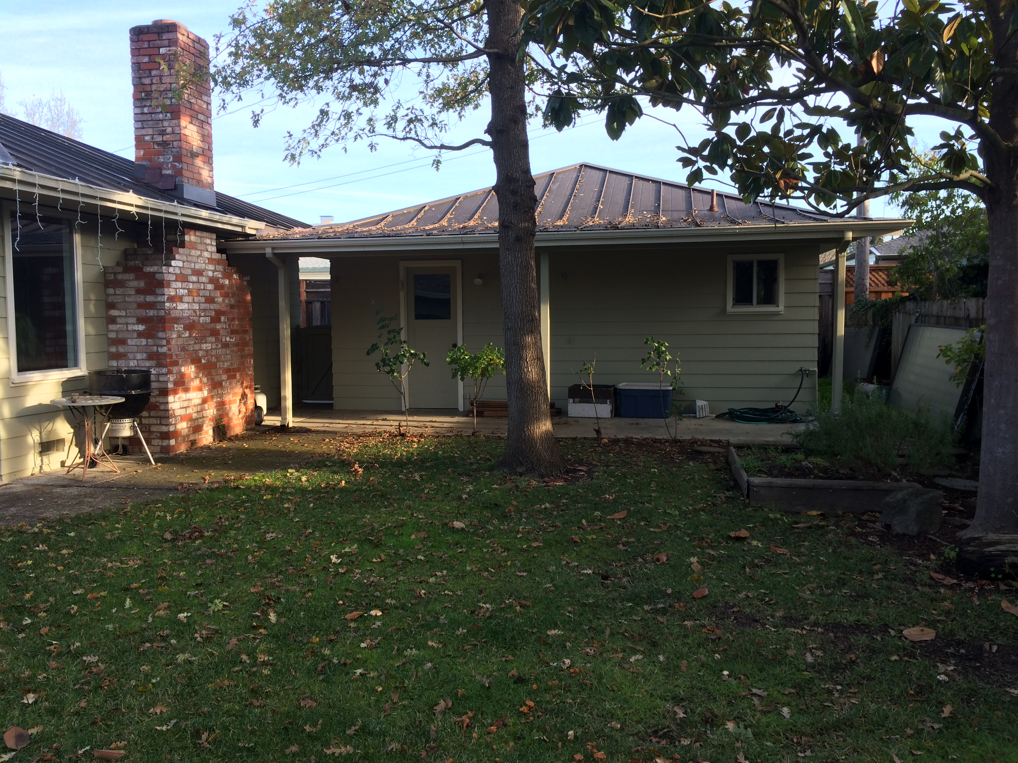
Alternate heat pump location
The back lawn is about 37’ from the ducts if more room is needed and it’s not too far to keep the hot water hot.

Slide 29
To Do
Item no. | Description
1 | Estimate everything else power. Add pie chart of power loads.
2 | Get answers to all yellow highlighted questions.
3 | Add battery alternatives and comparison.
4 | Redo page 7, 11 too wordy, add bullets, break out in to separate pages, go to summary/backup slide format.
5 | Explain that replacement at warranty is aggressive but labor not added yet.
6 | Add NiFe scenario, noting risk of unpopular product but advantage of lifetime.
7 | Create scenario result graphs of adding every 1 battery, every 1 panel, and both to show knee of curve.

