Slide 1
Jones Family Solar Expansion Project
Santa Rosa, CA January 5, 2023
Section | Title | Page
1 | Goals | 2
2 | System Block Diagram | 3
3 | Part List | 4
4 | Layout | 6
5 | Wiring Diagram
6 | Performance Estimate
7 | Return on Investment include used EV battery comparison
8 | Part Selection
9 | Winter Shade Analysis

Slide 2
Goals
Minimize grid use in order to:
Reduce toxic and greenhouse gas emissions being generated by the grid
Reduce power generation and delivery strain on the grid
Increase energy independence for monetary and national security reasons
Do not significantly disrupt our current lifestyle.
Do not significantly increase our ongoing home ownership cost.
Purchase equipment that is safe, reliable and repairable, with long lasting warranties and local repair and replacement support.
Maximize US made content whenever available with competitive prices and performance.

Slide 3
System Block Diagram
Sun
Grid
meter
240V:
Air and water heat pump w/ soft start
Level 2 EV charger
Resistive heat clothes dryer
Double convection oven
Stove
120V:
Level 1 EV charger
Clothes washer
Dishwasher
Lighting
Kitchen appliances
Garage tools
Electronics
Everything else
Load circuit breakers
PV Panels
Grid circuit breaker
Inverter/
Charger
Transfer switch
Batteries w/ BMS
Service panel

Slide 4
Parts List - Power
Inverter/Charger: Sol-Ark 15K
Manufacturer’s HQ design test and service center in Plano, TX: https://www.sol-ark.com/sol-ark-15k-all-in-one/
EcoDirect distributor in Carlsbad CA, $8,250: https://www.ecodirect.com/Sol-Ark-SA-Limitless-15K-Hybrid-Inverter-p/sol-ark-15k.htm
Specifications: 3 integrated 500V max MPPTs with up to 2 parallel PV strings, 13.2 kW 275A 48V continuous AC or DC battery charger, 12 kW 50A 240V split phase AC continuous output to loads. Manufacturer supports both DIY and pro installers.
PV panels: 26 Mission Solar MSE345SX5Ts
Manufacturer’s HQ and module assembly in San Antonio, TX: https://www.missionsolar.com/wp-content/uploads/2021/07/C-SA2-MKTG-0025-Data-Sheet-for-SX5T.pdf
EcoDirect distributor in Carlsbad CA, pallet of 26 for $7,550 equivalent to $290 each: https://www.ecodirect.com/Mission-Solar-345W-Pallet-of-26-Solar-Panels-p/mission-solar-mse345sx5t-pllt.htm
Specifications: 345 Watts, 41.0 Volts open circuit, 25 year warranty down to 84% capacity, 68.8” L x 41.5” W x 1.6” D, 45 lb.
Batteries with BMS: 11 Simpliphi Power PHI-3.8-M-48s (alternative are used EV batteries with home made CANBus BMS)
Manufacturer based in Oxnard CA, https://simpliphipower.com/wp-content/uploads/documentation/phi-3-8-m/simpliphi-power-phi-3-8-m-specification-sheet.pdf .
EcoDirect sells something similar for $2,450 each, $26,950 total: https://www.ecodirect.com/SimpliPhi-PHI-3-8-48-60-48V-75-AH-LFP-Battery-p/simpliphi-phi-3.8-battery-48v.htm
Specifications: 48V 75 Ah, 3.6 kWh, integrated BMS, 15.5” H x 13.6” W x 8” D, 86 lb, 80A max discharge, 37.5A continuous charge/discharge, 10 year warranty, 10K cycles to 100% DOD.
PV panel to standing seam metal roof attachments: S5! S-5-S system, https://s-5.com/products/s-5-s-clamps/
Power wires, boxes, conduit and service panel upgrade TBD
Total cost $42,750 less any used batteries that are employed.

Slide 5
Parts List - Heating
Air exchange hot water output heat pump: Chiltrix CX-34, Chesapeake, VA
Manufacturer’s website https://www.chiltrix.com/small-chiller-home.html
3 ton heat, 5 year warranty, 20 year design life, $4,889.
Variable speed hydronic ducted air handler fan coil unit: Chiltrix First Co. 16VMB, Dallas, TX
Manufacturer’s website: https://www.chiltrix.com/hydronic-air-handler/ducted-hydronic-FCU.html
2.7 to 3.7 ton, $3,402.
Domestic water heater tank with thermal solar and hot water heat pump exchangers: Chiltrix DHW80, Chesapeake, VA
Manufacturer’s website: https://www.chiltrix.com/heat-exchanger-tanks/
70 gallons, 23.6” diameter x 64” H, $2,299.
3-way valve: Chiltrix DHW G1 find datasheet
Use online Manual J report and then efficiency calculator, then contact Chiltrix for installer/service/DIY questions: https://www.chiltrix.com/air-to-water/
Total cost $10,590

Slide 6
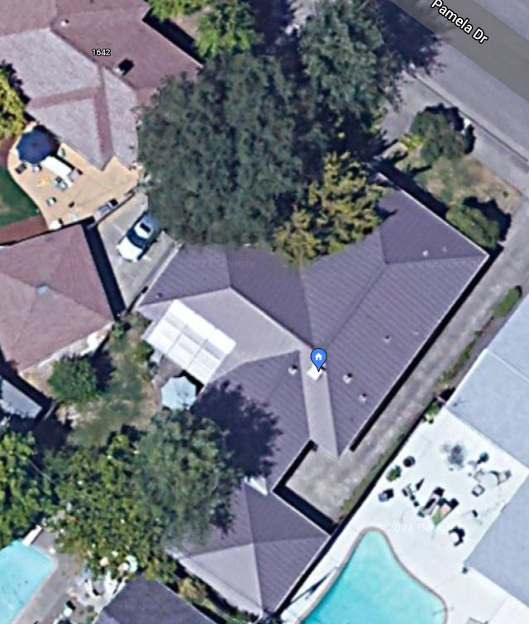
Layout – Overhead View
Batteries w/BMS
Inverter/Charger
Service Panel
New Rightmost SE-facing PV array
Central ducted space heater
Water heater
Existing SW-facing PV array
Legend
Tall Valley Oak that causes most of the shade and is hitting the power lines that needs to be removed
Power delivery
New Middle SE-facing PV Array
Added electrical loads
Heat pump
Conduit
Level II EV charging station
Shade source
New Leftmost SE-facing PV Array
120V EV charging outlet

Slide 7
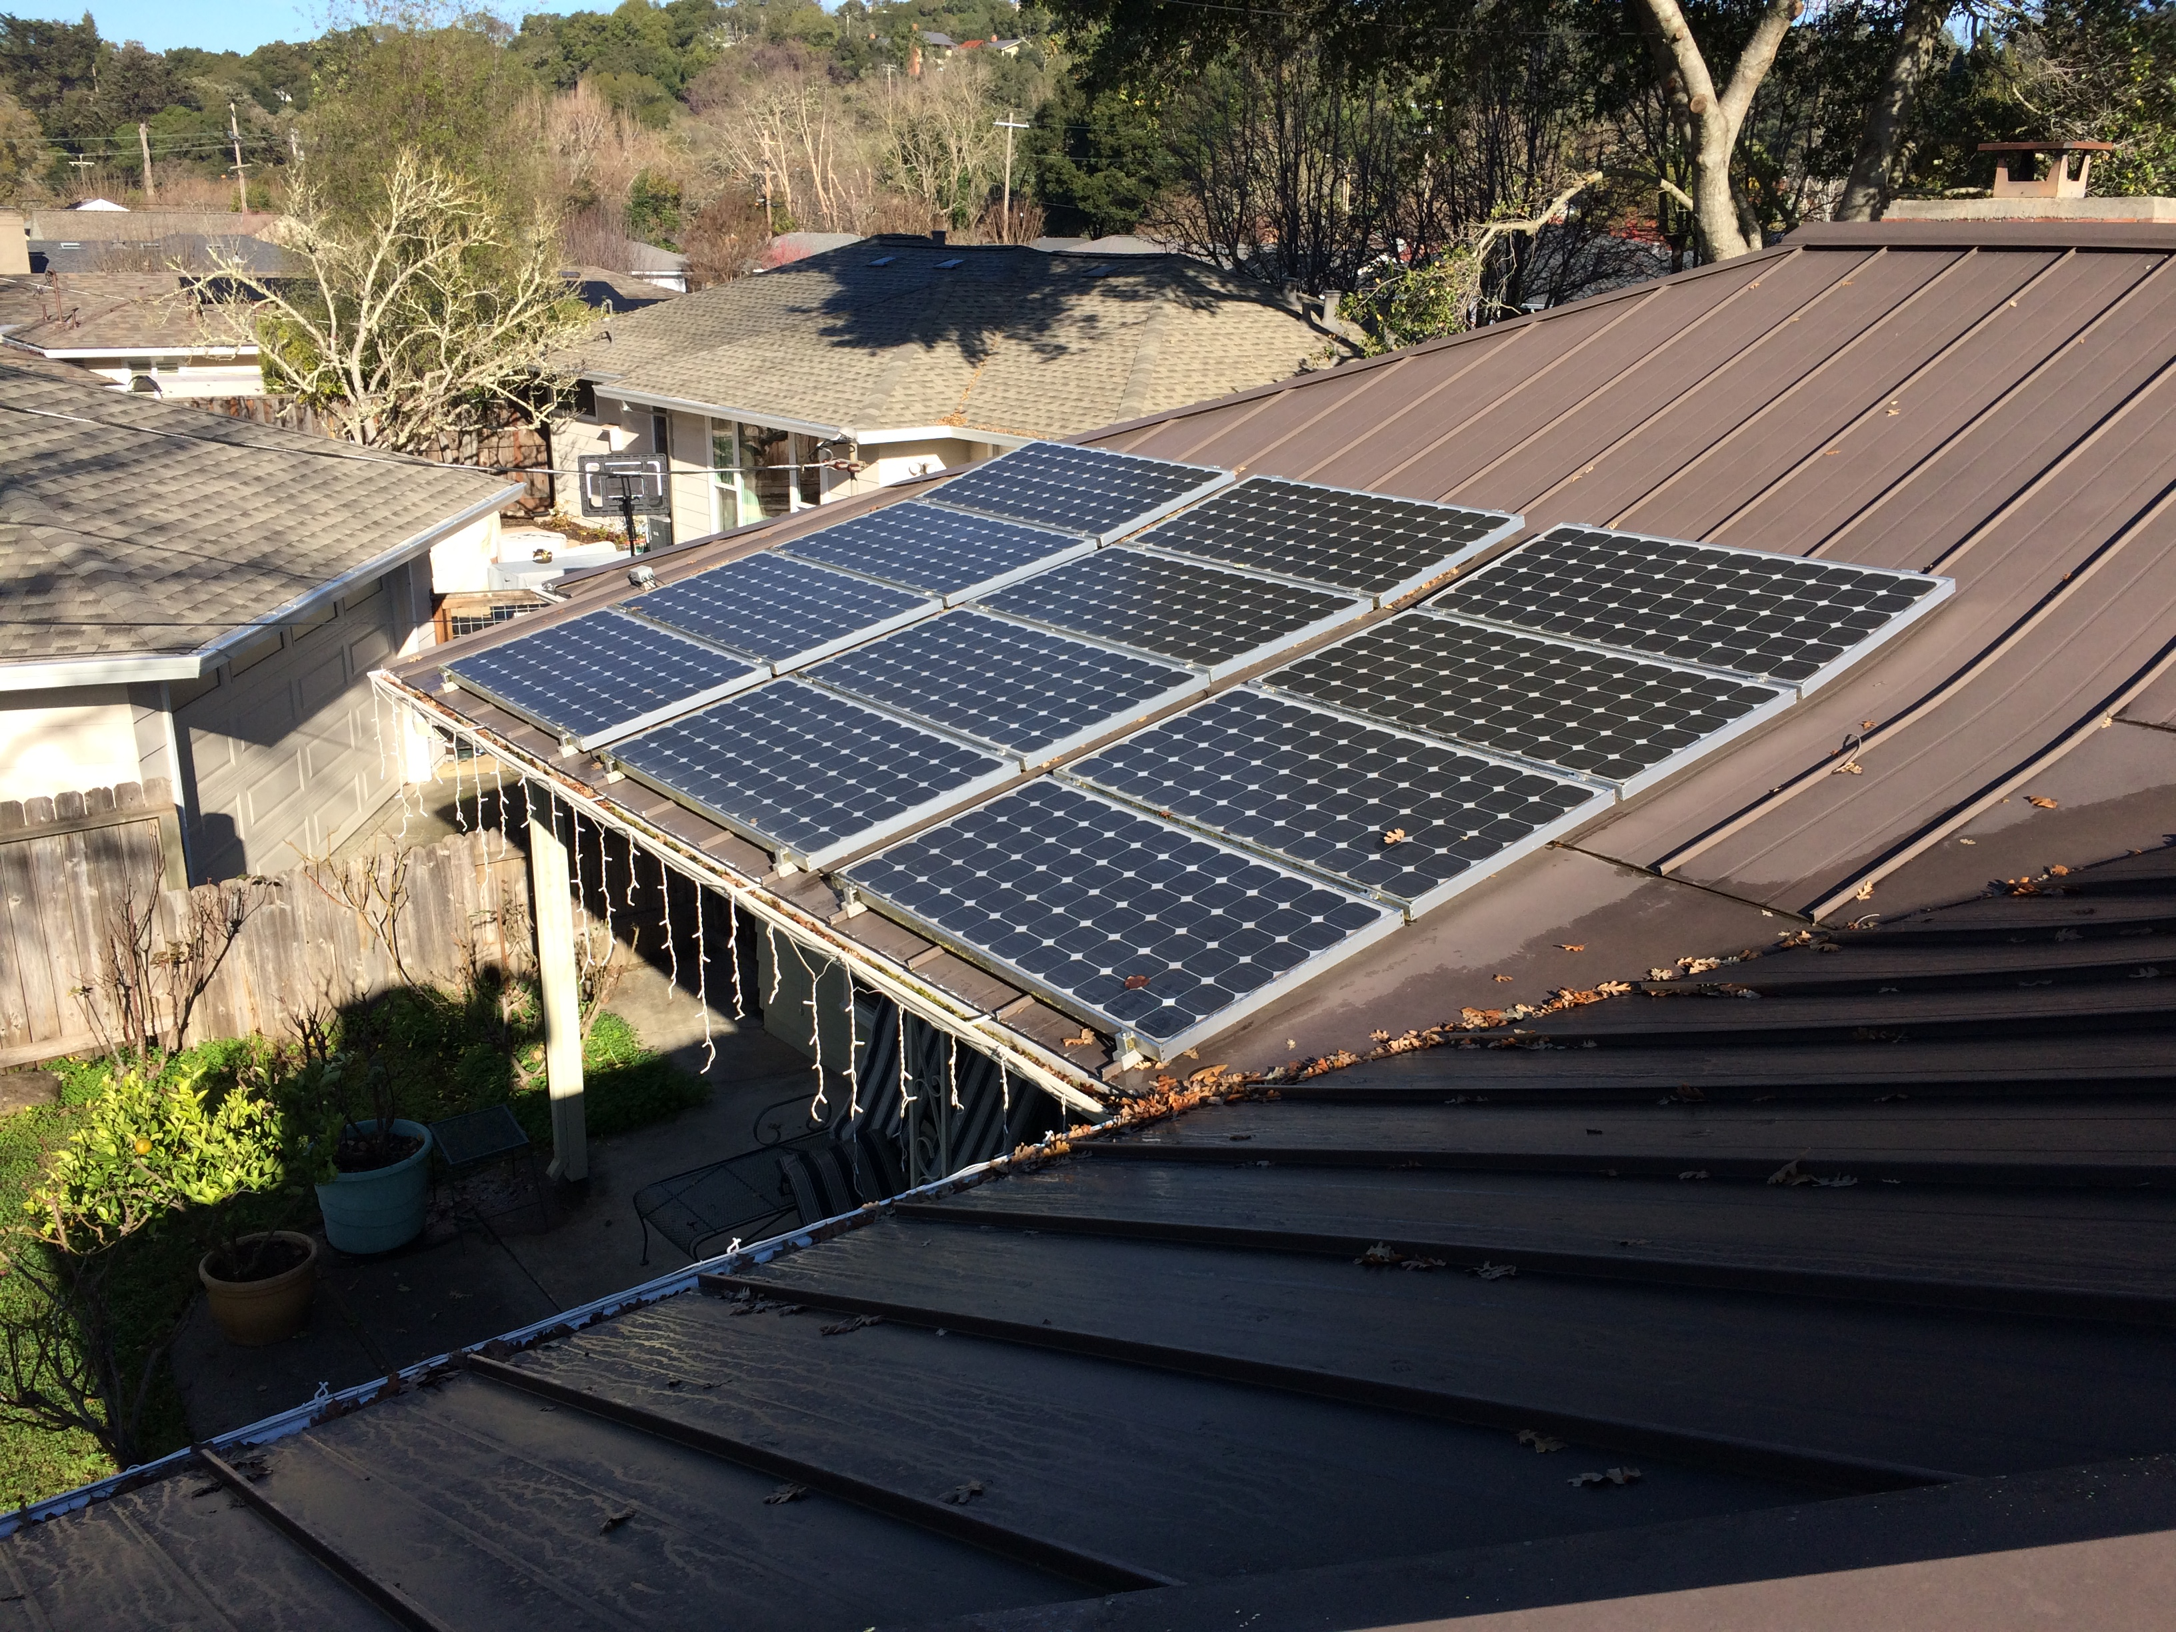
Existing SW-facing PV array over patio and great room,
10 AM
1/10/2022

Slide 8
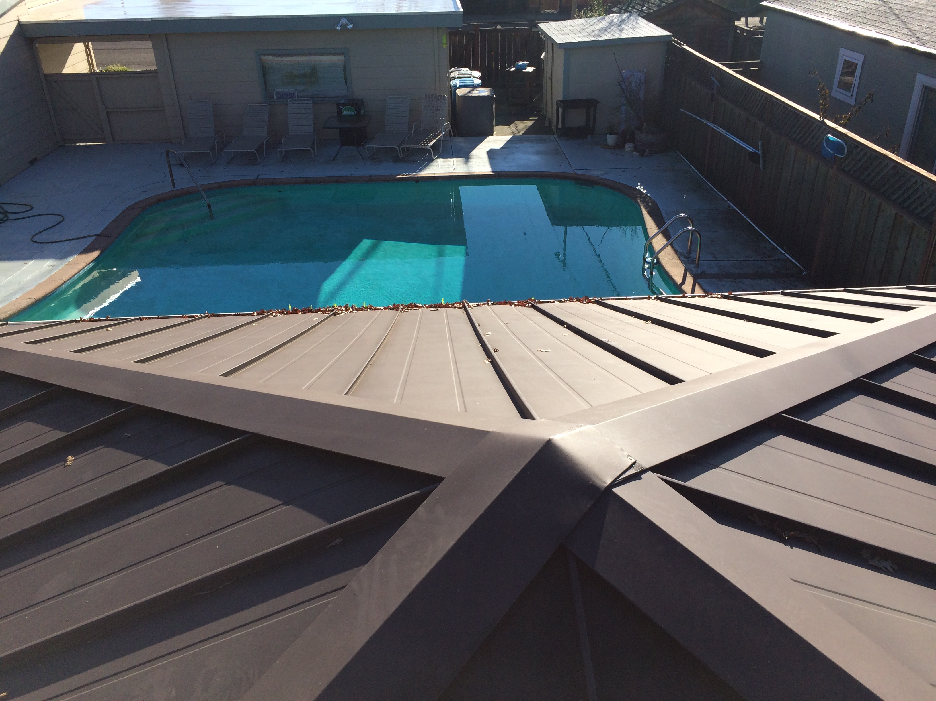
New Rightmost SE-facing PV array location over garage,
10 AM
1/10/2022

Slide 9
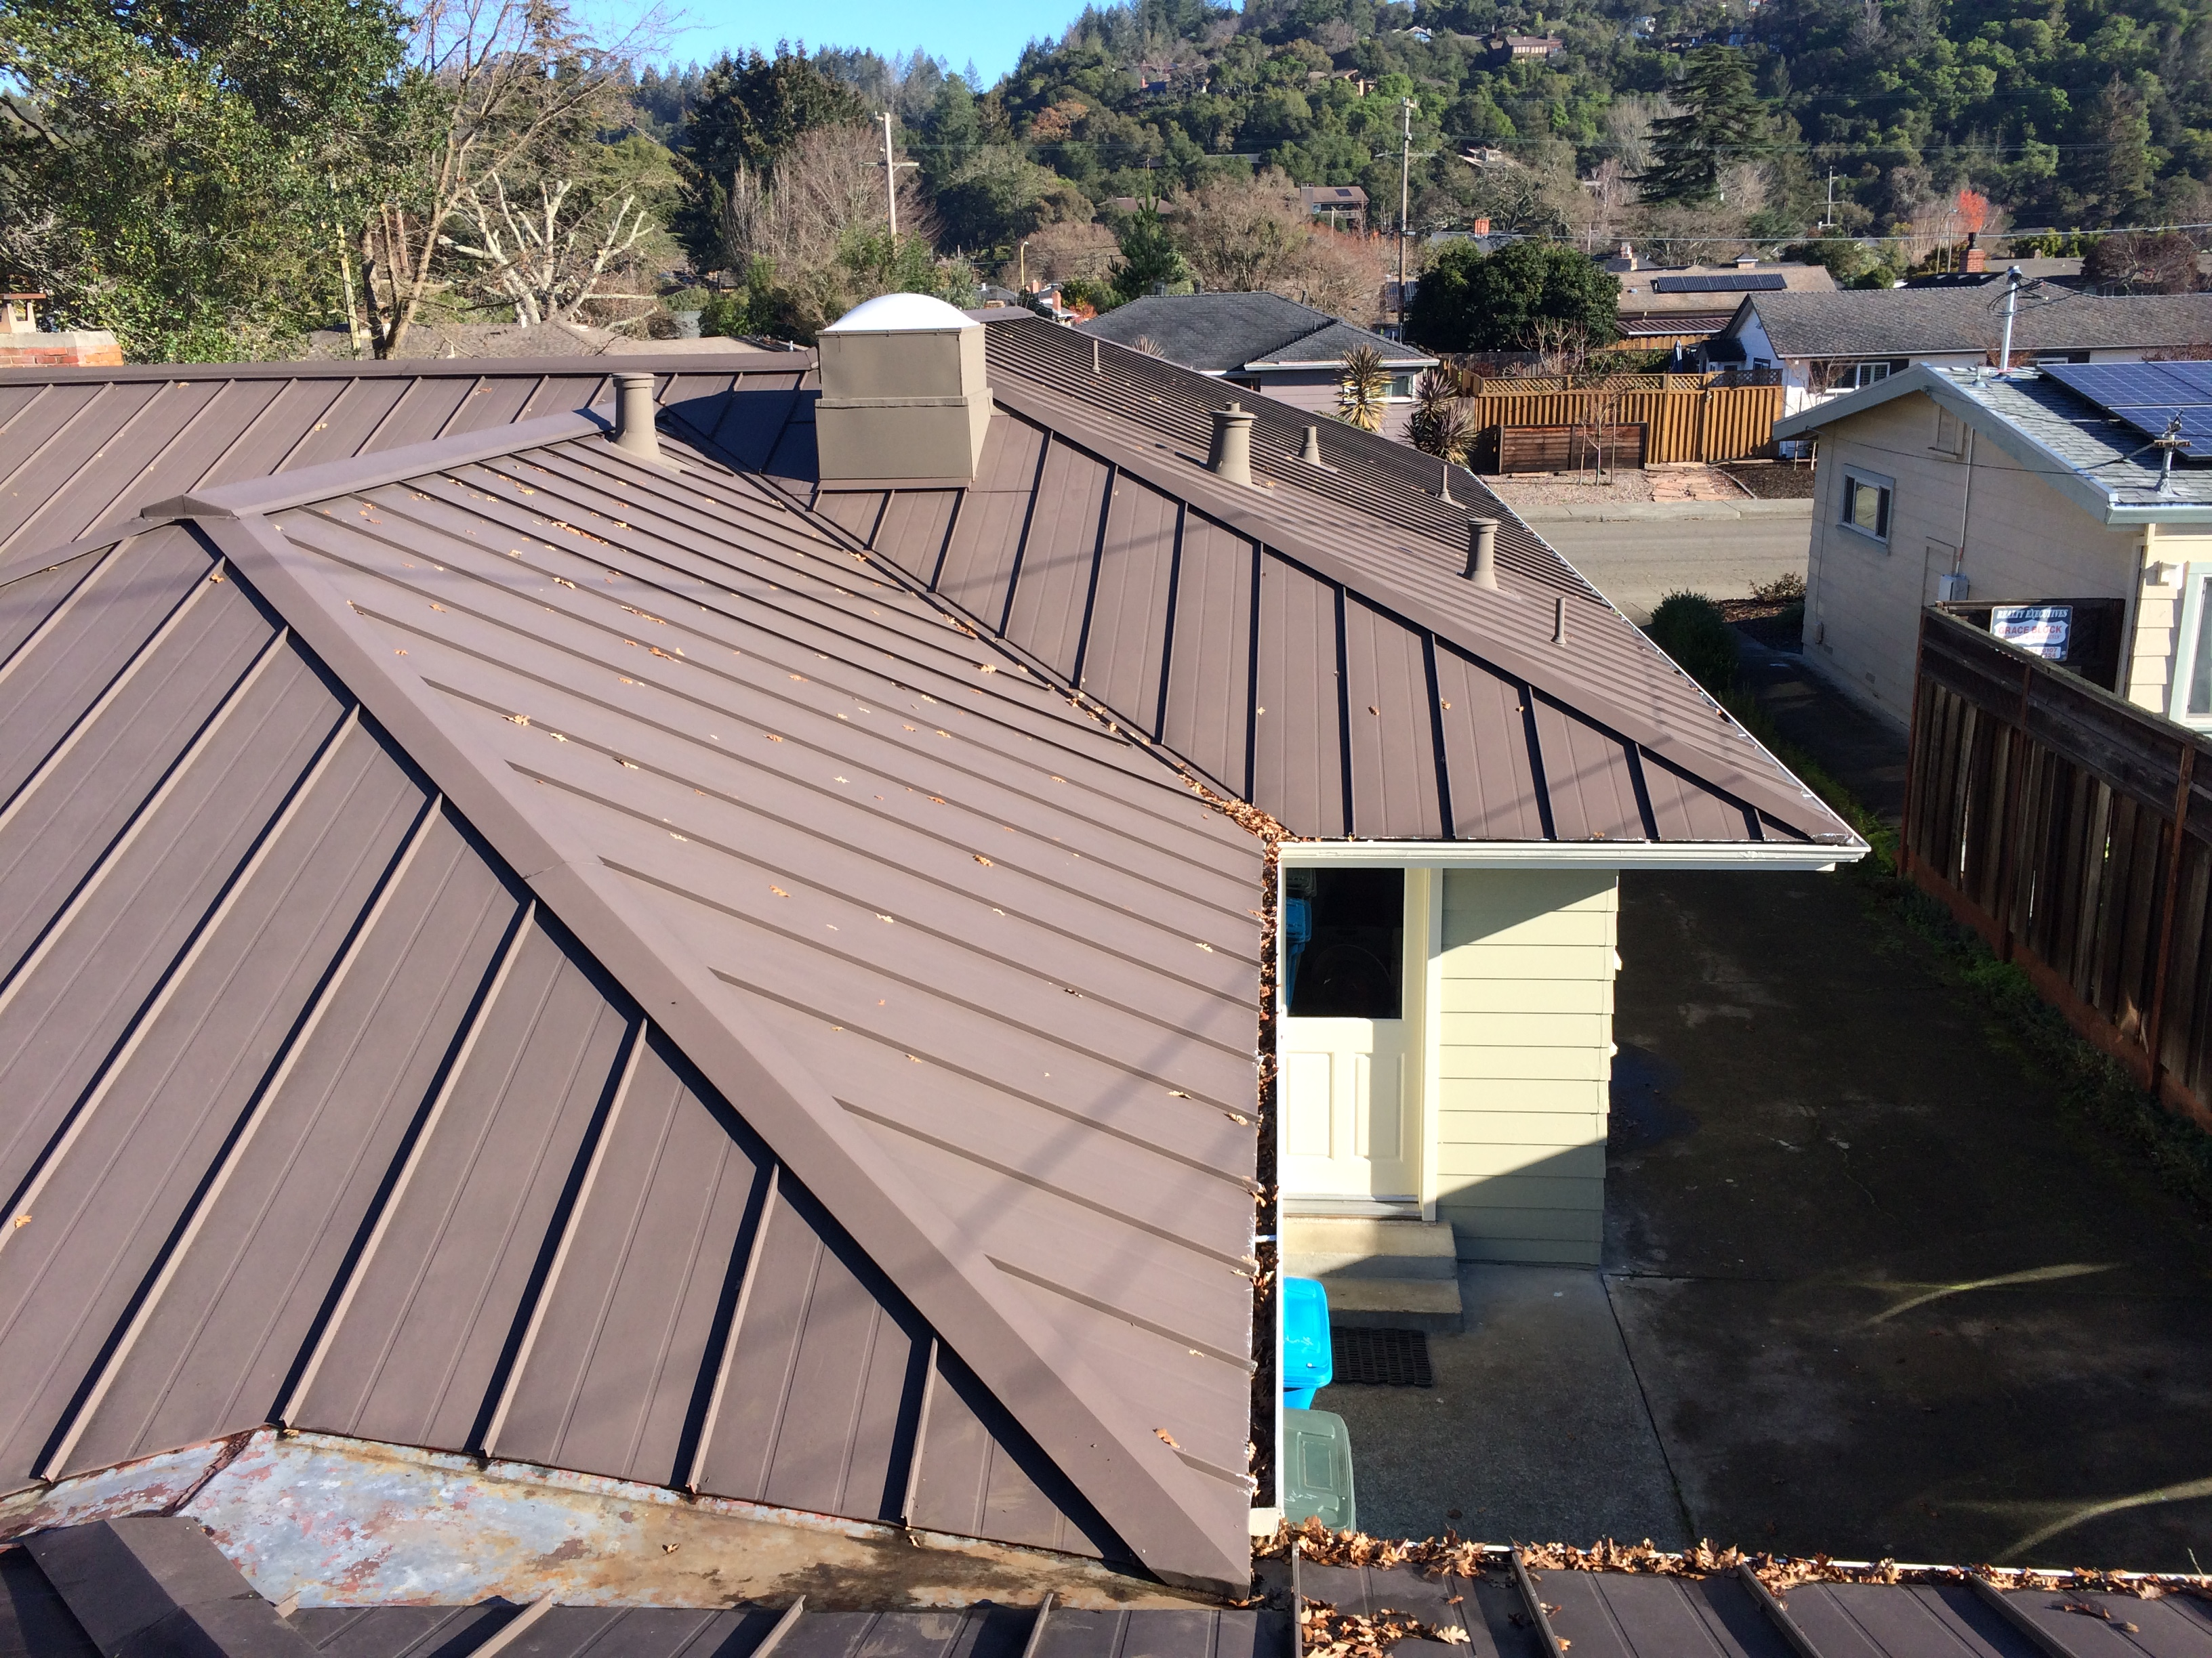
New Middle and Rightmost SE-facing PV array locations over family room and bedroom wing respectively,
10 AM
1/10/2022

Slide 10
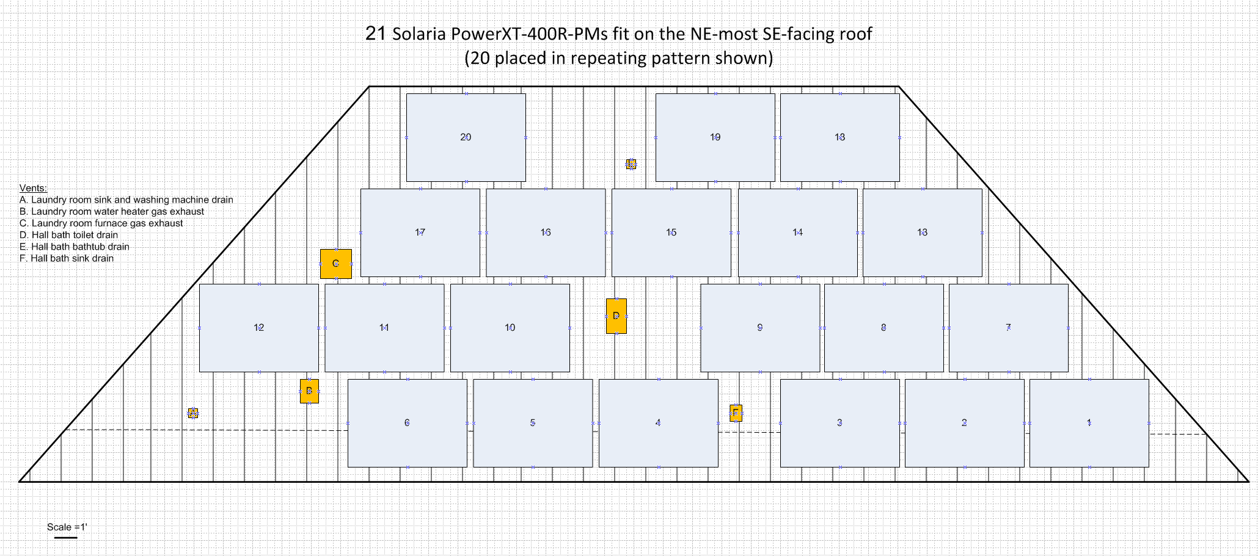

Slide 11
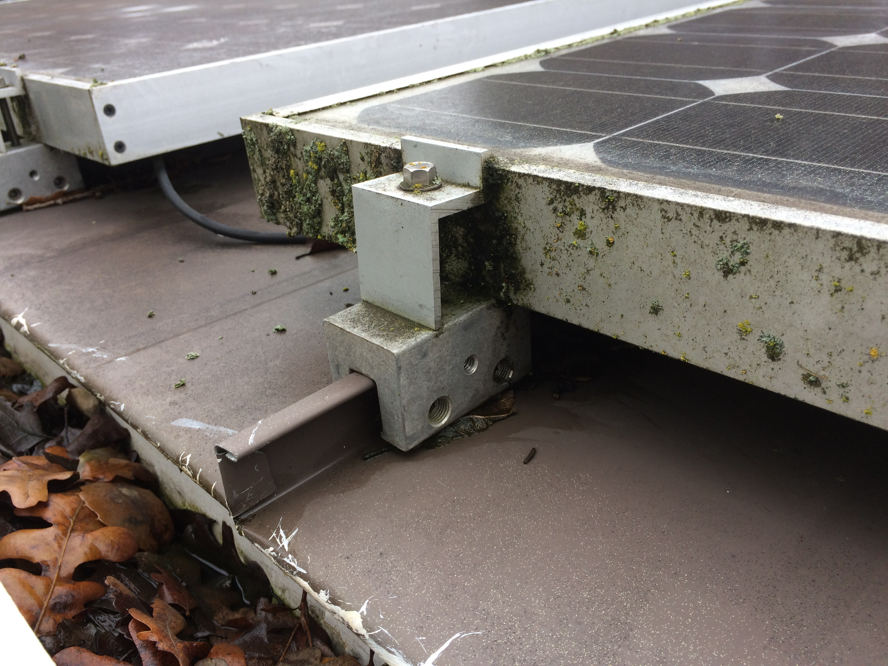
PV roof mount system
Standing seam metal roof installed ~2007, 1” high x ½” wide seam, 17.25” center-to-center
Current array on SW overhang with 2.5/12 pitch; SE side is 5/12
S5! S-5-S mounting system, 1” spacing on ends and between panels

Slide 12
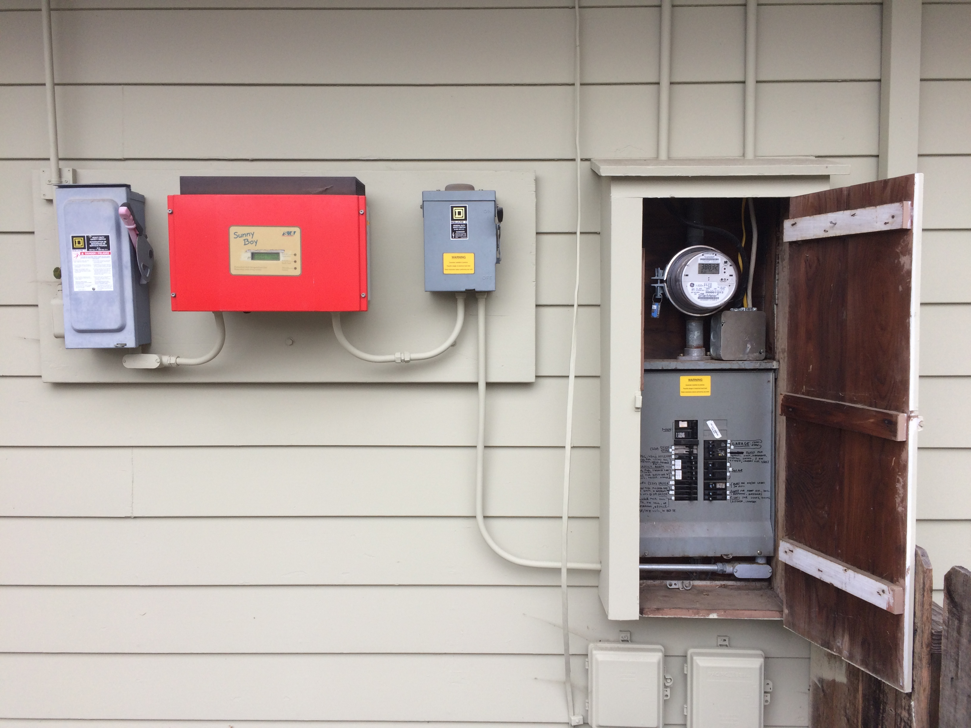
Pictures
Power feed

Slide 13
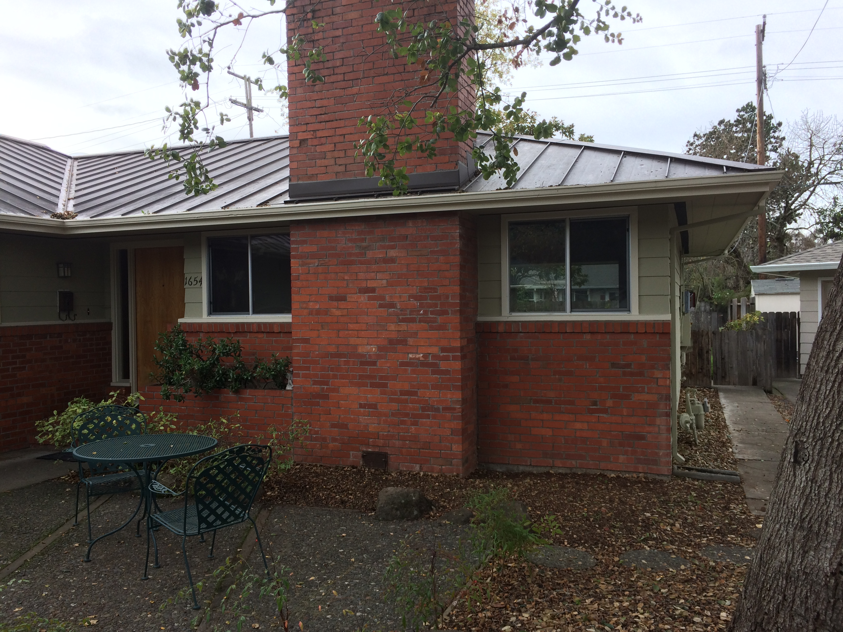
Alternate battery location #1
25’ NE of circuit breaker box, a long way away, but larger and very shady.

Slide 14
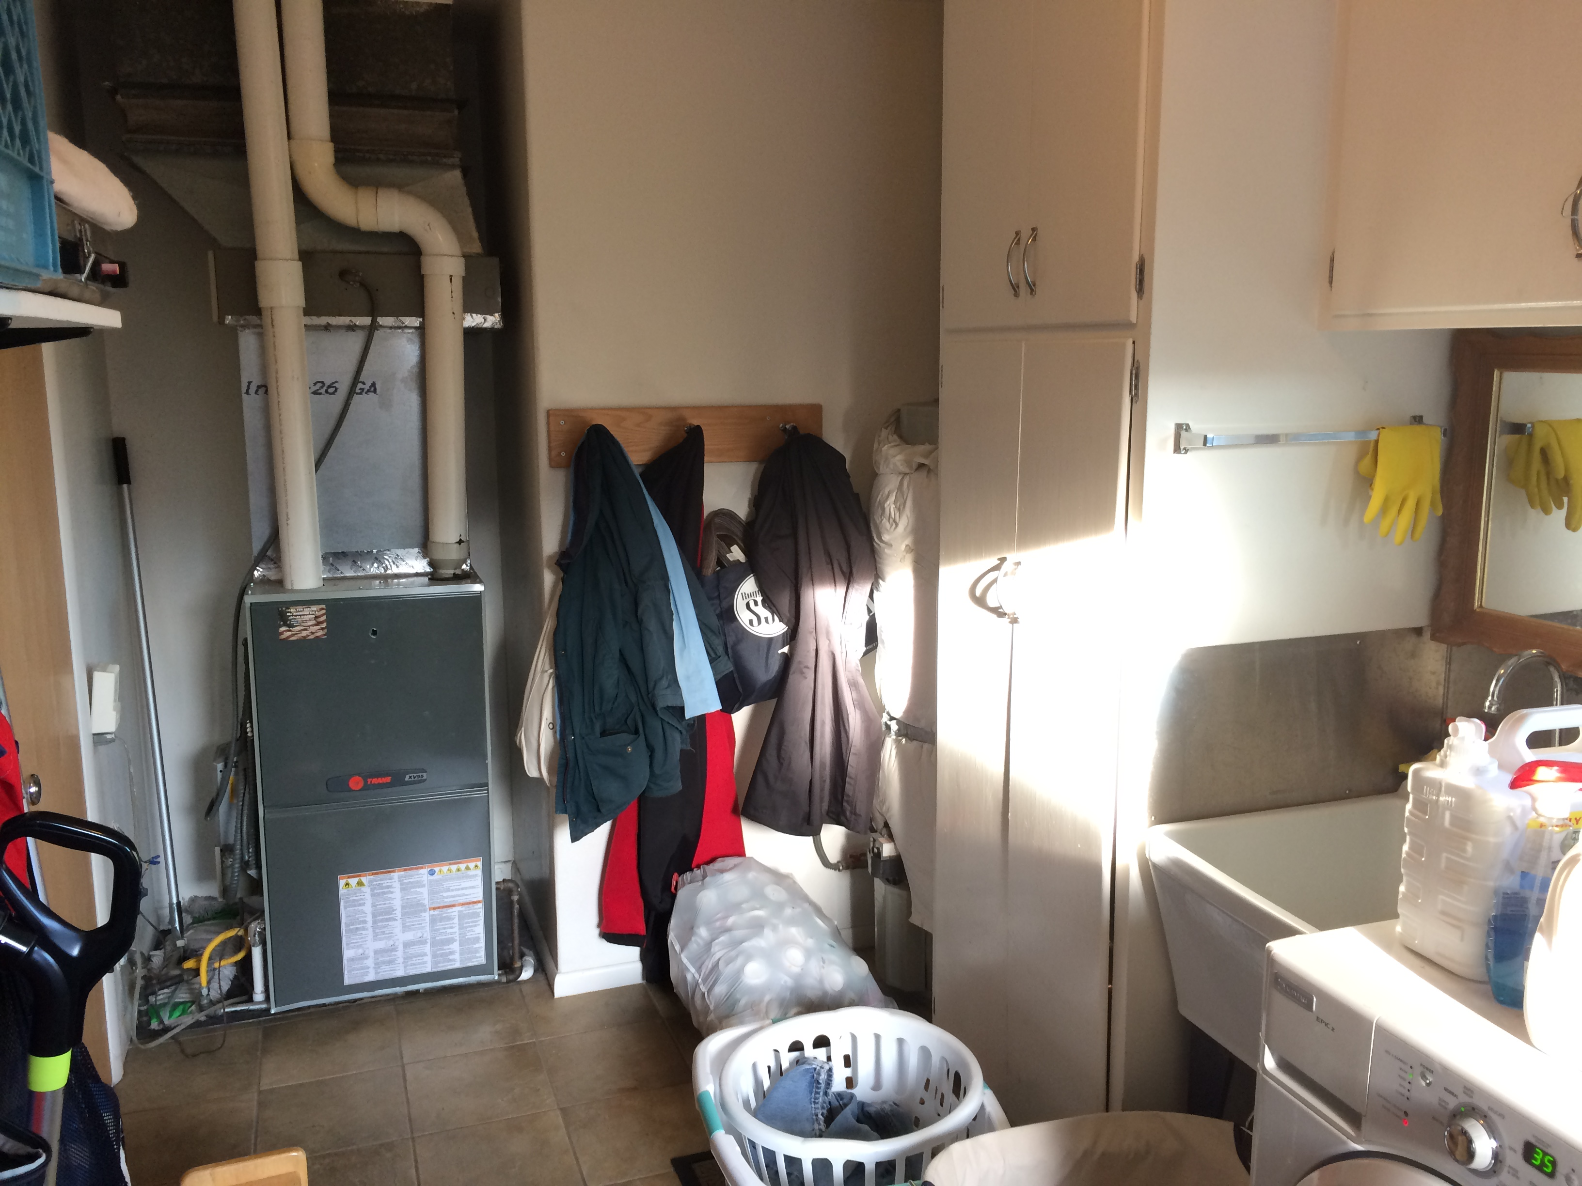
Laundry room
Has ~8 year old Trane XV95 5 ton furnace with Honeywell electric air filter system, and a hot water heater that is older than 20 years ago when we moved in.

Slide 15
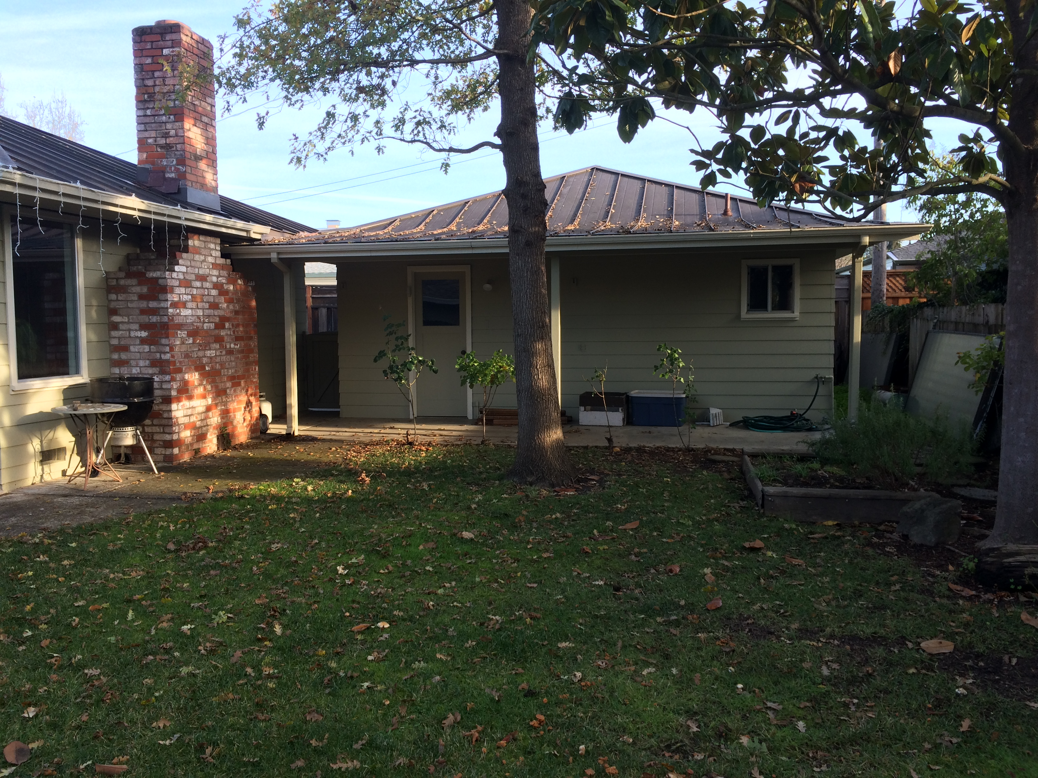
Alternate heat pump location
The back lawn is about 37’ from the ducts if more room is needed and it’s not too far to keep the hot water hot.

Slide 16
Power Requirements

Slide 17
DC Coupled
Other Loads
Grid
98%
93%
Charge Controller
95%
Inverter/charger
Critical Loads
PVs
Batteries
If batteries used for all energy and are only charged from PV and not grid, overall efficiency is 98% x 95% x 93% = 86%.
AC Coupled
97%
Other Loads
PVs
Inverter
Grid
95%
93%
Inverter/charger
Critical Loads
Batteries
If batteries used for all energy and are only charged from PV and not grid, overall efficiency is 97% x 93% x 95% x 93% = 80% or 7% worse than DC coupled.
240 VAC
600 VDC
150 VDC
48 VDC

Slide 18
Power components
Item | Existing | Proposed | Notes
Grid service and circuit breaker box | 90A (21.6 kW) | 1.) size this | Needed to support 2 electric vehicles and added air source heat pump for space and water heating. Also need to separate out oven and stove on different circuit breakers to remove the junction under the house, or replace the wire and move the junction to a box under the stove.
PV interface | SMA Sunny Boy 2.5 kW inverter with no monitoring, currently not functional (or may be broken PV panels or wires) | Sol-Ark 12 kW inverter/ charger with monitoring | 2.) Need to know how to install a transfer switch to reconnect the house directly to the grid when the Sol-Ark fails. 3.) Need to confirm that we don’t need a separate critical loads panel. 4.) Need to know how the Sol-Ark battery charging and discharging current can be gracefully cut back by the BMS in the event of an unbalanced cell or over-temperature instead of opening the contactor.
PV panels | 12 180W Sharp NT-180U1, 1.8 kW net max output, ca. 2003 | 19 Solaria PowerXT-400R-PM, 6.6 kW peak, 11.2 MWh/year | Need to move from shaded small SW roof to unshaded large SE roof. 5.) Need to verify location is good since afternoon loss should mostly be made up by morning gain. 6.) Need to research Solaria’s prospective longevity vs. LG which is top tier but from Korea not the US.
Batteries | None | 8 Simpliphi PHI-3.8-M-48 48V LiFePO4 75 Ah 3.6 kWh 37.5 amp 1.8 kW, 28.8 kWh 14.4 kW total; also experiment with Nickel Iron new or refurbished cells (only 70% round trip efficiency but 25 year warranty) and used EV LiFePO4s; will make home-made mechanical mounting and BMS | 7.) Need to verify location: area, sun heating, can it be under the eaves in case of fire? 8.) Need to verify using homemade batteries and BMS can be done legally to code, and won’t void the Sol-Ark warranty.

Slide 19
Loads
Item | Existing | Proposed | Max power, kW | Average daily energy, kWh | Notes
Space heater, hot water heater | Natural gas furnace, natural gas water heater | Central air source heat pump | 5.0 | 12.5 | 9.) Need to verify location of heat pump; area, distance from duct system, can it be under eaves due to fire? 10.) Need to confirm that over half the house registers can be closed and doors to those rooms closed and with added temperature sensors the heat pump can continue to run efficiently given the small duct diameter. 11.) Only a 5 year warranty; need to understand expected ongoing compressor repair costs, or look for an alternative with a longer warranty. 12.) Can we sell the used 8 year old furnace? It would be a shame to scrap it, but the PV and heat pump contractors should work together real time so both should be done at the same time instead of waiting for the furnace to die. 13.) Soft start so we can avoid a critical loads panel, or will it peak at 15 kW? 14.) Need to verify that heat pump alone for hot water is cost effective, and that a solar thermal preheater is not also needed which at 4’x10’ takes the space of 2 PV panels. 15.) Can heat pump installation be DIY?
EV #2 | 2022 Bolt EUV with 250 mile range | No change | 7.7 | 7.9 | Need to turn down max current from 40 amps to 32 amps.
EV #1 | 1966 Mustang EV conversion with only 30 mile range | No change | 0.8 | 3.5
Everything else |  |  | Un-known | 5.2 | Need to estimate this
Total |  |  | 13.5 + un-known | 29.1 kWh/day 10.8 MWh/yr | At 12kW max Sol-Ark output we need to not run everything at once to avoid a critical loads panel, but we are OK with doing it manually.

Slide 21
Current electrical load breakdown estimations
EV #1 Long Range:
A 125 mile range VW e-Golf was added Dec 2017-Sept 2020, then we had no long range EV for 9 months, then we got a 2022 Bolt EUV in July 2021. The Bolt currently being driven at a rate of ~20,000 miles per year to care for an ailing parent 90 miles away, and for taking longer road trips during a sabbatical. It will probably settle out closer to ~12,000 miles a year like our gas cars we used up until Nov 2017 and Oct 2020-Jun 2021. At least 9,000 miles will be charged overnight at either a.) 4 MPH rate on 120V 8A, b.) 6 MPH rate on 120V 12A, or c.) 25 MPH rate on 240V 32A.
EV #2 Short Range:
Added July 2006. Driven only ~4,000 miles per year or 11 miles per day on average. Charge at 2 MPH rate overnight on 120V 6.5A, 2.5 mi/ kWh AC. Can be charged at 7.7 kW, but rarely done due to limited range.
Everything Else:
Includes fixed electrical appliances including stove, double convection oven, furnace fan, whole house fan and lighting, as well as plug-in appliances clothes dryer, clothes washer, electronics, kitchen tools, vacuum cleaner and garage tools. Estimated by subtracting the EV estimates above from our energy usage history when we’ve had two EVs. More study can be done if needed to reduce energy consumption, but the added heat pump is swamping out the peak energy needs so more insulation and ability to close off and unheat unused rooms is the obvious action.

Slide 23
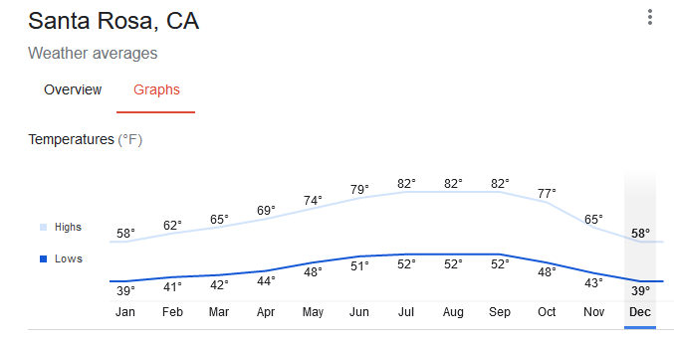
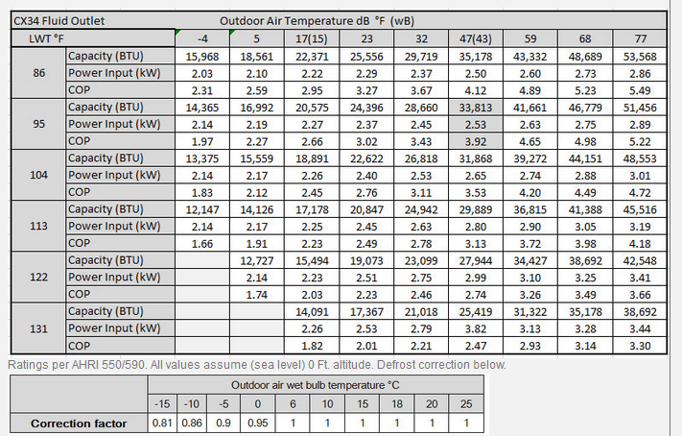
Added heat pump load estimate
We consume an average of 420 therms or 12,306 kWh/year of natural gas for space and water heat. We generally run our heater Nov-Apr where the lows are 39 to 44 F on average, vs. 48 to 52F for the rest of the year. Based on Chiltrix data it looks like COP will be around 2.6 for 122 degree domestic hot water which is assumed to be what will be used for the furnace, so we will need about 4,733 kWh per year, and our energy bills without solar would be about $346 more per year or about $1 per day, not a high price to pay to enable renewably powered heating, only ~1/4 of a Venti latte at Starbucks.
Average temps according to Google:
Heat pump COP according to manufacturer:

Slide 25
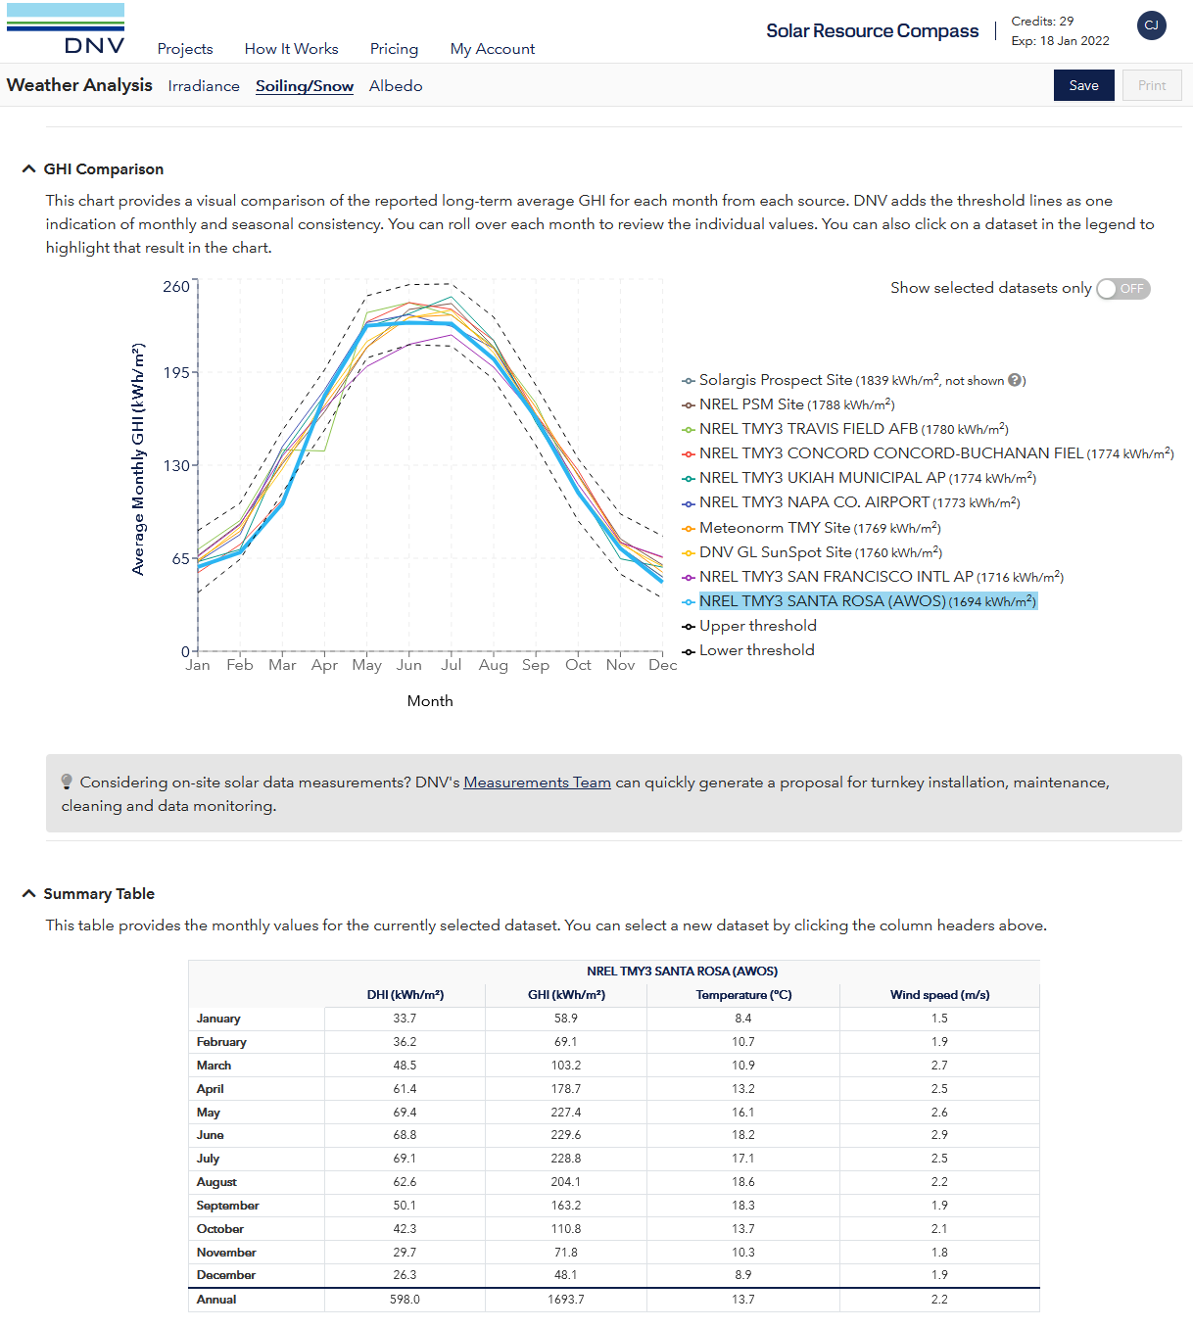
Local irradiation
According to NREL, our GHI (Global Horizontal Irradiation) = full sun hours equivalent per year = 1694, in Jan it is 65/31=2.1 hours per day and in May-July it is 225/31=7.3 hours per day. Annual average is 1694/365=4.6 hours per day. Multiply by net PV output to calculate energy produced in kWh per day.
Furnace needed Nov-Apr;
April good for solar, Nov bad

Slide 26
System sizing

Slide 27
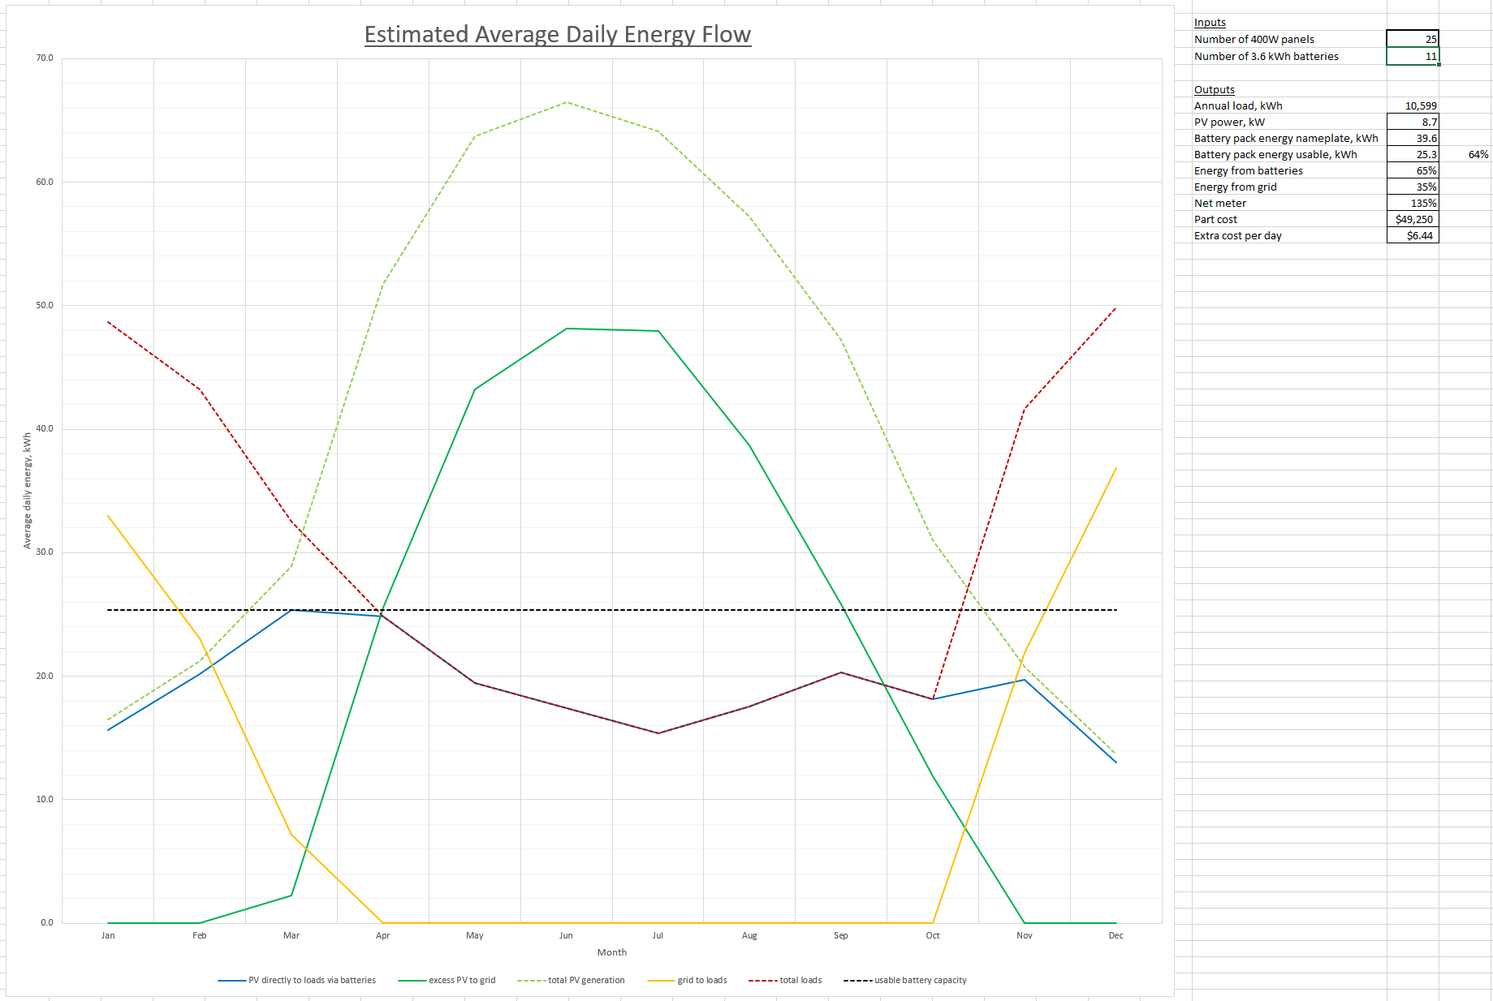
System performance estimate

Slide 28
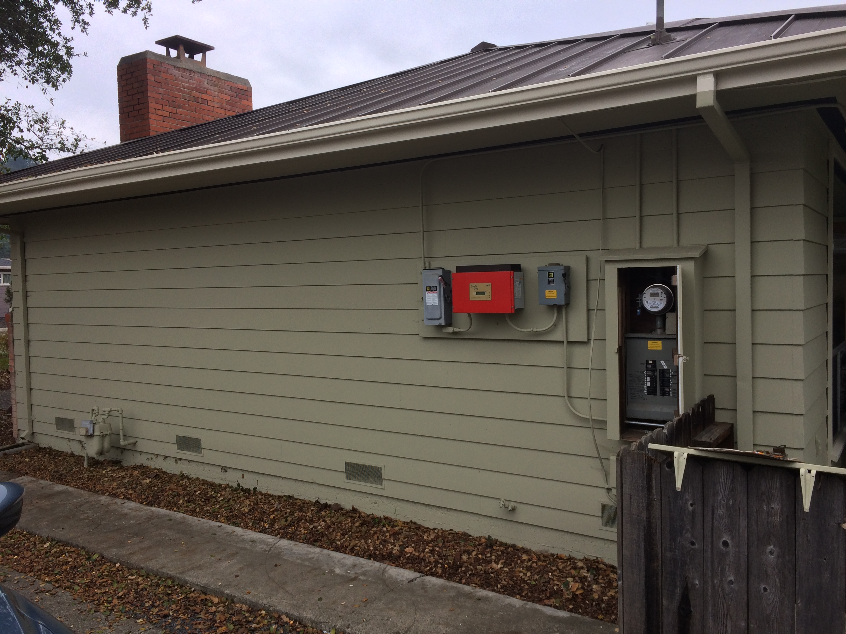
Close battery location
Best place for shortest cables, but only 2’ between house and walkway, and in full summer SW sun that could heat the batteries up more and shorten their lifespan. Perhaps a canopy over the batteries, similar to what we put over the inverter, would work if this is enough space.

Slide 29
To Do
Item no. | Description
1 | Estimate everything else power. Add pie chart of power loads.
2 | Get answers to all yellow highlighted questions.
3 | Add battery alternatives and comparison.
4 | Redo page 7, 11 too wordy, add bullets, break out in to separate pages, go to summary/backup slide format.
5 | Explain that replacement at warranty is aggressive but labor not added yet.
6 | Add NiFe scenario, noting risk of unpopular product but advantage of lifetime.
7 | Create scenario result graphs of adding every 1 battery, every 1 panel, and both to show knee of curve.

