Slide 1
Jones Family PV Battery Upgrade Project
February 20, 2023
Topic | Page
Current System | 2
New System Block diagram | 4
Inverter Upgrade | 5
Additional PV Panels | 6
PV Roof Mount System | 9
New Battery Backup System | 10
Conduit | 14
Service Panel Upgrade | 16
Parts List | 17
Appendix A - System Analysis | 18

Slide 2
Current System
1.8 kW net PV system installed in 2003
12 180W Sharp PV Panels
Keep
Inverter location

Slide 3
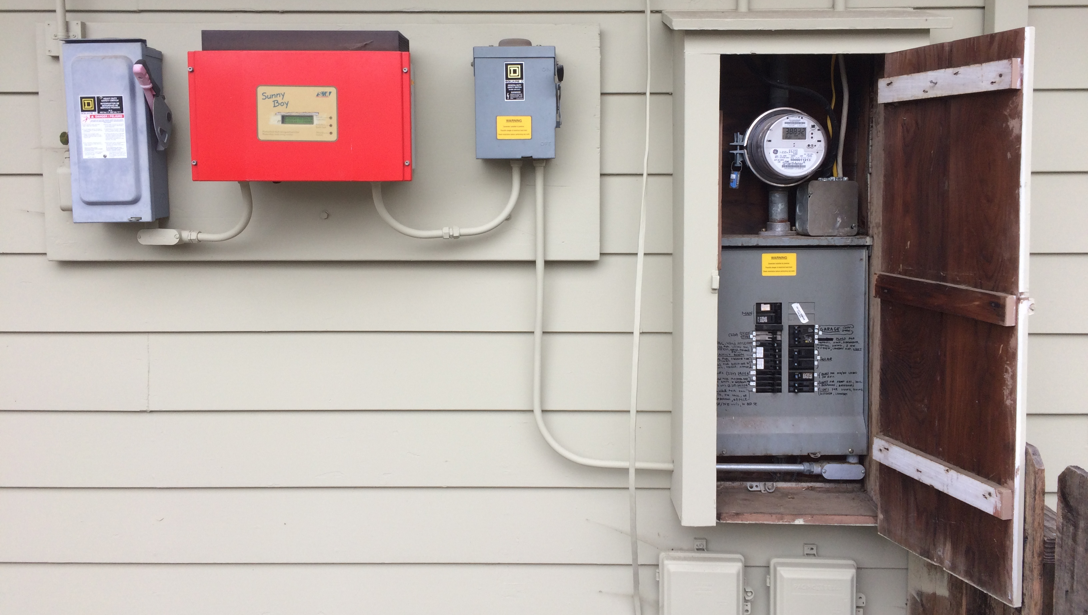
Current System
Upgrade
Upgrade
SMA Sunny Boy 2500W inverter
90 amp service panel
DC shutoff
AC shutoff

Slide 4
12 original PV panels
26 new
PV panels
New System Block Diagram
Grid
meter
240V:
Air and water heat pump (future)
Level 2 EV charger
Resistive heat clothes dryer
Double convection oven
Stove
120V:
Level 1 EV charger
Clothes washer
Dishwasher
Lighting
Kitchen appliances
Garage tools
Electronics
Everything else
Grid circuit breaker
All-in-one
DCDC Chargers
AC/DC Charger
Load circuit breaker
box
DC/AC Inverter
Control
Inverter Bypass
Switch
Legend:
500 VDC
240 VAC
Service panel
120 VAC
48 VDC
Battery cell, BMS and contactor box
CANBus

Slide 5
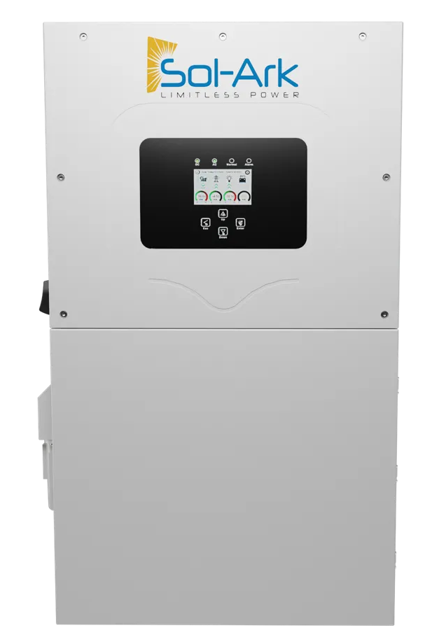
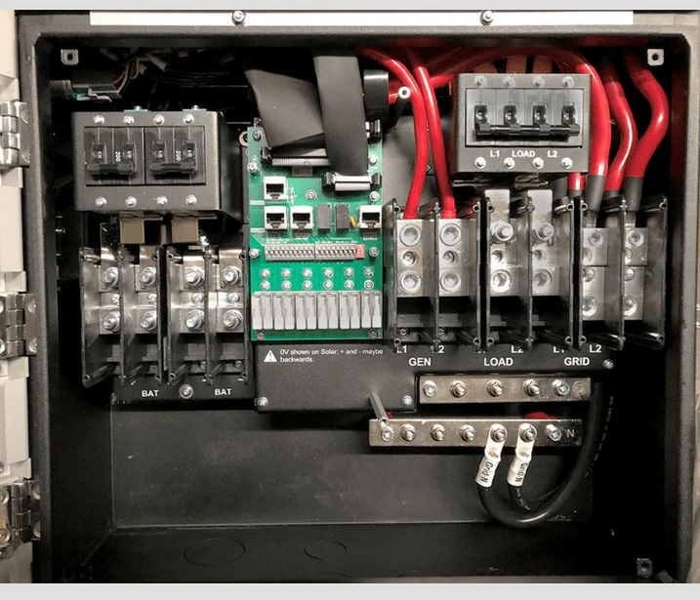
Inverter Upgrade
Sol-Ark 15K-2P-N All-in-one: https://www.sol-ark.com/sol-ark-15k-all-in-one/
31.8” high
18.3” wide
10.9” deep
135 lbs
Outdoor rated
Wall mount
WiFi connection
Designed and assembled in Texas
Lithium battery manager CANBus interface
Battery power interface:
48V nominal
275 amp max
50 to 9900 amp-hours
Grid interface
3 PV MPPT inputs:
500V open circuit max
26 amps max per MPPT
2 strings max per MPPT
Load interface:
12 kW max continuous from batteries only
15 kW max continuous using grid
$8,295 through EcoDirect in Carlsbad, CA: more local distributor? https://www.altestore.com/store/inverters/hybrid-inverters/sol-ark-hybrid-inverter-pre-wired-systems-p41381/#SOLARK15K

Slide 6
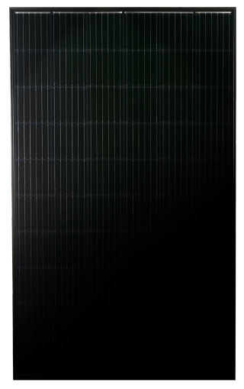
Additional PV Panels
Mission Solar MSE345SX5T 345 Watt Panels: https://www.missionsolar.com/wp-content/uploads/2022/03/C-SA2-MKTG-0025-Data-Sheet-for-SX5T.pdf
41V open circuit
11A short circuit current
69” high
42” wide
1.6” deep
45 lbs
25 year warranty to 84% capacity
Designed and assembled in Texas
$318 each from EcoDirect in Carlsbad, CA: more local distributor? https://www.ecodirect.com/Mission-Solar-345-Watt-All-Black-Mono-Solar-Panel-p/mission-solar-mse345sx5t.htm

Slide 7
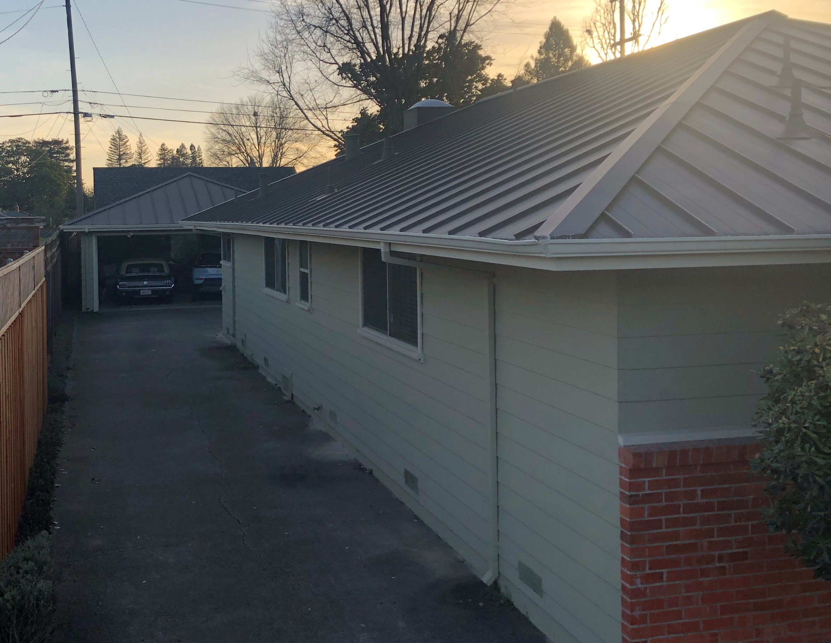
SE family room roof (not shown)
SE roof above bedrooms
Additional PV Panels
SE garage roof

Slide 8
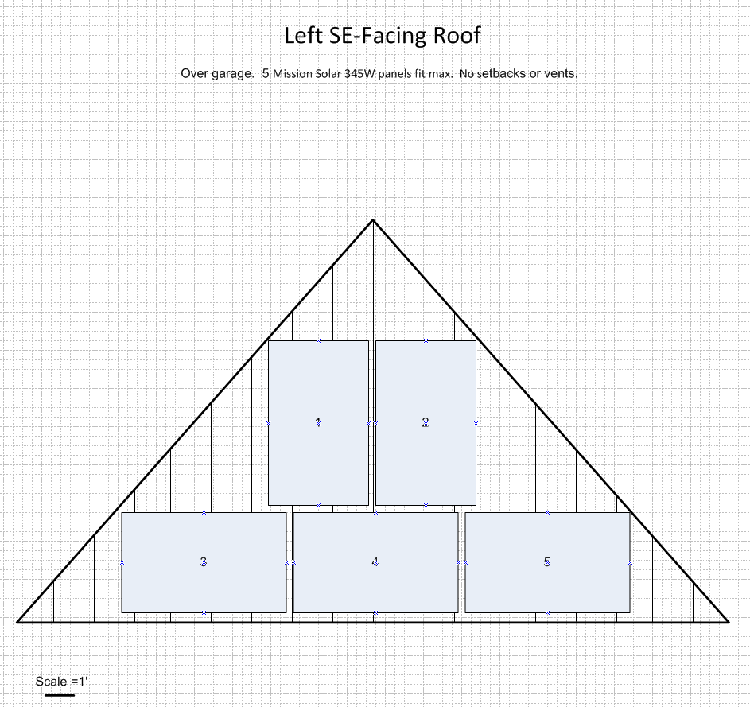
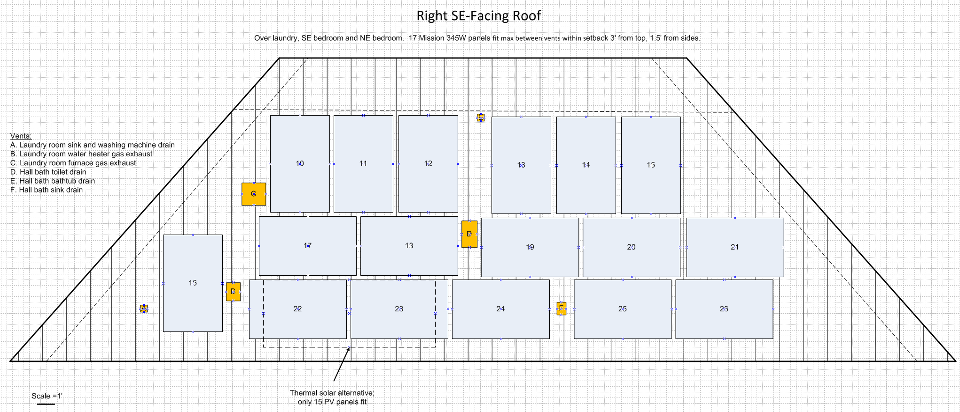
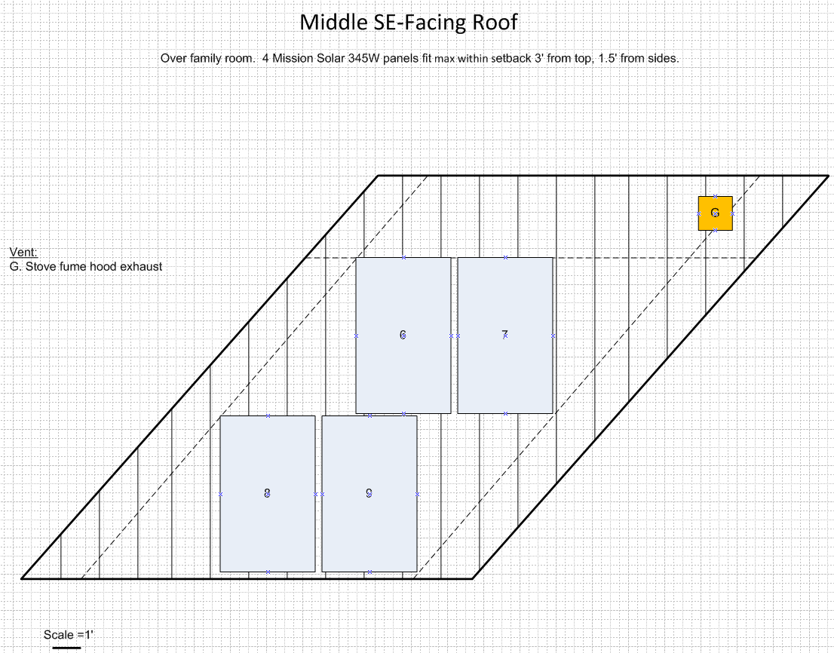
Additional PV Panels
Up to 26 fit in mixed orientations x 345W = 8970W in to DC/DC battery charger.

Slide 9
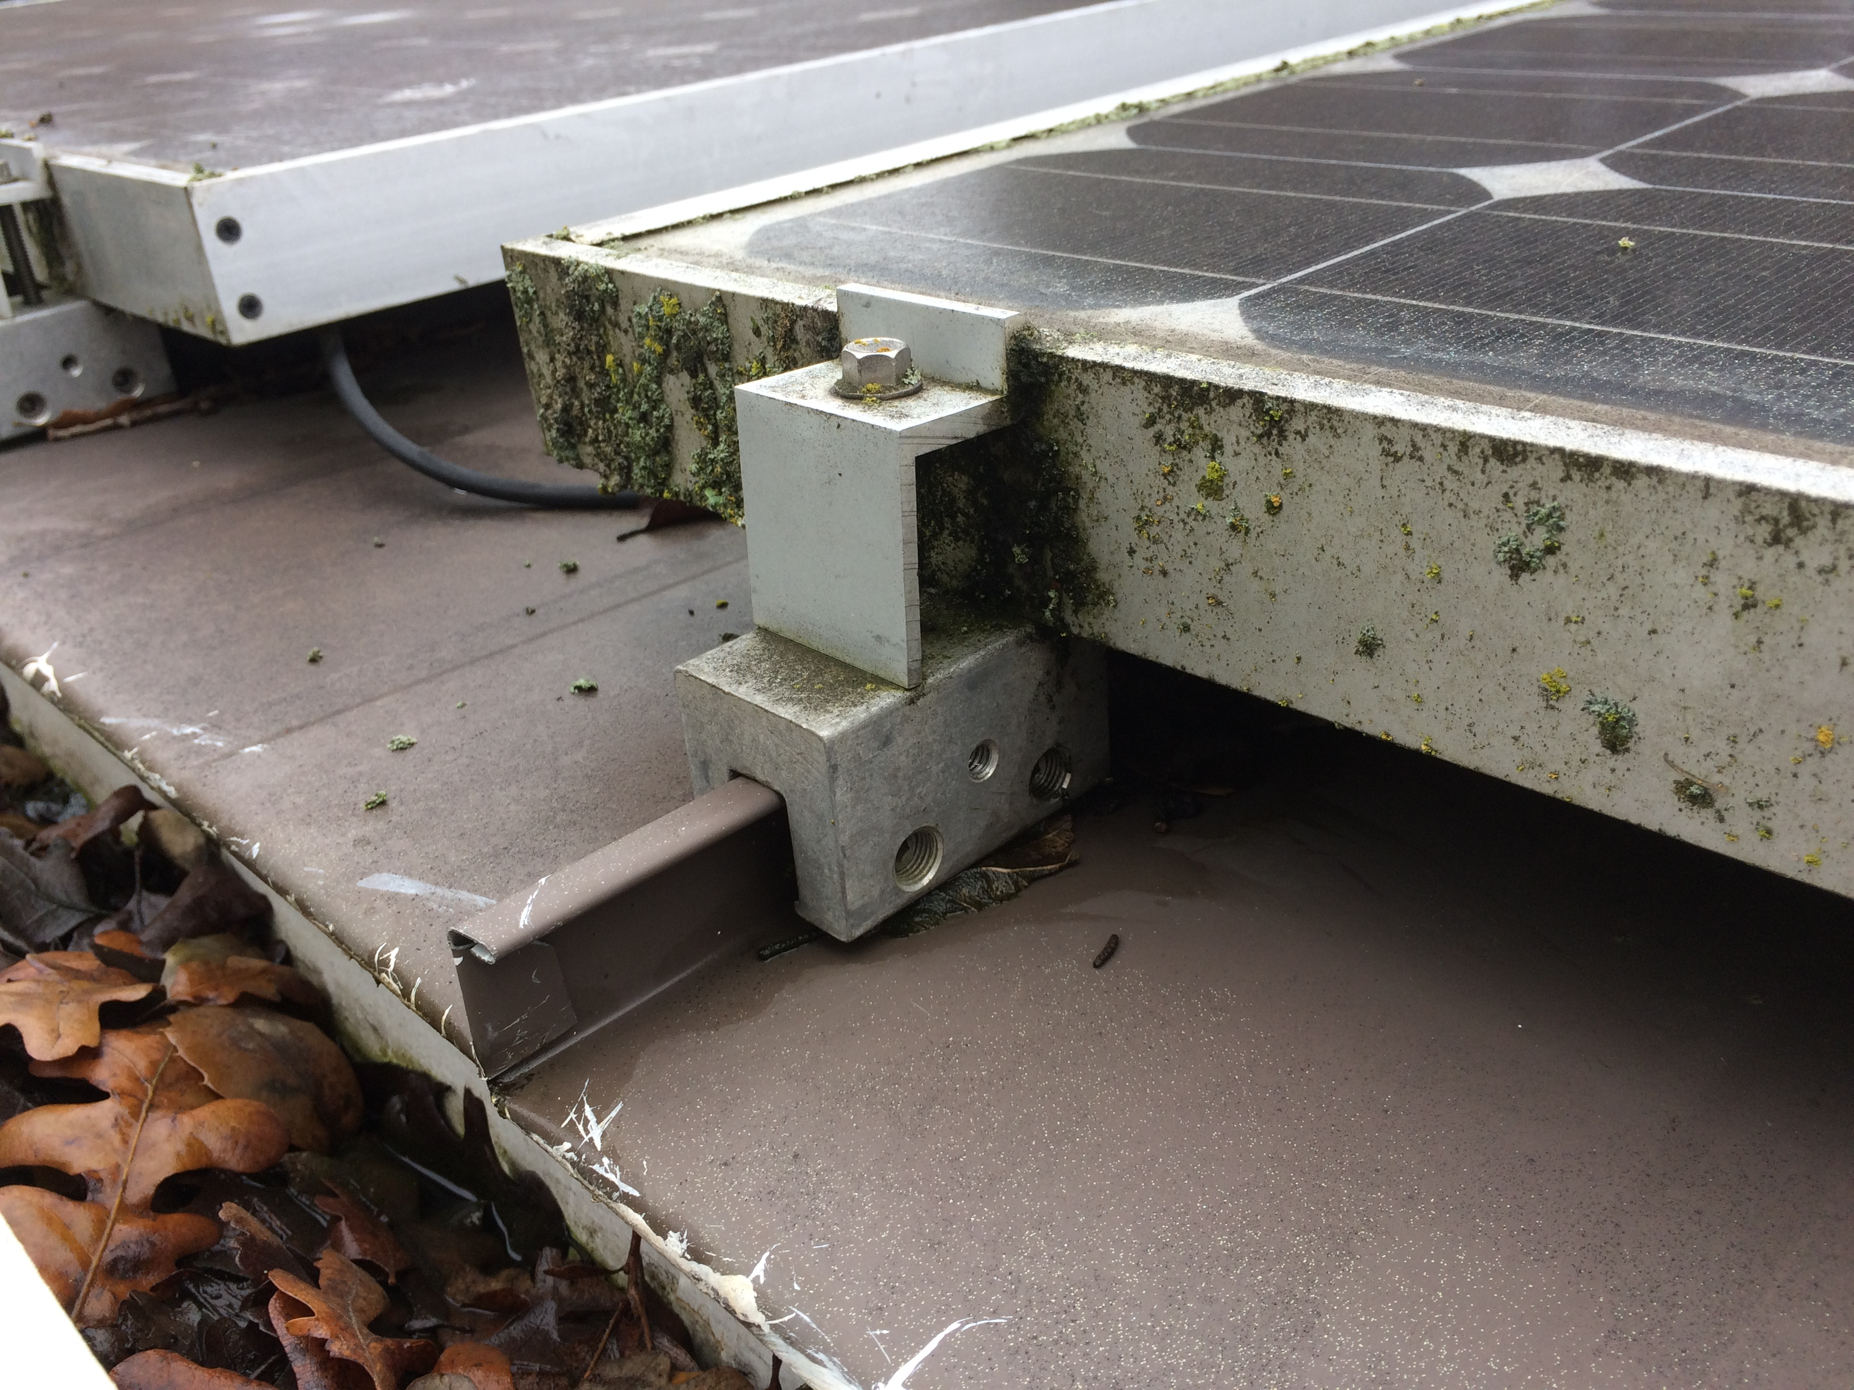
PV Roof Mount System
Standing seam metal roof installed ~2007, 1” high x ½” wide seam, 17.25” center-to-center
Current array on SW overhang with 2.5/12 pitch; SE side is 5/12
S5! S-5-S mounting system, 1” spacing on ends and between panels

Slide 10
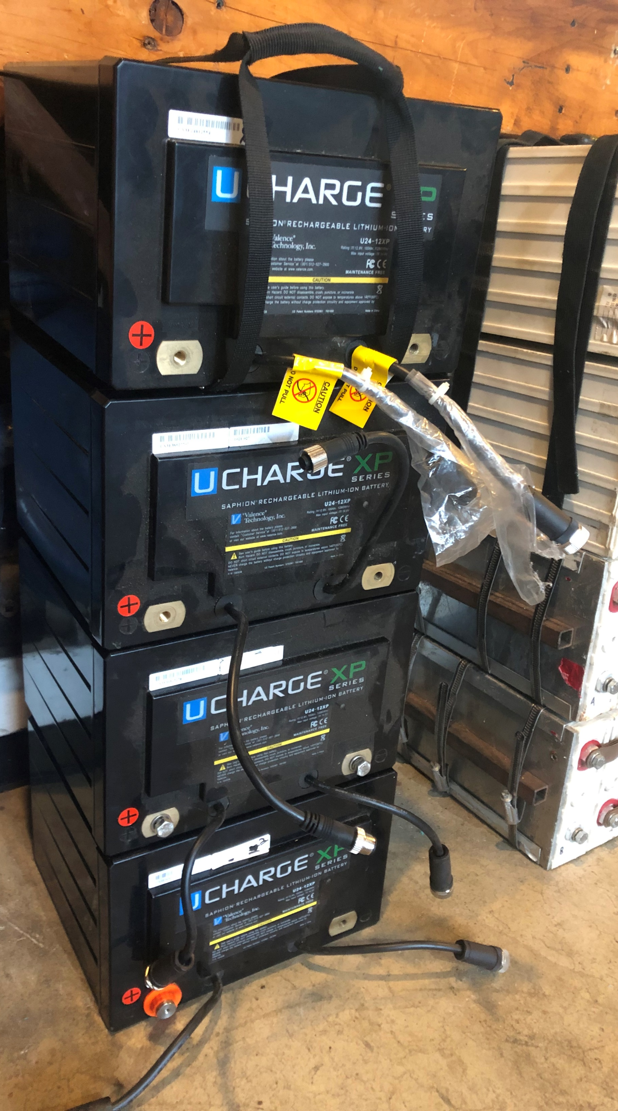
New Battery Backup System
Up to 8 used 48V 100 amp hour LiFePO4 electric vehicle battery packs in parallel
4 Valence Ucharge XP Modules
16 HiPower Cells

Slide 11
New Battery Backup System
Insert Trevor’s BMS info and connection to All-in-one here
Add battery box details:
Foundation
Underground conduit
Shell
Rack system

Slide 12
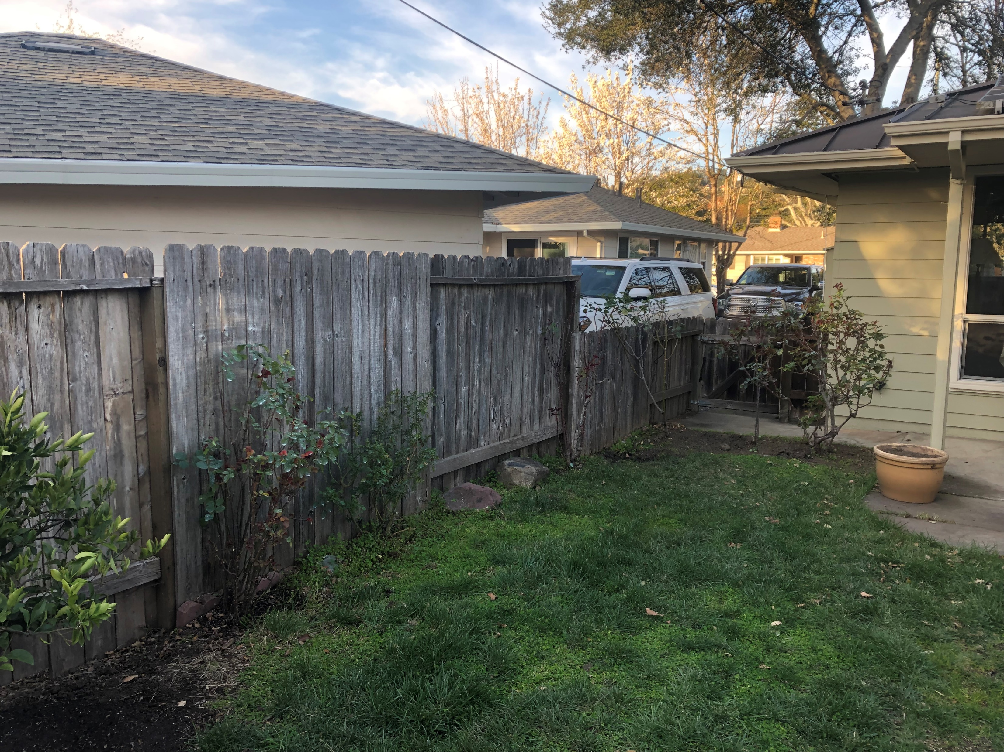
New Battery Backup System
Service panel
Battery box location (rose bushes to be transplanted)

Slide 13
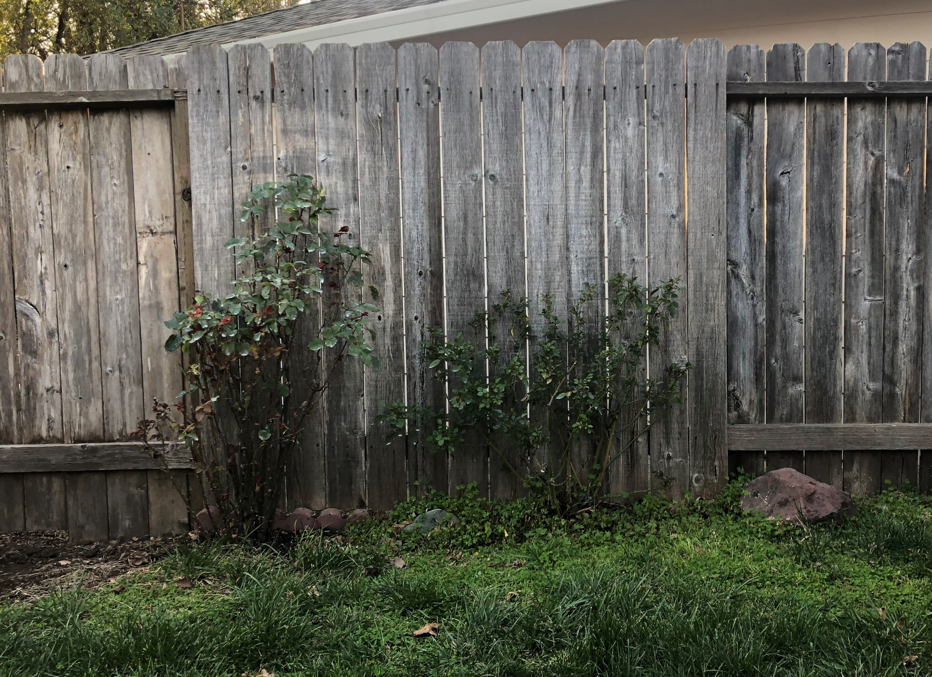
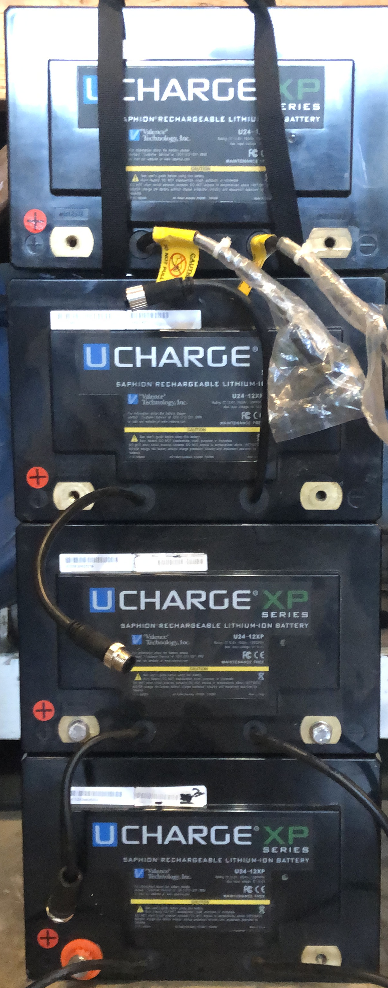
New Battery Backup System
Battery box mockup

Slide 14
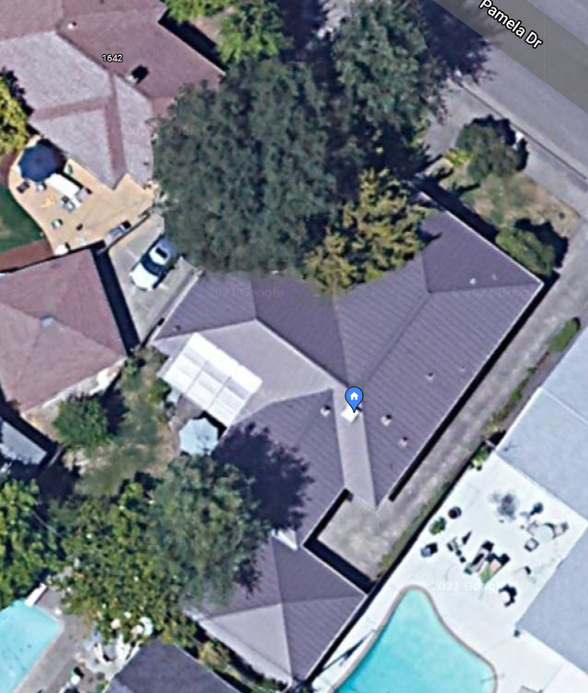
Conduit
All-in-one
Service Panel
Batteries w/BMS
Existing SW-facing PV array
Legend
New PV panels
System components
Conduit

Slide 15
Conduit
TBD
Which wires go in which conduit
Junction boxes
Layout

Slide 16
Service Panel Upgrade
TBD
Grid circuit breaker
Bypass switch
Load circuit breakers

Slide 17
Part List fill out
Item No. | Item | Make | Model | Supplier | Unit cost | Qty | Tax | Shipping | Subtotal
1 | All-in-one | Sol-Ark | 15K-2P-N | EcoDirect | $8,295 | 1 |  |  | $8,295++
2 | PV panels | Mission Solar | MSE345SX5T | EcoDirect | $318 | 26 |  |  | $8,268++
3 | Roof panel attachments | S5! | S-5-S
4 | Battery cells | Will start with 2 5 kWh packs I already own |  |  |  |  |  |  | $0
5 | Battery management boards | THJ Media | BMS-1
6 | Battery box foundation, shell and underground conduit
7 | Battery box rack | Home made
8 | Power wiring
9 | Control wiring
10 | Above ground conduit
11 | Conduit junction boxes
12 | Grid circuit breaker, inverter bypass switch and load circuit breaker box
Total |  |  |  |  |  |  |  |  | $16,563++

Slide 18
Appendix A – System Analysis

Slide 19
System Analysis

Slide 20
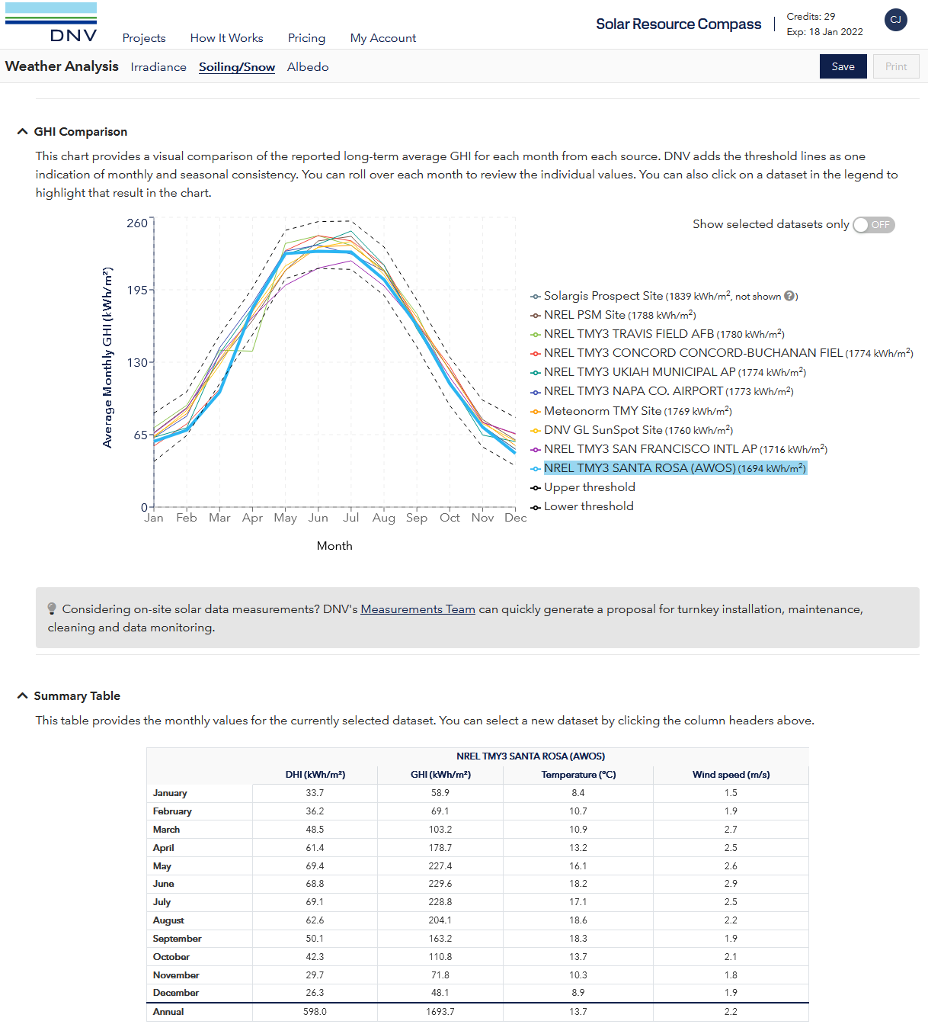
System Analysis
Local irradiation
According to NREL, our GHI (Global Horizontal Irradiation) = full sun hours equivalent per year = 1694, in Jan it is 65/31=2.1 hours per day and in May-July it is 225/31=7.3 hours per day. Annual average is 1694/365=4.6 hours per day. Multiply by net PV output to calculate energy produced in kWh per day.
Furnace needed Nov-Apr;
April good for solar, Nov bad
8 kW PVs x 4.6 average full sun hours per day should generate 37 kWh/day average. With enough battery backup to store it for overnight use we would have >2x our current average need.

Slide 21
System Analysis
But we eventually want to add a high efficiency space and water heat pump that uses most in the winter when we have the least sun, so we need to know the added load and upsize accordingly, possibly curtailing any solar we can’t sell back to the grid in the summer.

Slide 22
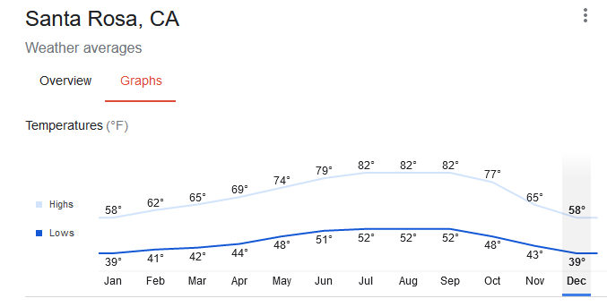
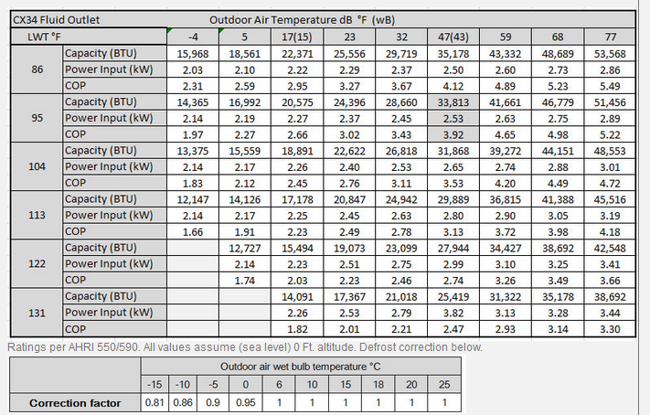
System Analysis
Added heat pump load estimate
We consume an average of 420 therms or 12,306 kWh/year of natural gas for space and water heat. We generally run our heater Nov-Apr where the lows are 39 to 44 F on average, vs. 48 to 52F for the rest of the year. Based on Chiltrix data it looks like COP will be around 2.6 for 122 degree domestic hot water which is assumed to be what will be used for the furnace, so we will need about 4,733 kWh per year, and our energy bills without solar would be about $346 more per year or about $1 per day, not a high price to pay to enable renewably powered heating, only ~1/4 of a Venti latte at Starbucks.
Average temps according to Google:
Heat pump COP according to manufacturer:

Slide 23
System Analysis
Thus future needs will rise once we add a high efficiency heat pump.

Slide 24
System Analysis
It’s hard to go completely off grid. We will target an eventual size of 8 kW generation with 40 kWh production to get about 69% off grid at about ¼ the cost of getting 99% off the grid.

Slide 25
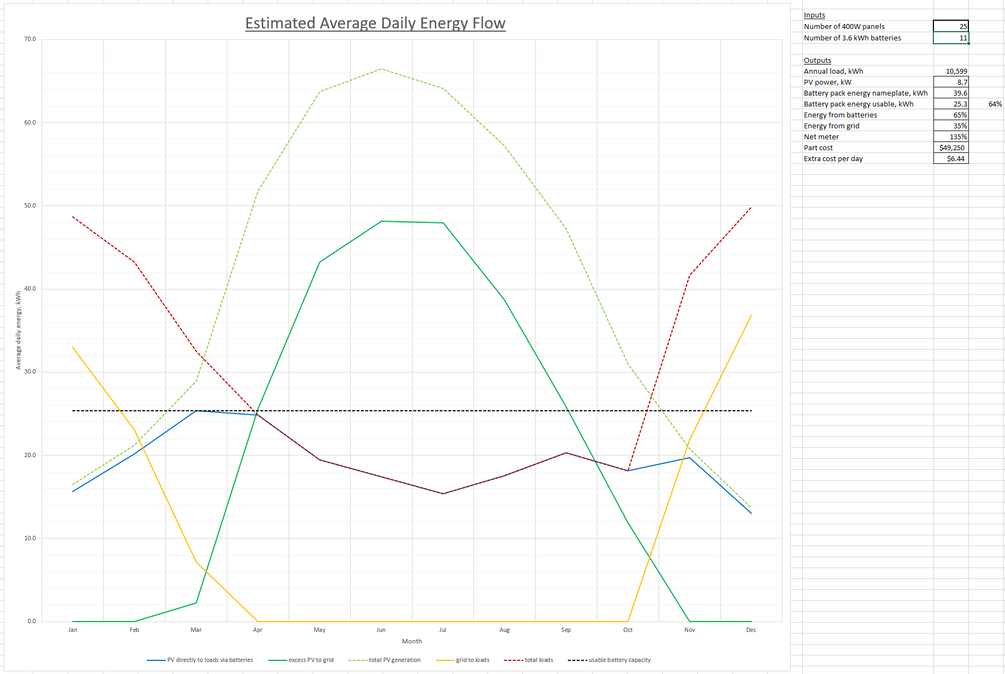
System Analysis
Estimated future system performance.

